Slide 1
Governance as a competitive advantage
in the sustainability era
Carolynn Chalmers
15 September 2026

Slide 2
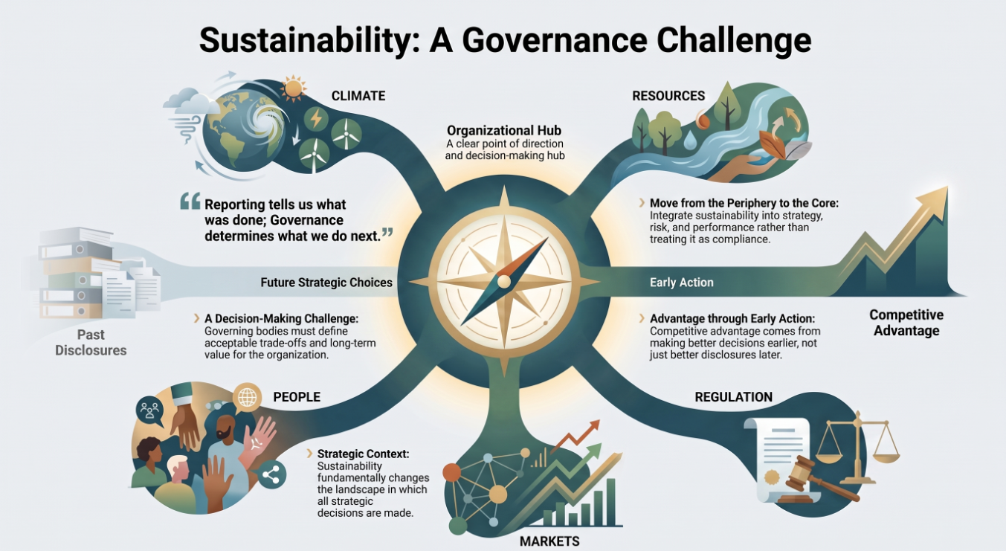
Sustainability reporting makes visible the organisation’s performance, position and prospects.
Governance determines
how it responds.
2
Notes:
Sustainability changes the context in which strategic decisions are made.
The governing body must decide what matters, what trade-offs are acceptable and what long-term value means for the organisation.
Governance determines whether sustainability is treated as compliance at the periphery or incorporated into strategy, risk, opportunity and performance.
Competitive advantage begins with making better decisions earlier, not merely producing better disclosures later.
Sustainability is a governance and decision-making challenge, not merely a reporting requirement.

Slide 3
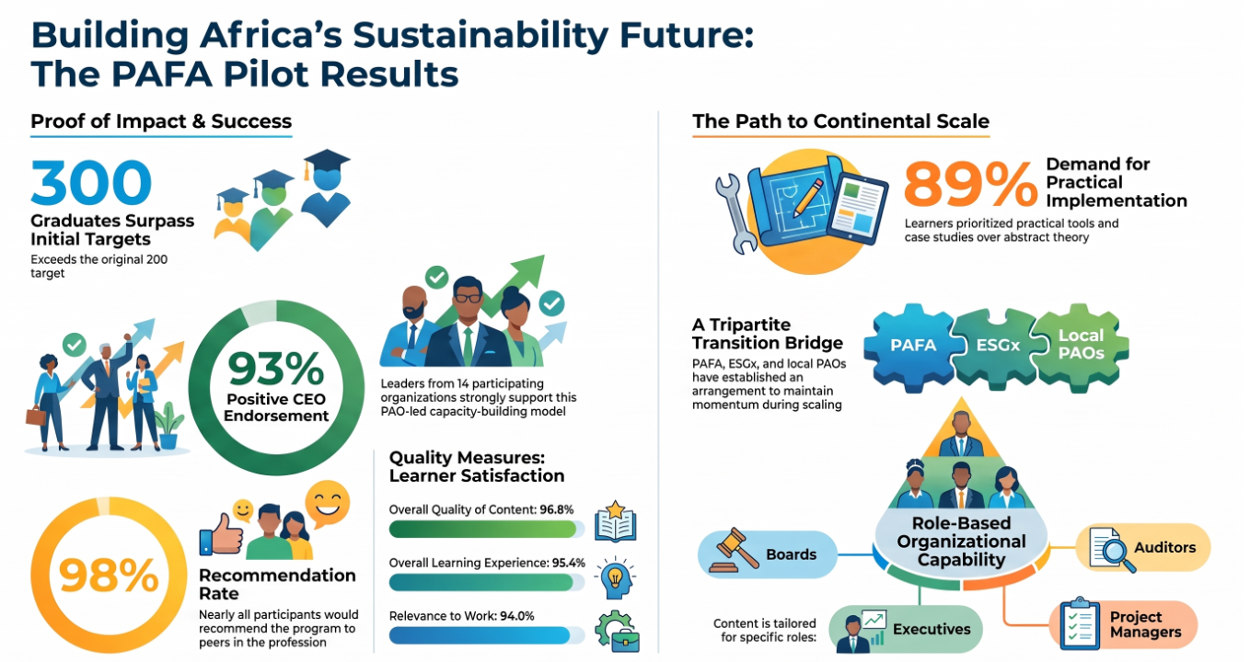
Capability is created
when people know
what sustainability requires, and what they are responsible for deciding and doing.
3
Notes:
Sustainability cannot be delegated to one specialist or reporting team.
Boards, executives, accountants, internal auditors and project managers each have different responsibilities, but they must operate within one coherent system.
Through the PAFA pilot, The ESG Exchange translated international frameworks into practical, role-based organisational capability.
The programme connected governance, planning, implementation, evaluation, reporting, correction and accountability.
Its reach across more than 18 professional accountancy organisations (and across English, French and Portuguese contexts) demonstrates that a common architecture can be applied across different roles and jurisdictions.
The achievement is not simply that people completed training. It is that sustainability requirements were converted into a repeatable way of working.
Governance creates advantage when it builds organisation-wide capability to act coherently.

Slide 4
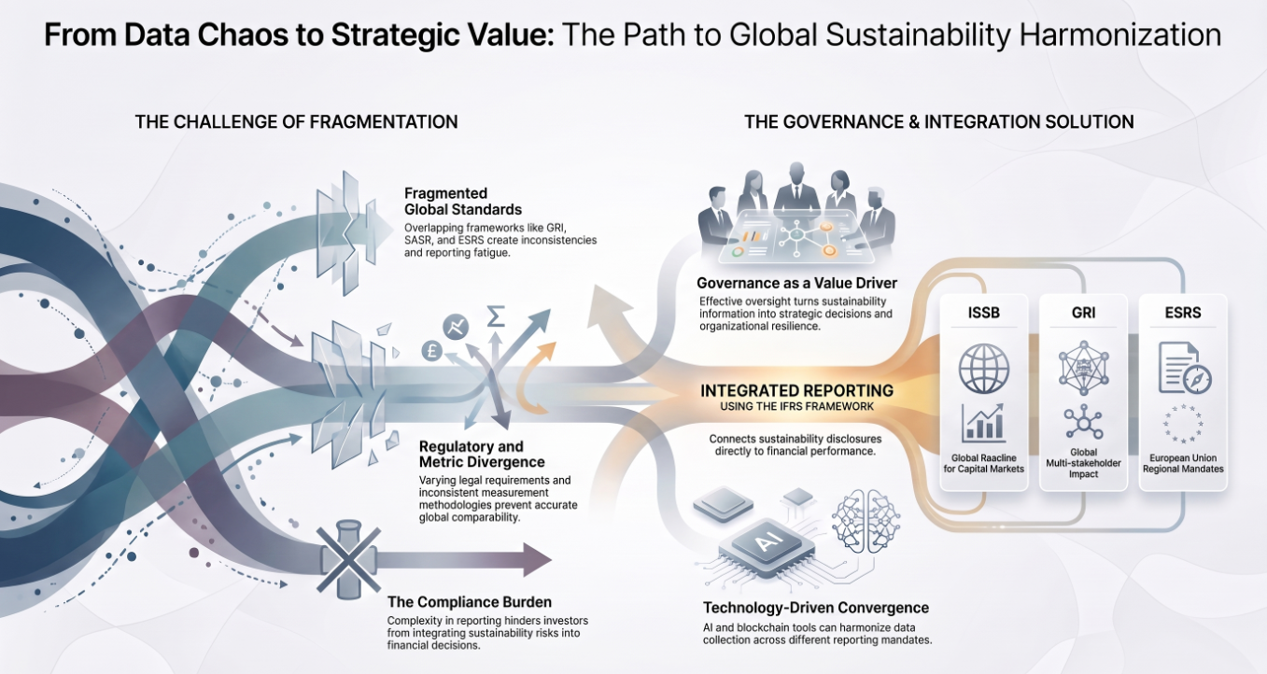
In the sustainability era, competitive advantage will not belong simply to the organisations with the most information or the boldest commitments.
It will belong to those with the governance capability to turn information into sound decisions, and decisions into lasting value.
4
Notes:
Decision-useful information is valuable only when it reaches the right decision-makers at the right time.
Clear decision rights and accountability enable organisations to respond more quickly.
Effective oversight enables correction and learning rather than retrospective blame.
Trust is earned when commitments, decisions, actions and reporting remain connected.
These conditions strengthen resilience, innovation and long-term value creation.
This is also the territory I am exploring through my doctoral research: the governance conditions that enable organisations to turn sustainability information and intention into sound strategic decisions and lasting value.
The ESG Exchange exists to help organisations build that capability—by translating sustainability expectations into practical roles, decisions, actions and evidence.
The organisations that govern sustainability well will make better decisions, adapt sooner and earn greater trust.

Slide 5
Let’s connect on LinkedIn
Carolynn Chalmers

