Slide 1

Nature AND society:
Reflections, reactions and renewed ambition
Emeritus Prof Coleen Vogel
Global Change Institute
University of the Witwatersrand

Slide 2
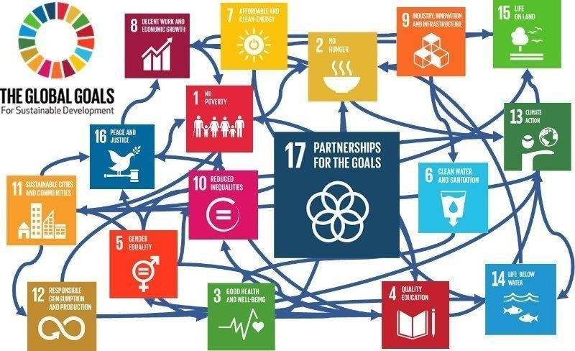
The world is interconnected, the challenges urgent, and the polycrisis complicated and complex!
Notes:
So why a theme on TD and engaged scholarship. We all know we cant achieve the SDGs without transforming how we do our research. ….

Slide 3

  Reflections on Planetary ‘health and well being’ ?
  Reactions to well being – Is resilience enough?
  The need for Renewed Ambition!

Slide 4
  Reflections on Planetary ‘health and well being’

Slide 5
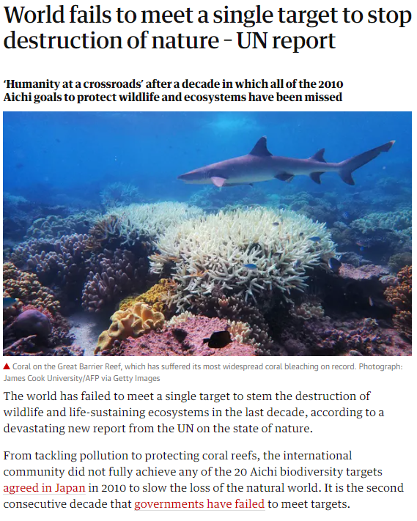
https://www.theguardian.com/environment/2020/sep/15/every-global-target-to-stem-destruction-of-nature-by-2020-missed-un-report-aoe and Karen O Brien

Slide 6
Limiting
Overshoot
Navigating exceedance of 1.5ºC
and pathways towards return
www.unep.org

Slide 7

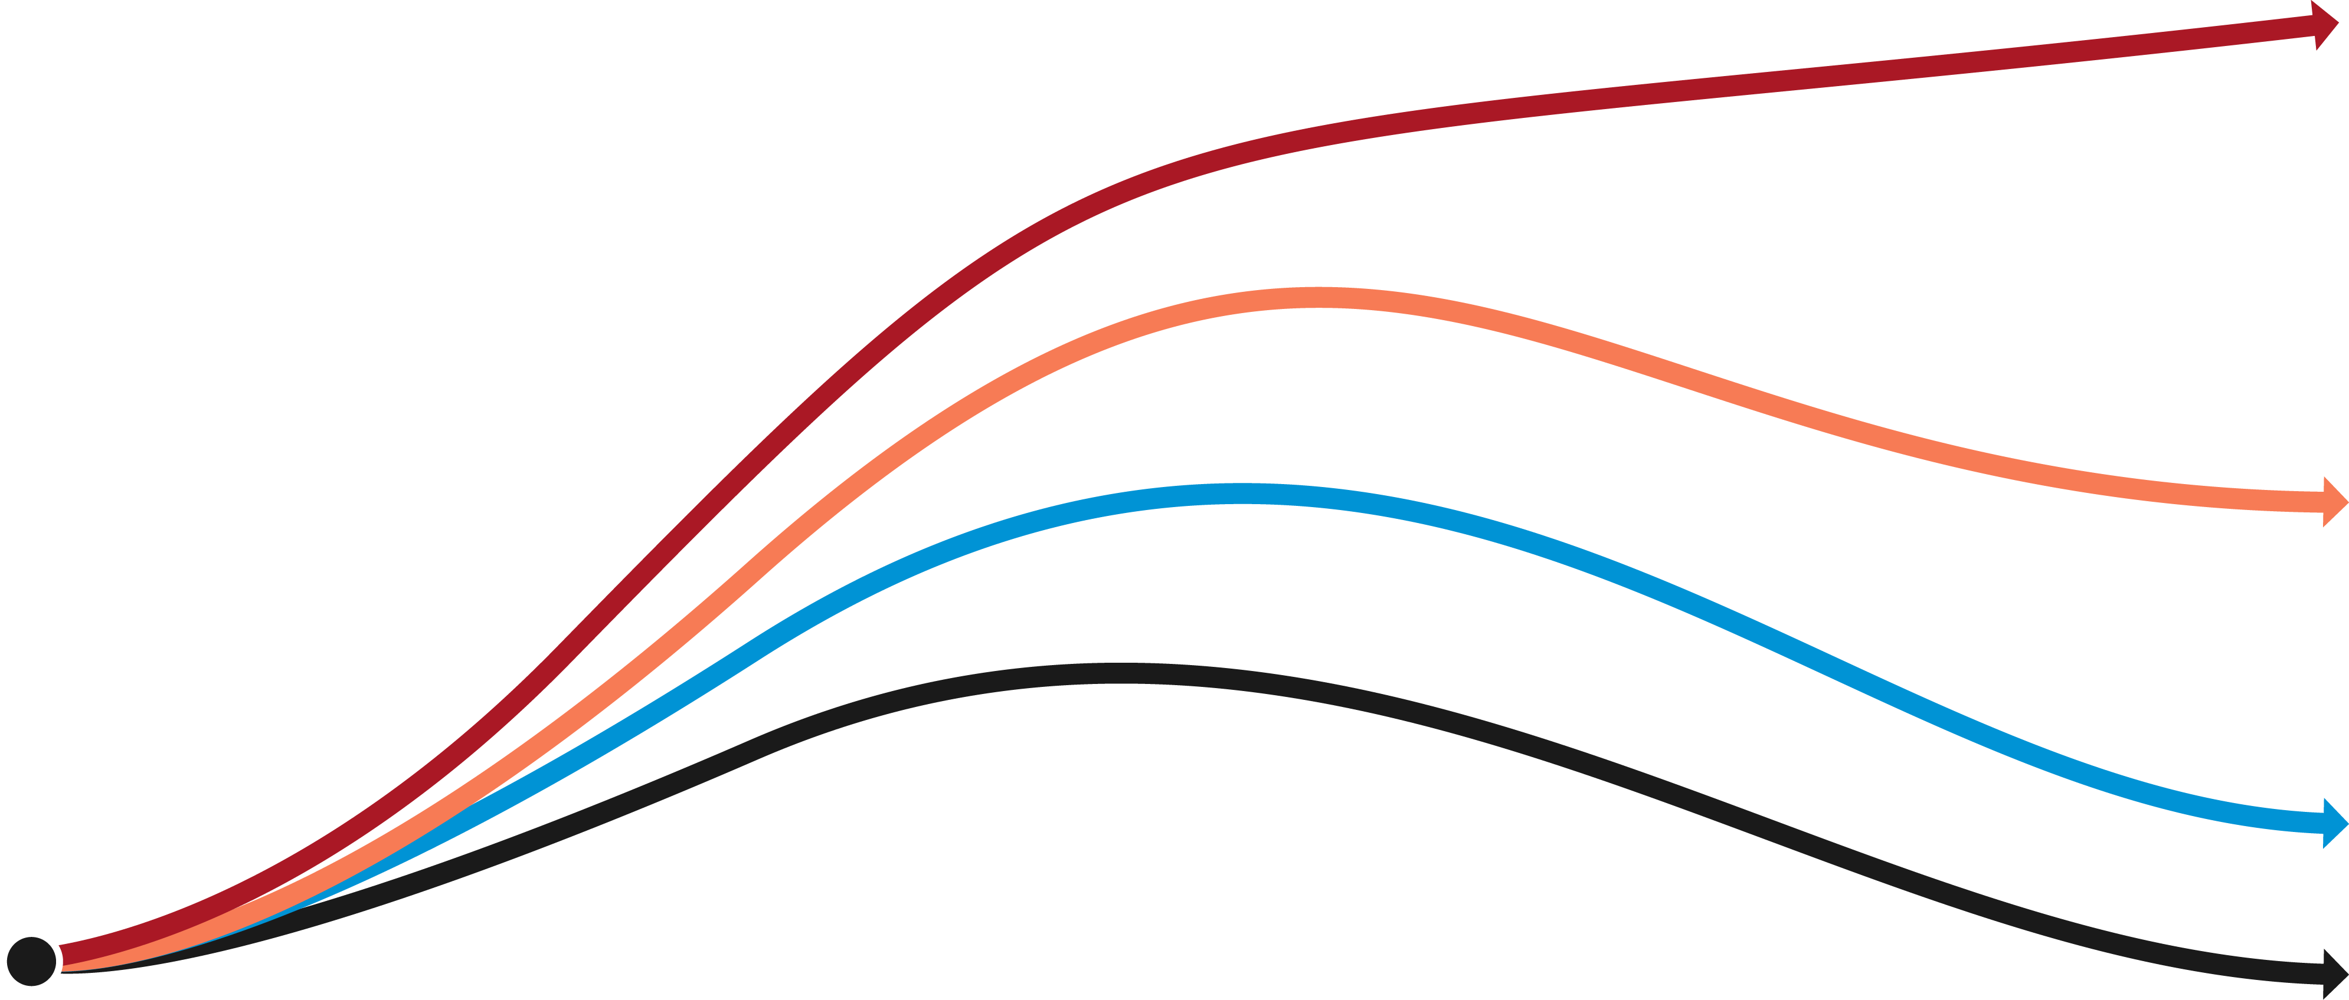
  Insufficient action has made exceeding 1.5°C unavoidable
  Decades of scientific warning and climate commitments have not produced sufficiently rapid emissions reductions.
  As a result, global warming is now approaching and moving beyond 1.5°C.
Current policies
Insufficient action
is driving 1.5°C exceedance – we can still act to limit the magnitude.
  GLOBAL WARMING
1.5°C
  TODAY
Decades
  TIME

Slide 8
Not only about exceedance - an overshoot pathway unfolds through four stages
  EXCEEDANCE: Warming is above 1.5°C and still rising toward its peak.
  PLATEAUING: Warming reaches its maximum level above 1.5°C and remains near that level.
  DECLINE: Warming falls from its peak.
  STABILIZATION: Warming reaches and stabilizes at or below 1.5°C.
Overshoot is a pathway, not a threshold.
Each stage brings different and cumulative implications for mitigation, adaptation and resilience.
EXCEEDANCE
PLATEAUING
DECLINE
STABILIZATION
Limit further warming
Halt warming
Sustain net-negative CO₂
Manage residual risks
PEAK
WARMING
GLOBAL WARMING
1.5°C
CROSSING
1.5°C
Decades
TIME

Slide 9

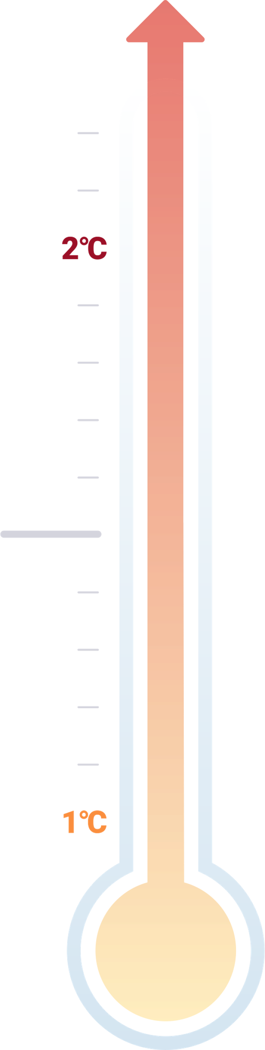
Decades of insufficient action result in three challenges that require urgent action
IF WE DELAY ACTION
We lose the chance to decline to 1.5°C and face an unprecedented damaged world.
IF WE ACT NOW
We can limit overshoot
(exceed, peak and decline to 1.5°C)
ACTIONS
Mitigation and adaptation to
address the three challenges
1.5°C
ACTION
NOW
TIME
OVERSHOOT
Exceed and decline to 1.5℃
Our actions determine
if overshoot
lasts decades
or millennia
THREE COMPOUNDING CHALLENGES
Challenges must be addressed in parallel to limit overshoot
1
1
2
3
2
3
IMMEDIATE RESPONSE
Addressing impacts and reducing emissions
COPING AND PREPAREDNESS
Managing risks and
limiting peak warming
LONG-TERM RESILIENCE
Scaling adaptation and
sustaining decline

Slide 10
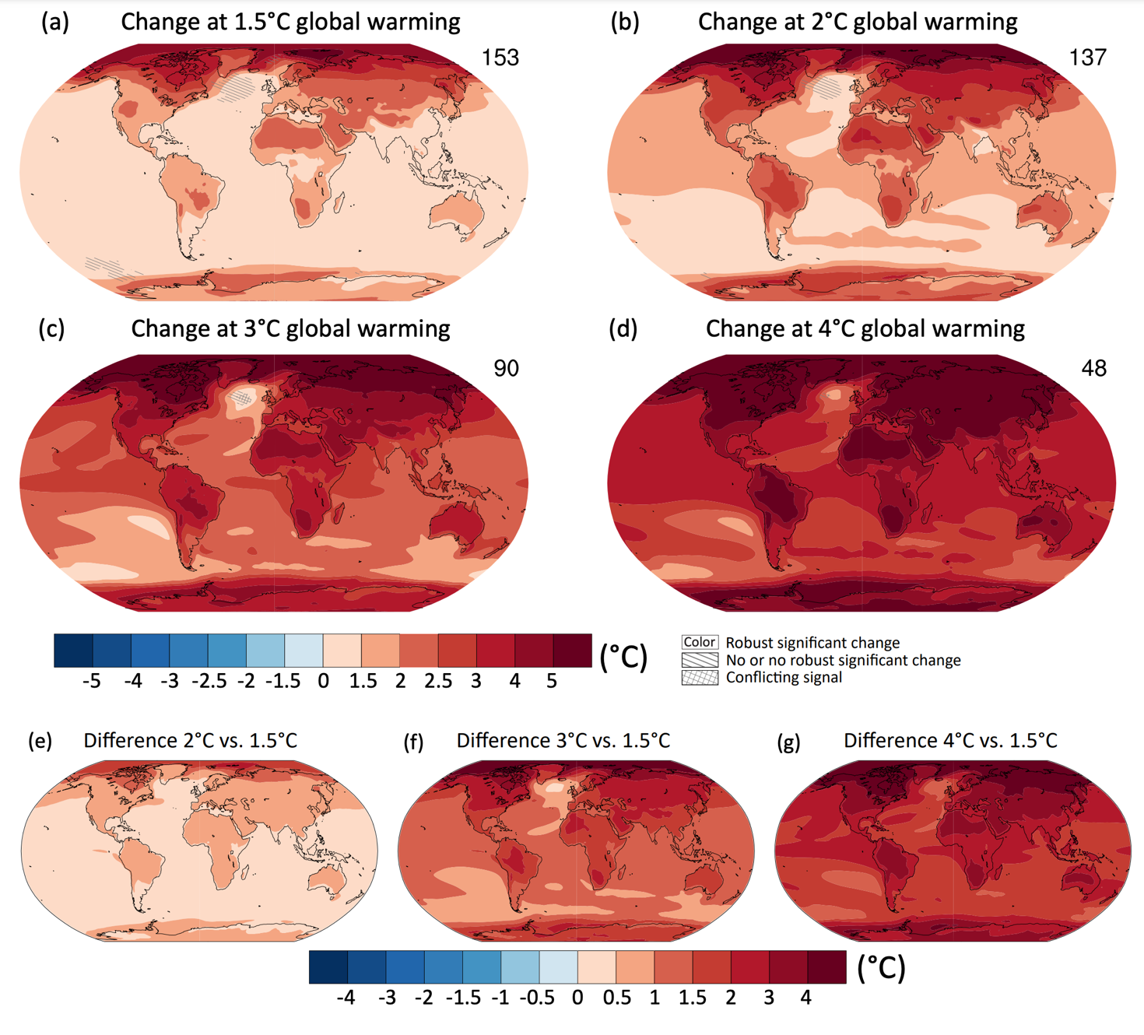
Projected spatial patterns of change in annual average near-surface temperature (°C) at different levels of global warming (Figure 4.31, Chapter 4, IPCC AR6).

Slide 11
Future climate change in southern Africa:
key messages
Southern Africa is warming drastically – over the interior regions the rate of warming is in the order of twice the global rate of warming.
The region is likely to become generally drier, but rainfall futures over the eastern escarpment areas are uncertain.
We can expect more frequent, long-lasting droughts co-occurring with heatwaves of unprecedented intensity.
Over eastern southern Africa, the number of extreme rainfall events are projected to increase in their frequency of occurrence.
Source: F. Engelbrecht, GCI, Wits

Slide 12
El Niño summers in southern Africa have been getting warmer
2027 is likely to be the warmest year ever recorded, with the level of global warming reaching 1.7 ° C.
Southern Africa is likely to experience below-normal rainfall and the drought may be severe.
If the El Niño of 2026/27 is to bring below-normal rainfall to southern Africa, the summer is likely to be the warmest on record with unprecedented heat waves.
Climate change fuelled heat-stress is a major risk this summer: in terms of human health, crops and water losses via enhanced evaporation.
Source: F. Engelbrecht, GCI, Wits

Slide 13
  Reactions to well being approaches – is resilience enough?

Slide 14
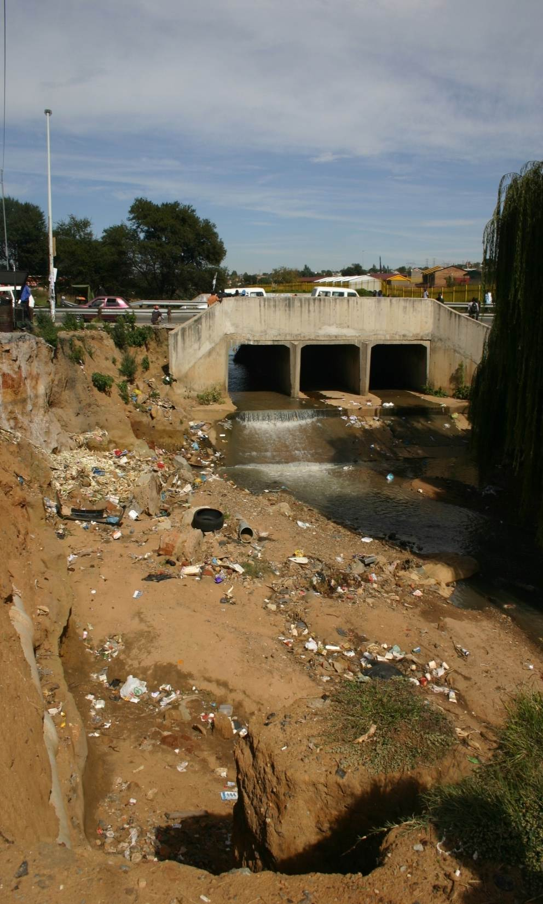
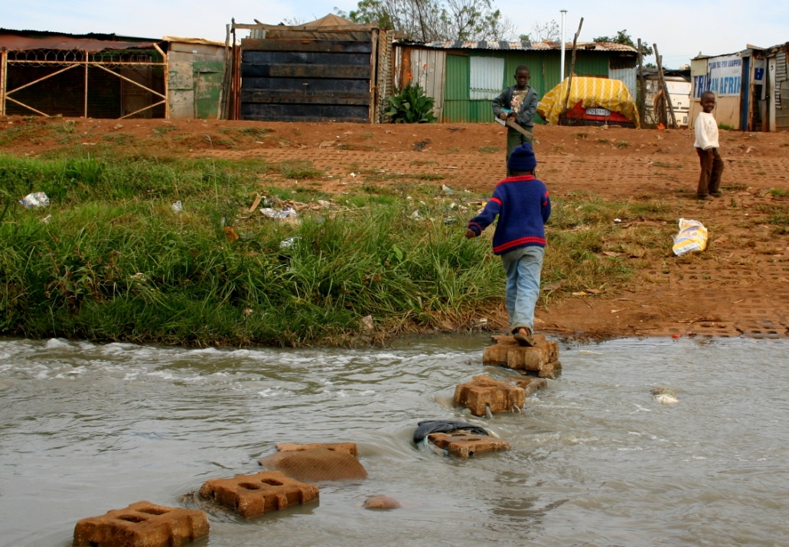
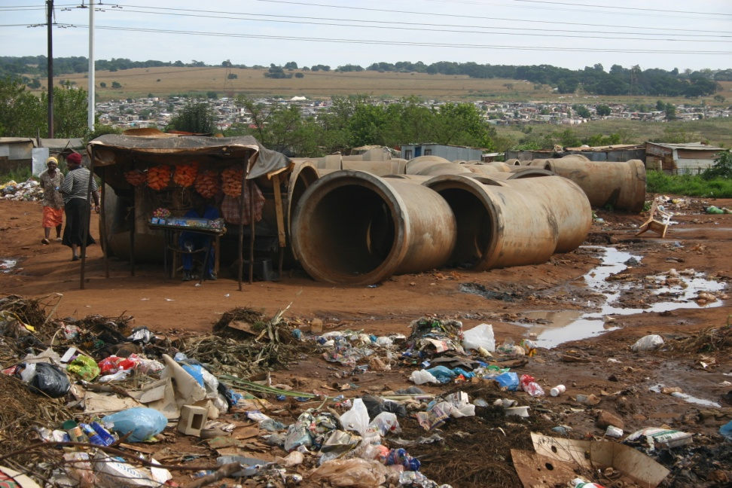
What drives vulnerability, risks and anxiety? – context matters !

Slide 15
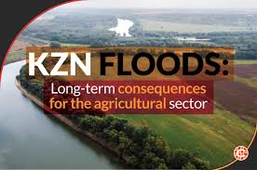
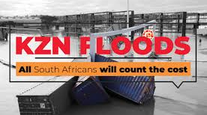
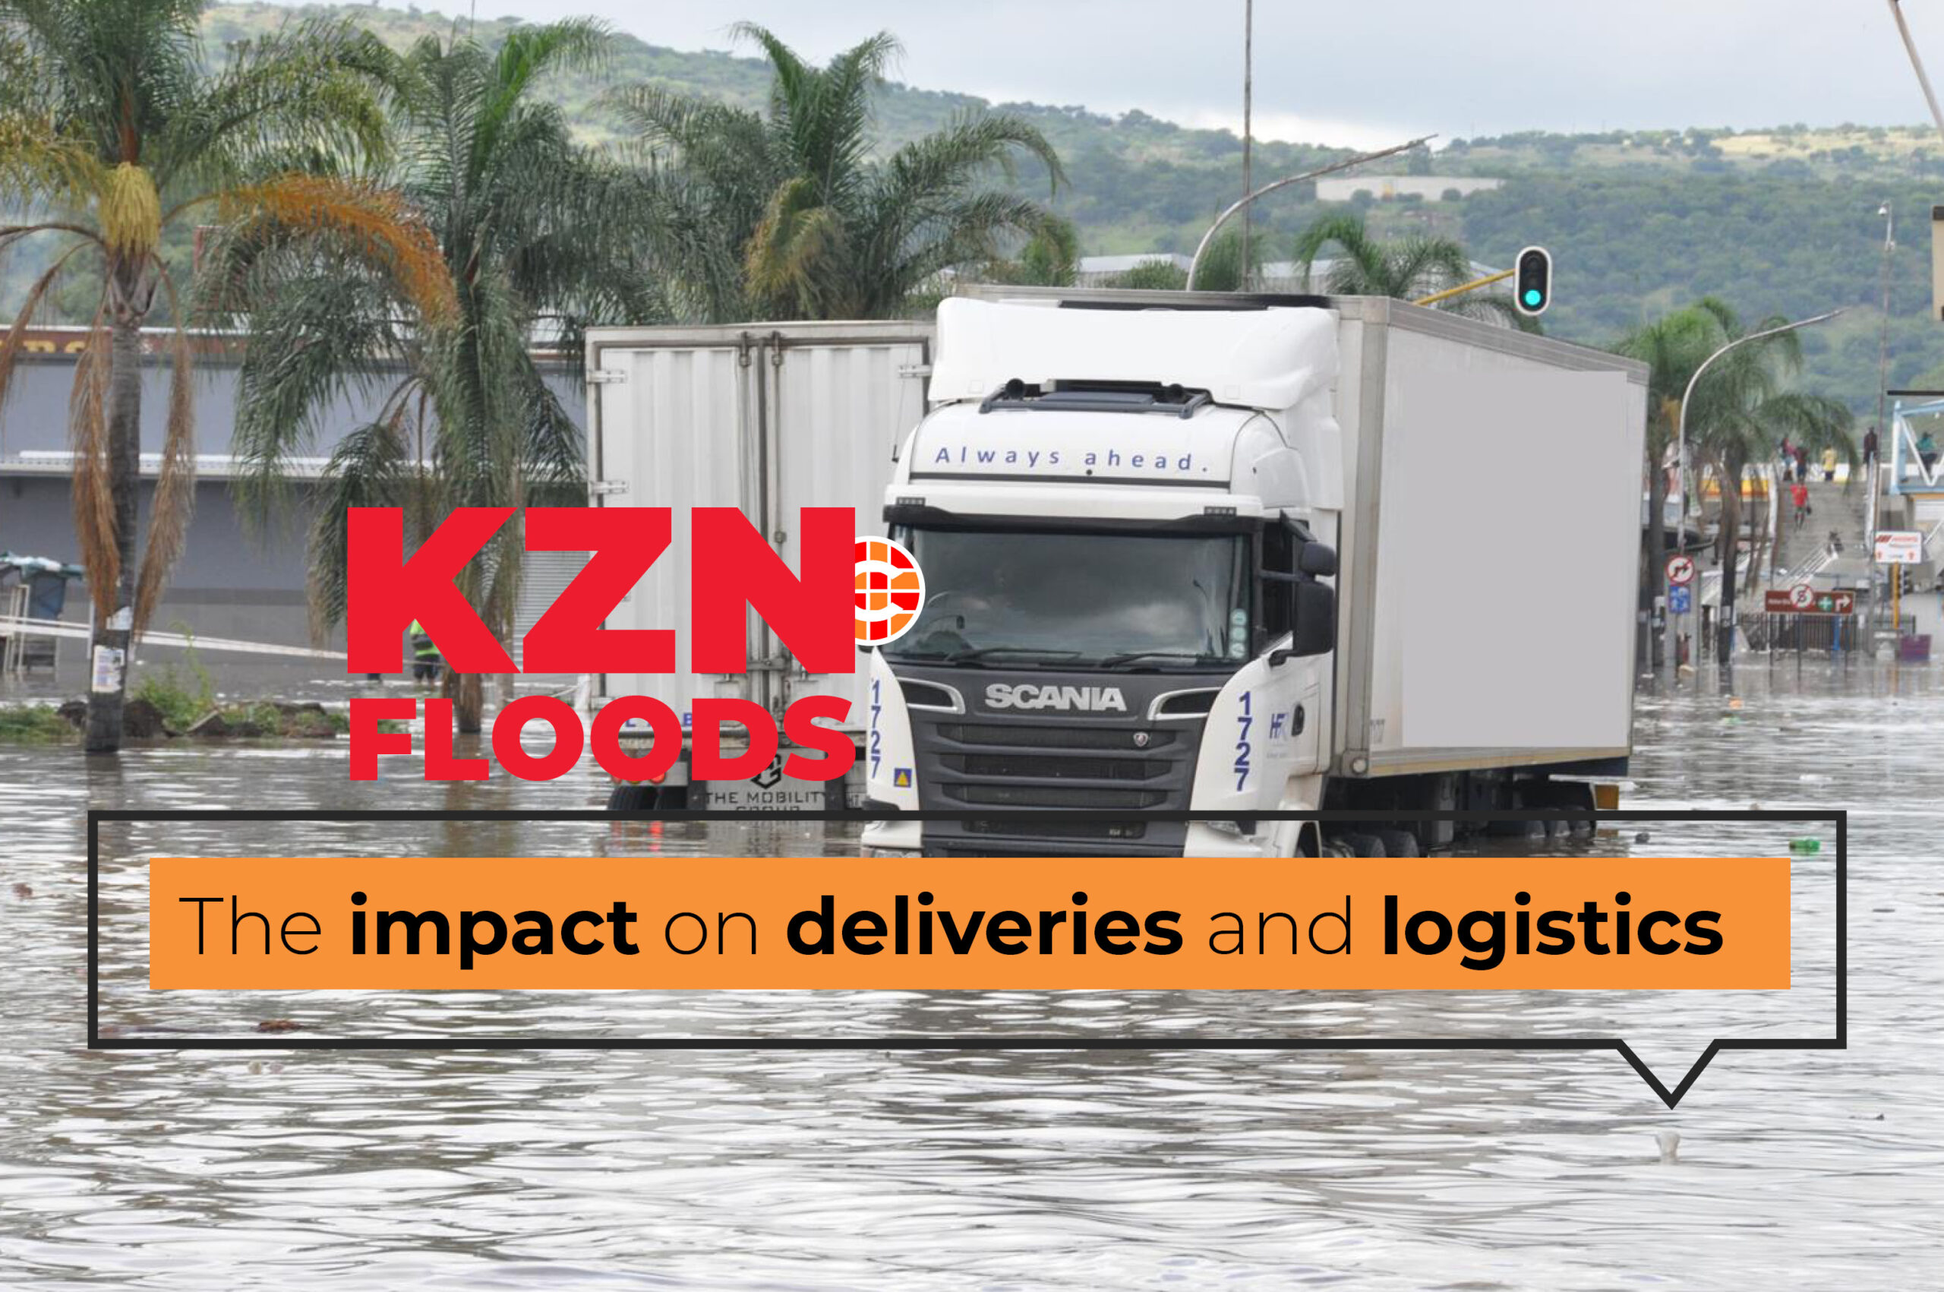
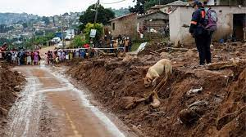
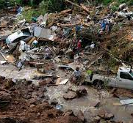
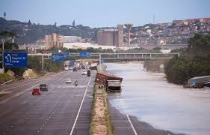
KZN flooding
In April and May 2022 Kwazulu Natal Province experienced severe floods and landslides caused by heavy rainfall
  Over 400 people died;
  Over 40,000 went missing and some displaced;
  Nearly 4,000 houses were destroyed, and more than 8,000 others were damaged.
  Multiple infrastructure was also destroyed.
  An estimated R17 billion worth of damage

Slide 16
Intersectionality of CC and other vulnerability drivers
Exposure to Hazards and Threats
LACK OF ACCESS
Health Services
Credit
Information
Etc…
LACK OF RESOURCES
Income
Assets
Social Support
Etc…
Increased Vulnerability
Reduced Capacity to Cope and Recover
(After Wisner)

Slide 17
Early Warning days BEFORE – reducing risks key
Hazards; Vulnerability; Impacts; Impact based forecasts;
Communication; Chains and cycles of risk research and action
Institutions for warning, co-design etc….
Community based work; Engaging business
Economics etc.

Slide 18
BUT, What about the days AFTER ….what then?
But instead, we might shift focus and take seriously the words of Tracie Washington, President of the Louisiana Justice Institute, who requested that policymakers and the media stop calling Hurricane Katrina and BP Oil spill victims “resilient”.
“Stop calling me resilient” was the loud cry of the public campaign she launched and disseminated across New Orleans. Objecting to the way the media and policymakers continuously praised her community for its resilience, Washington explained:
“every time you say, “Oh, they’re resilient, [it actually] means you can do something else, [something] new to [my community]. ... We were not born to be resilient; we are conditioned to be resilient. I don’t want to be resilient .... [I want to] fix the things that [create the need for us to] be resilient [in the first place]”
Maria Kaika – Don’t call me resilient again!: the New Urban Agenda as immunology … or… what happens when communities refuse to be vaccinated with ‘smart cities’ and indicators, Environment and Urbanisation, 2017, 29, 89-103.

Slide 19
Seeing our planetary risks through different eyes
Public Significance Statement in “Decolonizing Mental Health in the Polycrisis: Pathways Toward
Neuro-Decolonization”
The root causes of today’s social and ecological crises can be found in how modern society separates humanity from the rest of nature and creates relational hierarchies within humanity as well.
Insights from Indigenous communities and decolonial scholars suggest that to
address these crises in responsible ways, we will need to interrupt inherited patterns of
separation and supremacy and reactivate peoples’ sense of connection and responsibility to other beings, both human and not.
Source: Cash, Stein, Andreotti, et al., 2025: Decolonizing Mental Health in the Polycrisis: Pathways Toward
Neuro-Decolonization, American Psychologist, Vol. 80, No. 8, 1297–1312, ISSN: 0003-066X https://doi.org/10.1037/amp0001540

Slide 20

Hospicing Modernity –
Book review, CriSTAL, 2024, 12, Special Issue DOI: 10.15526/cristal.v12iSI1.2148
Is a book of meaningful stories that invite the readers to explore how it is and feels to acknowledge the hurt, contradictions, and illusions caused by modernity inside our bodies, in educational institutions, in our communities, and on the planet.
Rooted in the decolonial studies that understand the interdependency between coloniality and modernity, Vanessa Machado de Oliveira warns us that modernity, typically associated with stories of progress and development, is facing its end and there is a need to prepare ourselves to let modernity die peacefully within and around us.

Slide 21
  The need for Renewed Ambition!

Slide 22
“While exceeding 1.5ºC is unavoidable. How high we go and for how long it lasts is still in our hands.”

Slide 23
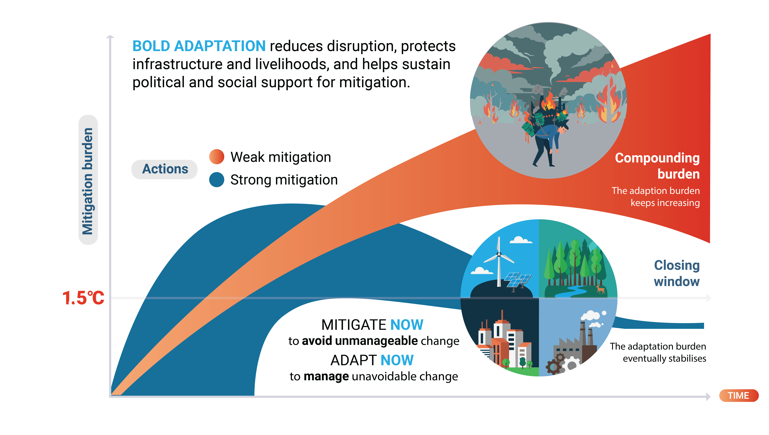
Bold adaptation supports climate ambition
Weak adaptation diverts resources to reactive crisis response
Notes:
Adaptation is a precondition for mitigation
Core message: Adaptation protects people and systems now, while mitigation determines the future level of risk that adaptation must confront.
Talking points:
Adaptation must address impacts already unavoidable or approaching.
Mitigation must start equally now because it determines peak warming and the future climate.
Strong adaptation helps maintain social and economic capacity for climate action.
Strong mitigation reduces the future adaptation burden.
Figure cue: Make simultaneous action explicit: adaptation and mitigation both begin now, but affect different dimensions of the pathway.
Exit point / transition: Adapt now to manage unavoidable change; mitigate now to avoid unmanageable change.
weak adaptation--> diversion of funds from mitigation and adaptation to serial emergency responses --> undermining of mitigation and adaptation = extending of magnitude and duration of OS
With weak mitigation, we have a compounding burden. If we go strong mitigation, reduce the long term burden.

Slide 24
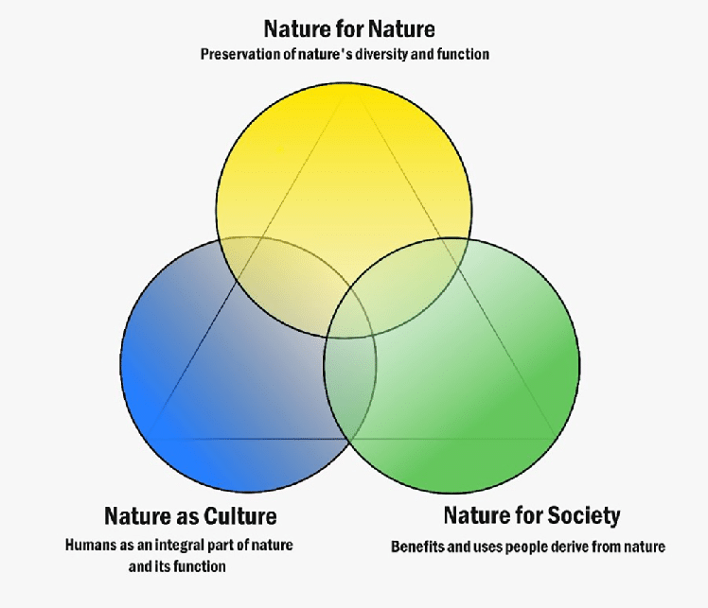
IPBES Nature Futures Framework
Pereira et al (2020) and Pascual et al (2017)
Notes:
Addressing the shortcomings that prevent the use of scenarios and models at different scales requires better integration of the feedbacks between nature and good quality of life for people, and recognition and inclusion of both synergies and trade-offs between the targets of the post-2020 global biodiversity framework, goals for mitigating climate change under the Paris Agreement, and the Sustainable Development Goals. Also required is the use of participatory approaches, which involve stakeholders in the development of future scenarios for nature and people and incorporate multiple value perspectives and different pathways to achieve societal goals
The Nature Futures Framework presents three nature value perspectives (intrinsic: nature for nature; relational: nature as culture; instrumental: nature for society) in a triangle. The coloured circles associated with each value perspective blend together, showcasing that these value perspectives are not mutually exclusive. Desirable nature futures are represented within the triangle, whereas undesirable state for nature and people are represented by the space outside the triangle. The framework is based on the understanding that there may be undesirable futures that are good from a particular value perspective on nature but not from an overall Nature Futures perspective. The dotted lines of the triangle indicate that 128 the boundary between desirable and undesirable futures are often context- or place-specific.

Slide 25
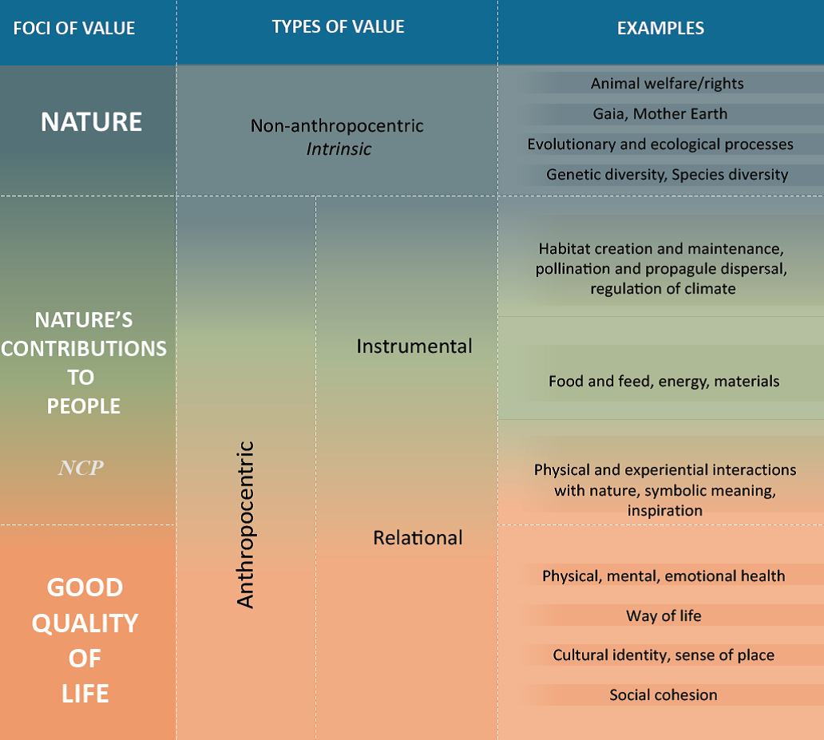
Nature futures, Nature Based approaches, Eba
(Pascual et al. 2017, Holden et al., 2026; IPBES reports)

Slide 26
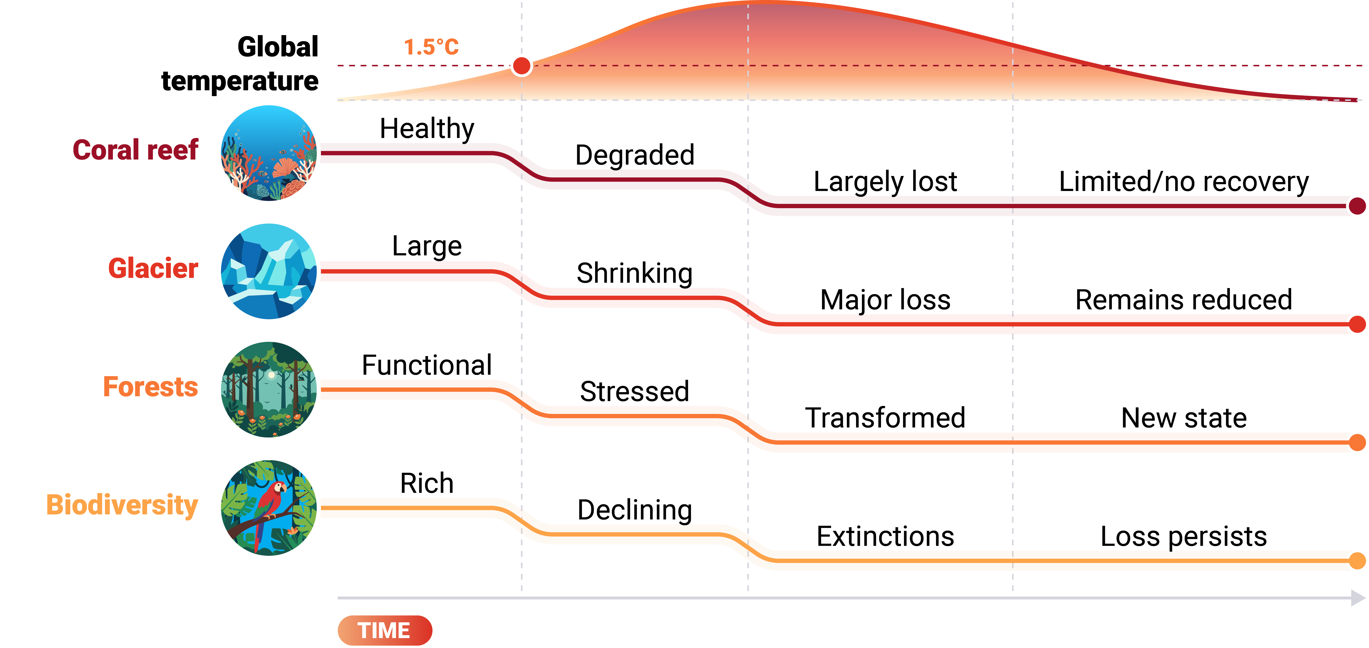
Chapter 2 Slide 3:
Some losses incurred across overshoot pathways may not be reversed
  Coral reefs, forests, glaciers, ice sheets, and other vulnerable natural systems can cross critical thresholds during overshoot pathways.
  Loss of biodiversity can weaken the natural systems on which people depend.
  Lower and shorter exceedance reduces the chance of crossing these thresholds.
Cooling is not ecological rewind

Slide 27
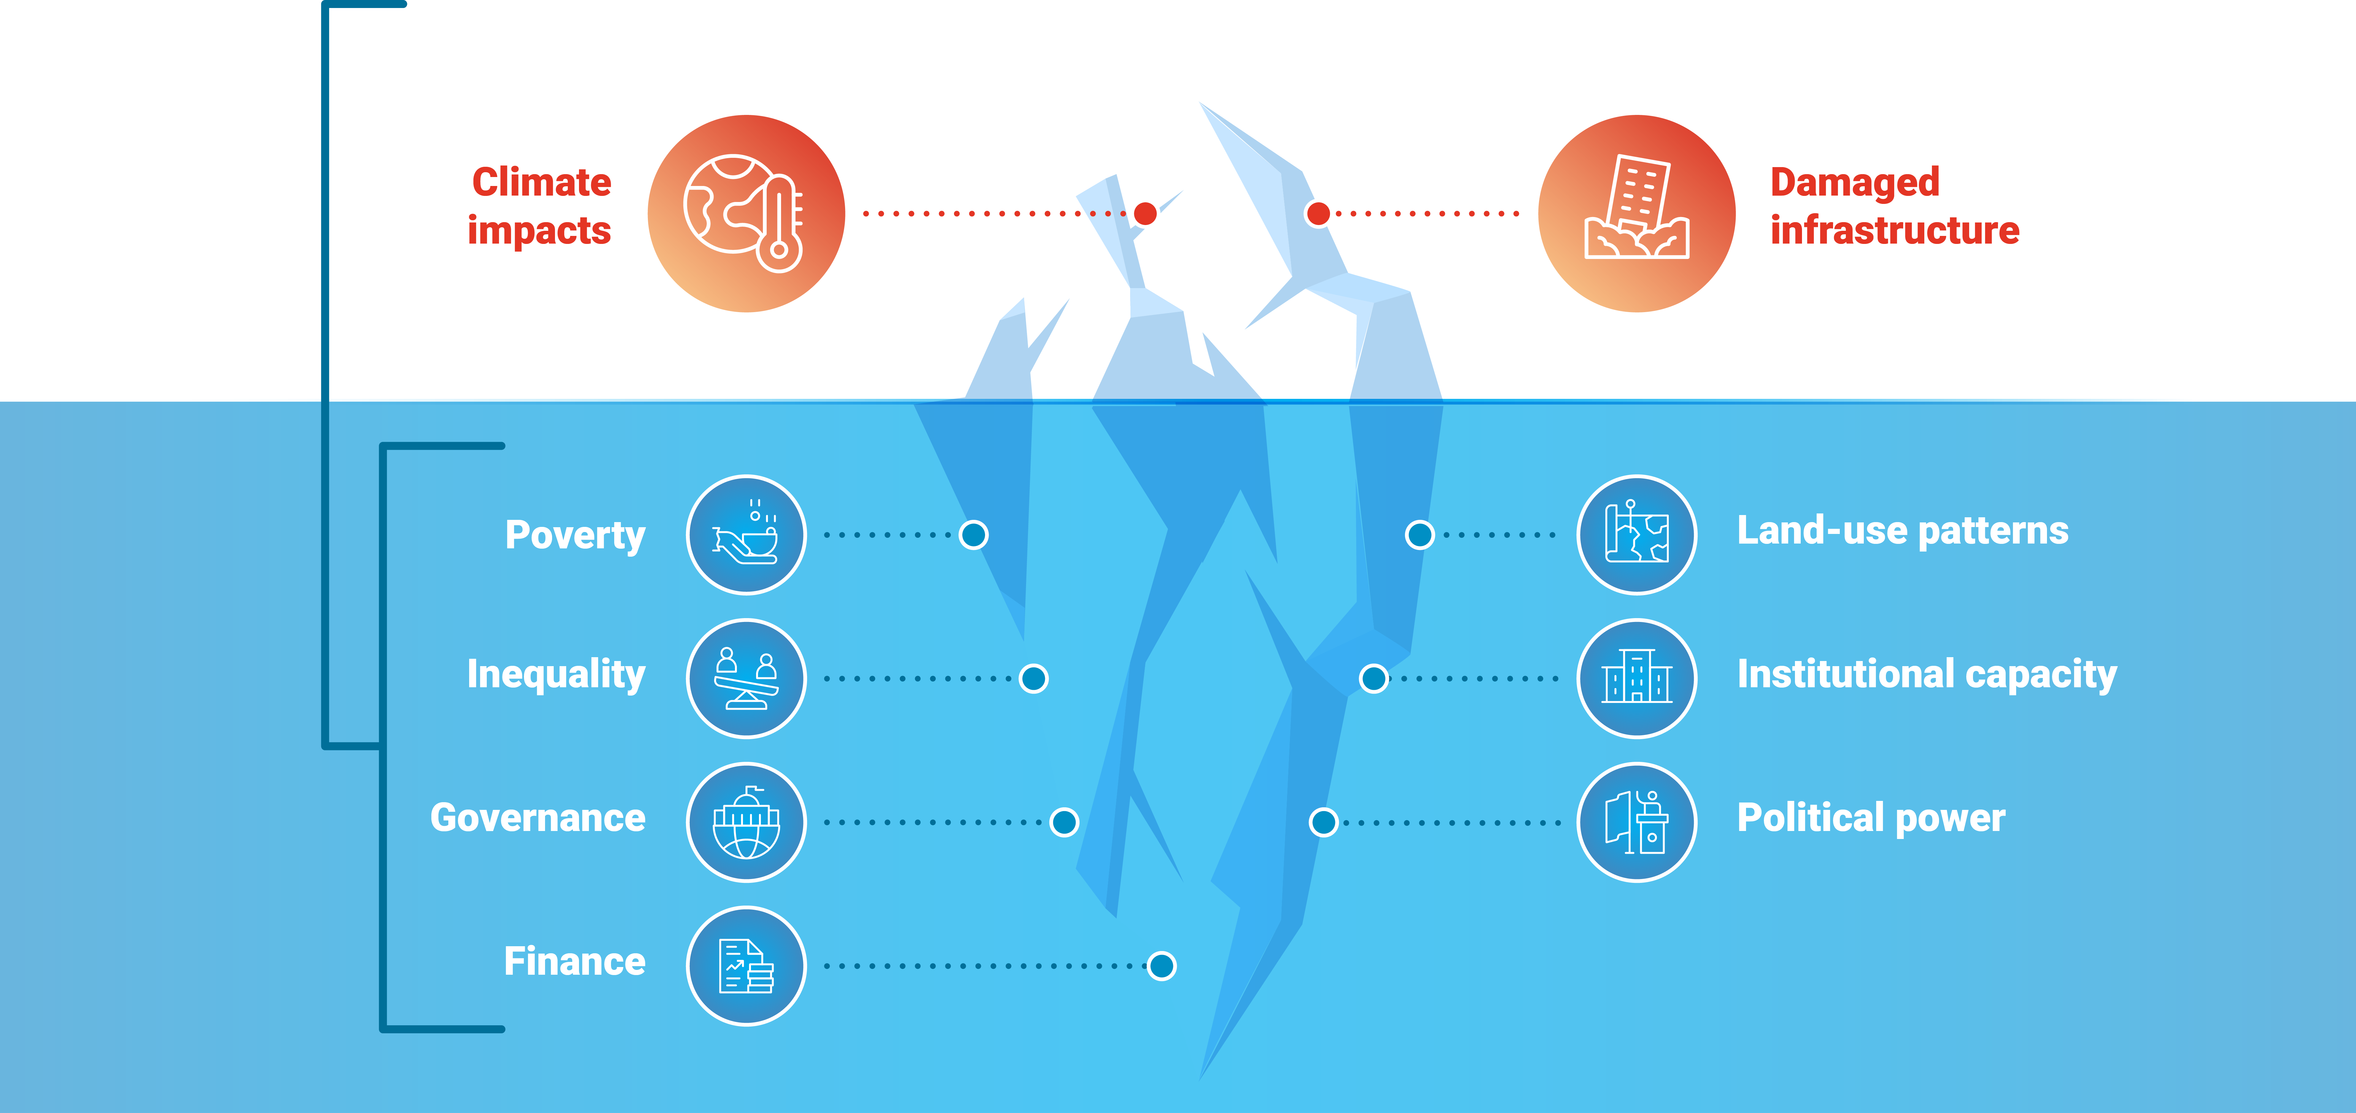
Overshoot requires anticipatory, flexible
and evolving adaptation
Practical responses are necessary but not sufficient.
Transformational adaptation – plan for a changing world
Adaptation must address vulnerability drivers, reshape institutions, finance,
and governance, and account for limits, equity, and justice.

Slide 28
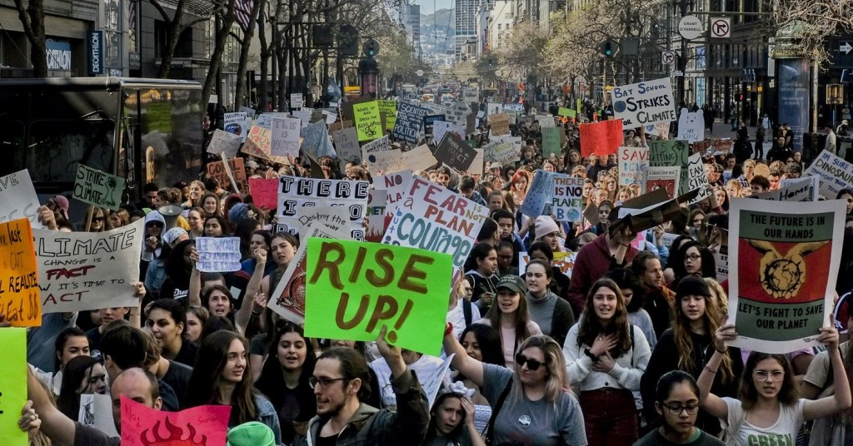




Transformation: “The powerful unleashing of human potential to
commit, care, and affect change for a better life.” (Sharma 2007; O’Brien)
https://350marin.org/climatestrike/
Notes:
Its about transformative leadership

Slide 29
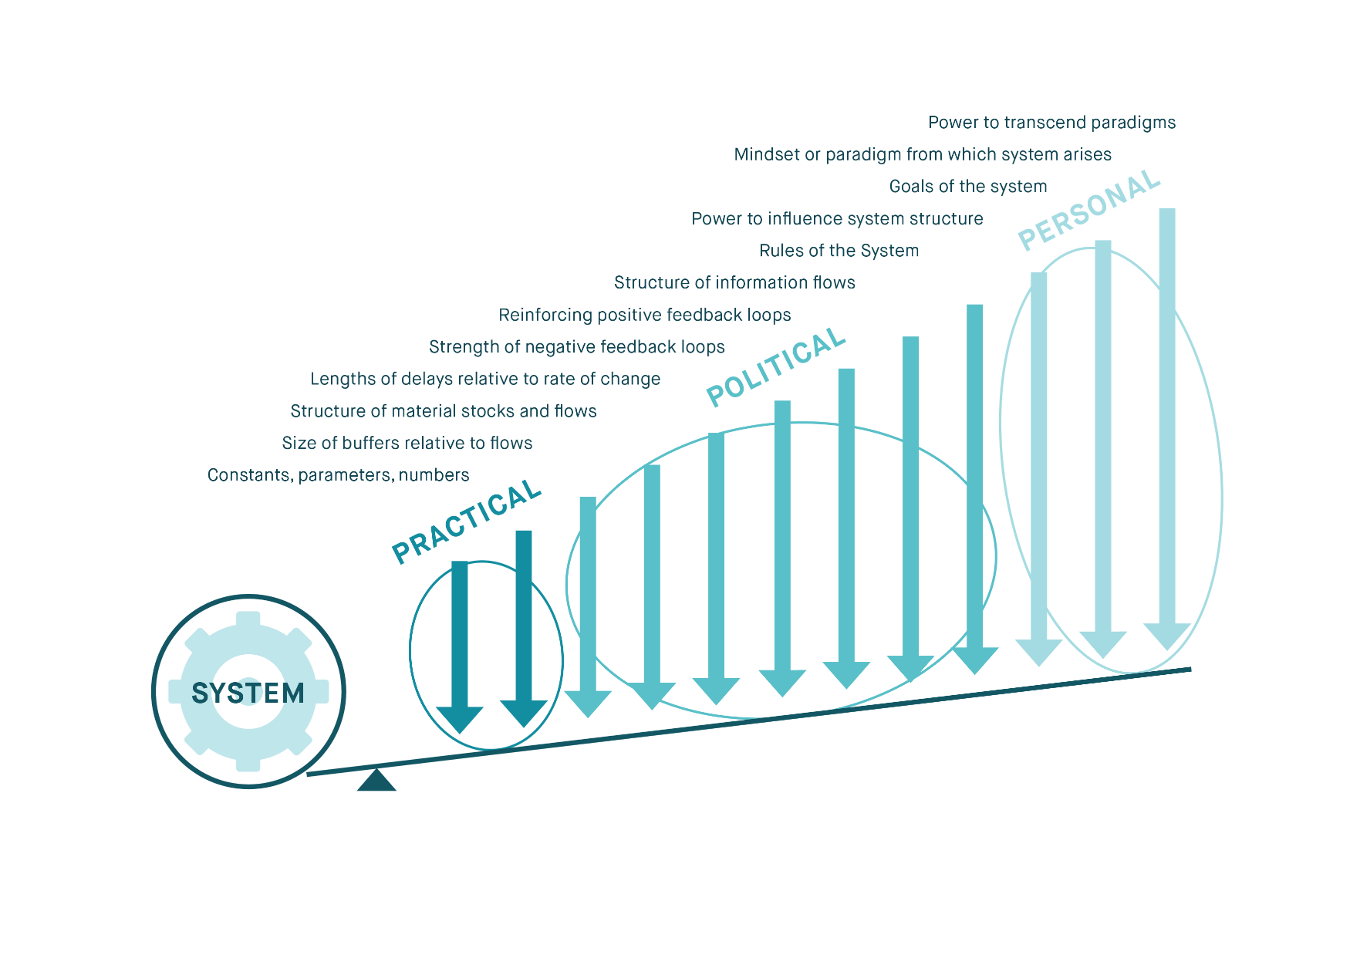
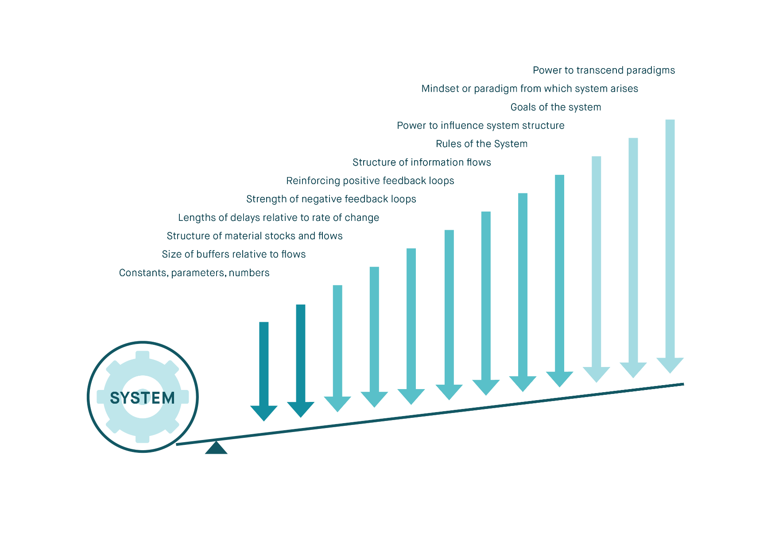

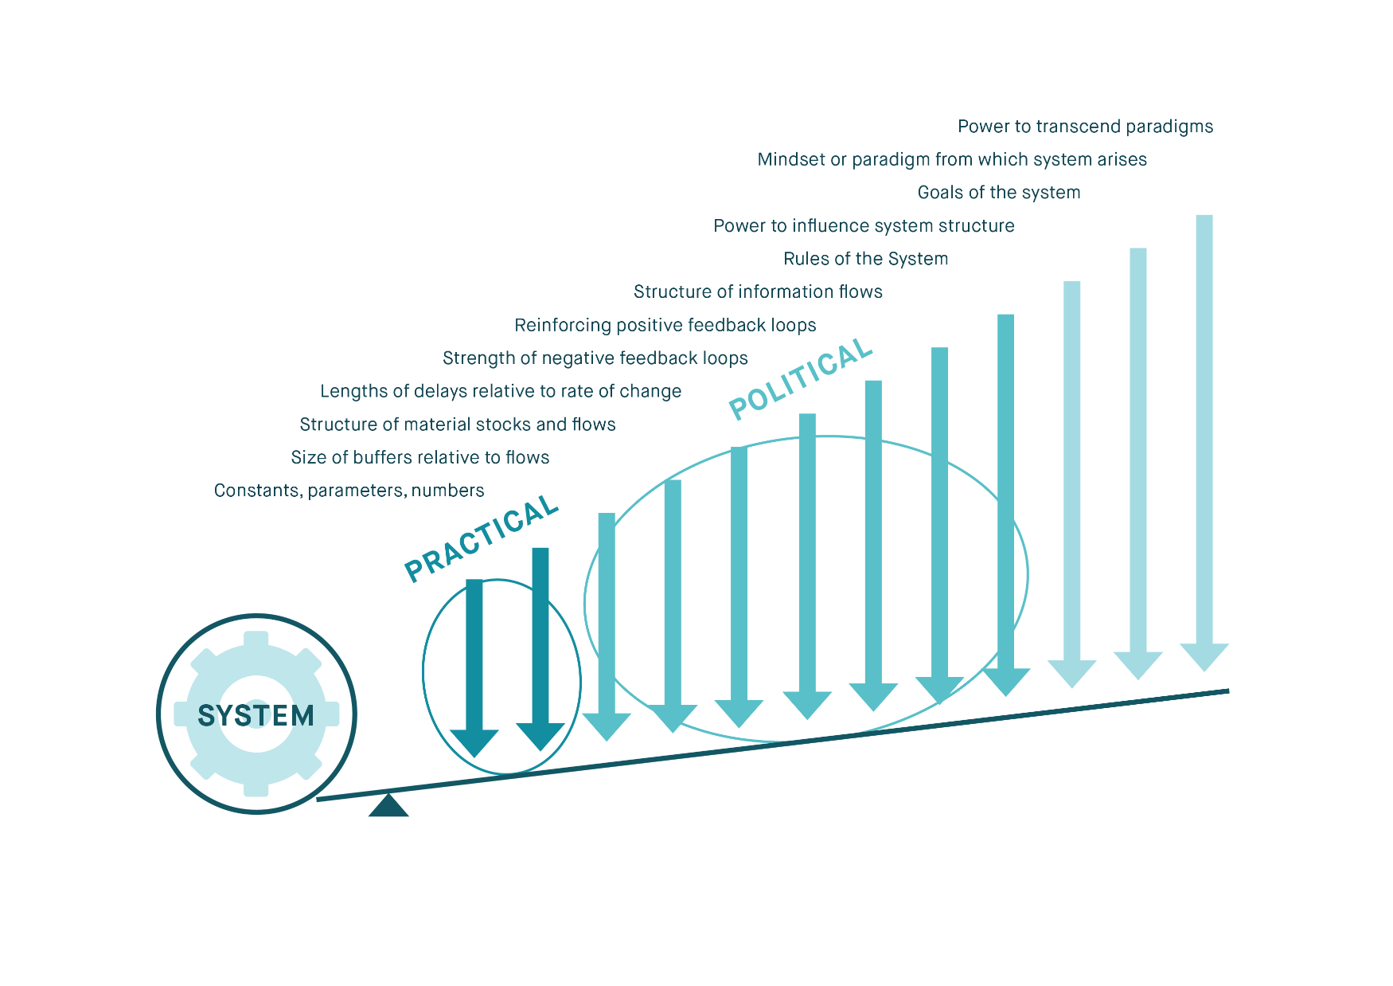
Based on: Meadows, D. H. 1999. “Leverage Points: Places to Intervene in a System.” The Sustainability Institute and O’Brien and Sygna, cChange, Oslo..

Slide 30
So where to next? – Well-Being approaches
Linking HEART and MIND…
Exploring “ways of being” (Rigolot, 2020) – values, beliefs, world views
Knowledges:
Soft ware – social
Hard ware – technical
Heart ware – local, tacit

Slide 31

Heartware
Internal motivation for long-term collective action
Hardware
Technological solutions
Software
Policy, Politics & Institutions
Arts, social media
(Source: Zeeda Fatima Mohamad)

Slide 32
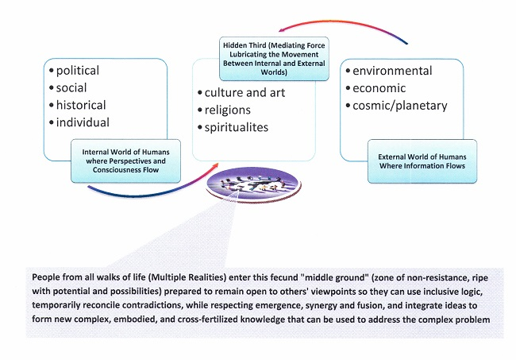
Transdisciplinary approaches –
(After McGregor, 2015)
Notes:
Art can hold contradiction, opposing views and differences

Slide 33
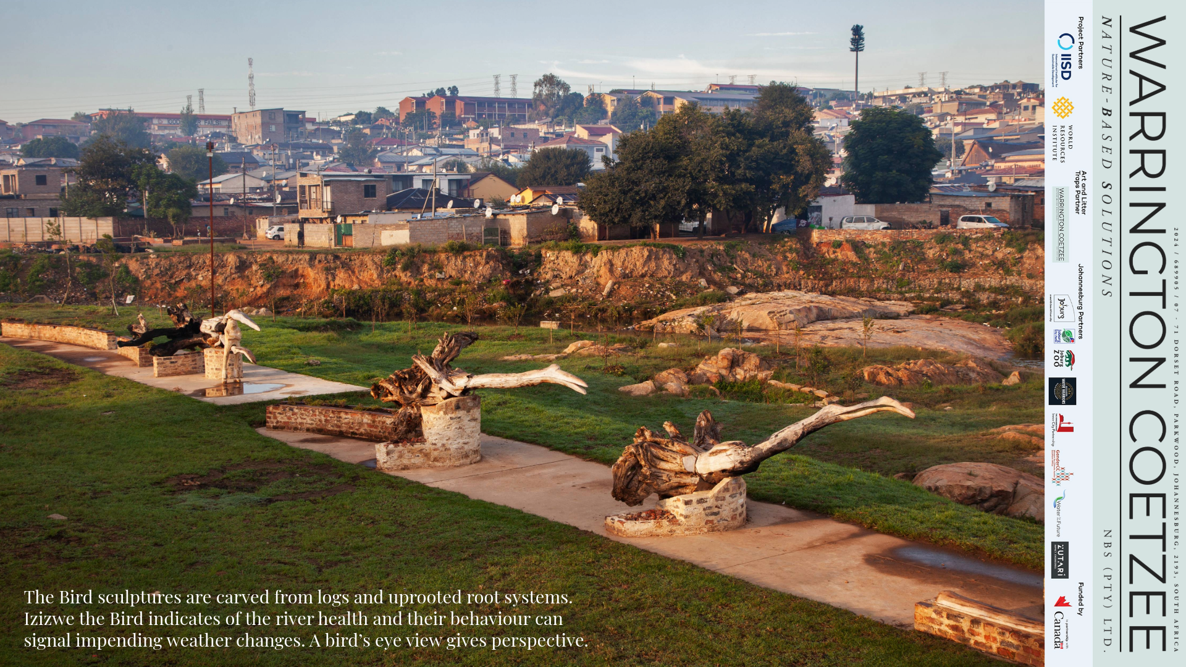

Slide 34
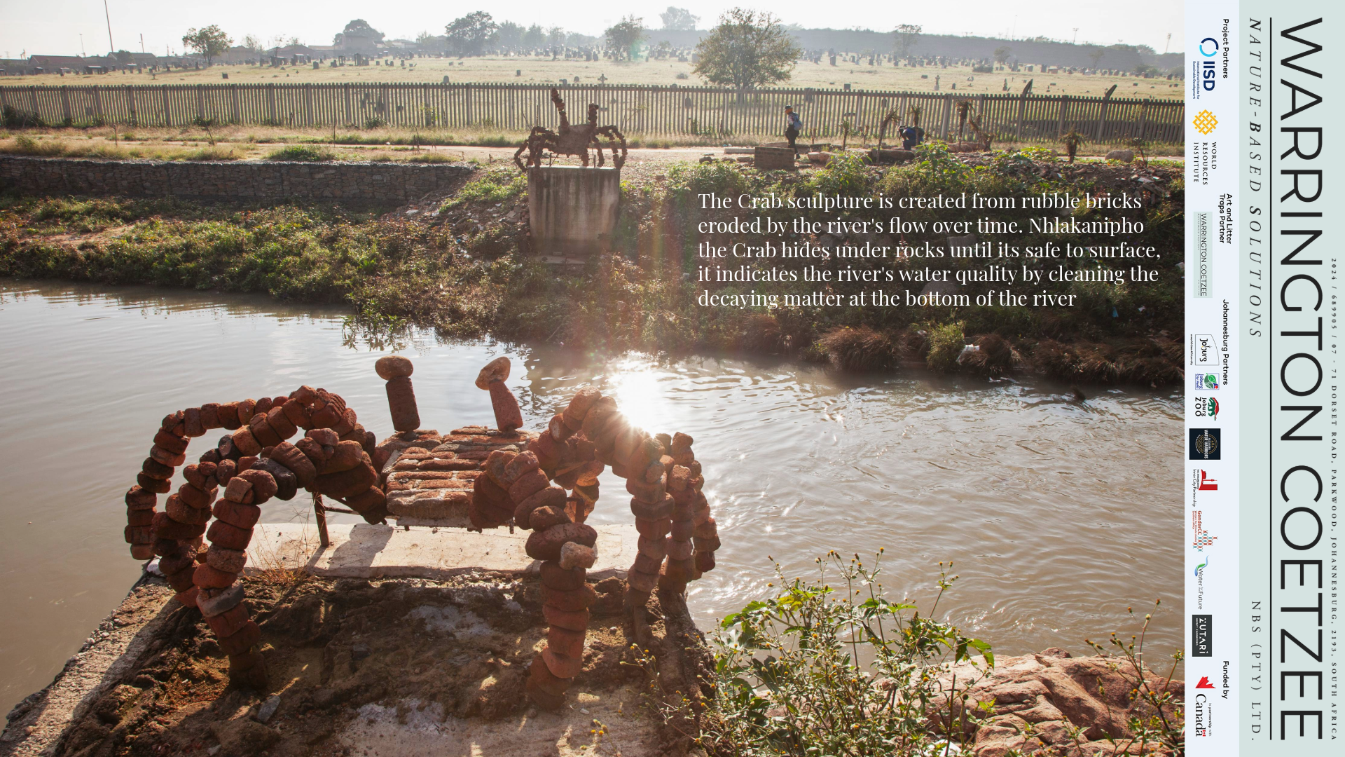

Slide 35
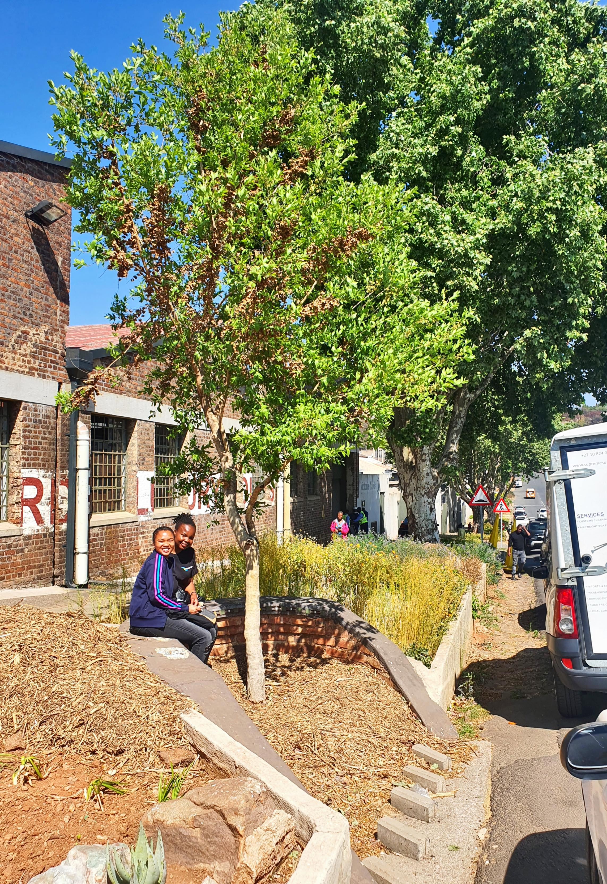
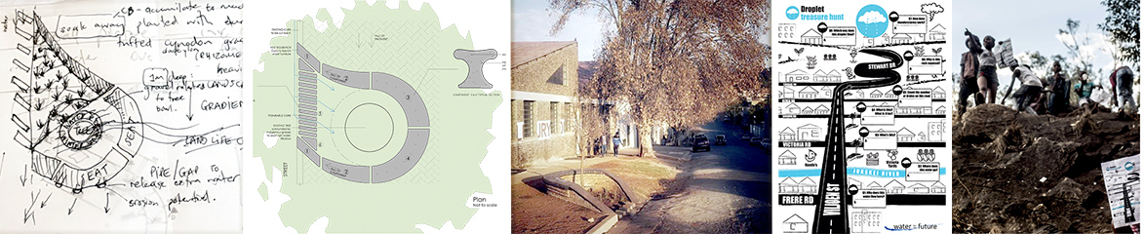
Eco Tree Seat, Viljoen Street, Lorentzville, Johannesburg
Layered co-design process cuts informal ideas into formal infrastructer
Below from left to right
Artists impression,
with engineering ideas
Architectural drawing
Intervention on Viljoen Street
Treasure hunt and
Children's education
hannelie@hanneliecoetzee.com
www.hanneliecoetzee.com
#hanneliecoetzee
Notes:
Drop sound in 4min
Ongoing, just not running the NGO anymore – focus on the arts and when this funding is available my energy goes into it.

Slide 36
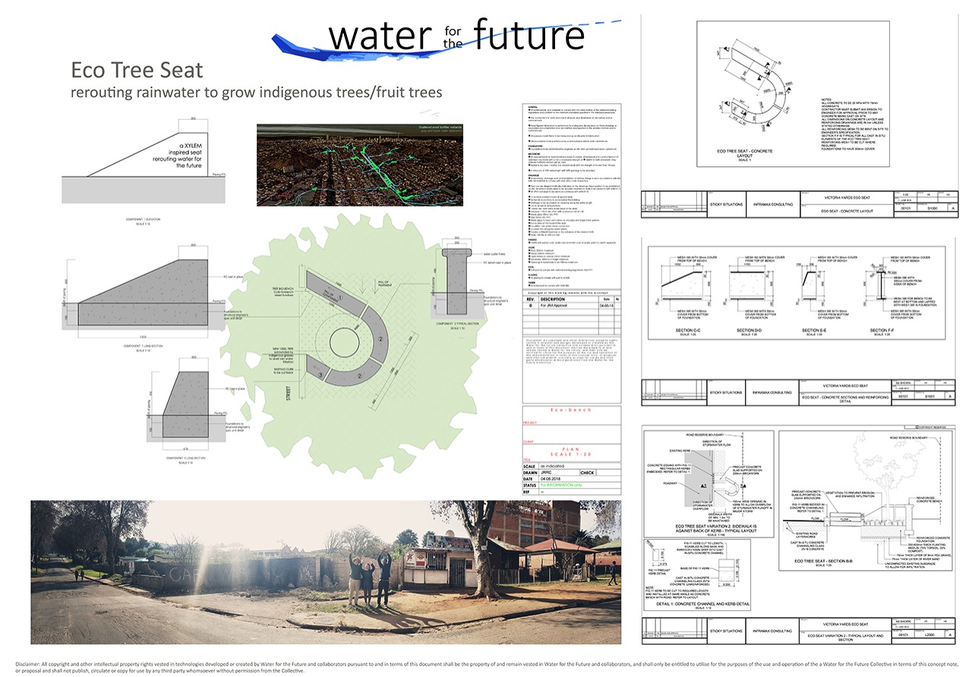

Slide 37






Hold long-term direction, keep learning
SCIENCE
POLICY
Continuous • Two-way • Agile
EVIDENCE
Distinguish what is established from what remains uncertain
OBSERVATION
& MONITORING
Detect changing conditions and emerging risks
GOVERNANCE
Learn and adjust without losing long-term direction
FINANCE
Align investment
with the physical sequence of overshoot
EQUITY
& JUSTICE
Shape what
is feasible, acceptable
and durable

Slide 38
Opportunities
Opening up and transforming ‘spaces’ and ‘agoras’ for action
Working with new ways of seeing and being
Co creating with “Young change agents”, business and civic society
The arts, creatives, culture, and other knowledges (tacit, local)
Engaging urgently with various knowledge holders

Slide 39

Transformation: Significant physical and/or qualitative changes in form, structure, or meaning-making.
Photo: Mathisa/ Shutterstock
Photo: Mathisa/ Shutterstock, , Karen O’Brien

Slide 40
“While exceeding 1.5ºC is unavoidable. How high we go and for how long it lasts is still in our hands.”

Slide 41
Acknowledgements
Debra Roberts, Bruce Hewitson, David Dodman and UNEP Overshoot team
Francois Engelbrecht, Bob Scholes and GCI team
Karen O Brien and Linda Sygna
City of Jhb – EISD and the youth - SAIIA
Bradley Riley, former student – World Bank
Zeeda Fatima Mohamad – Malaysia
Hannelie Warrington Coetzee – Independent artist
SADAG – South African Depression and Anxiety Group, www.sadag.org.

