Slide 1
Climate shocks and climate costs in the era of 1.5-2 °C of global warming
Prof. Francois Engelbrecht
Director and Wits-Nedbank Chair in Climate Modelling
Global Change Institute| Faculty of Science | University of the Witwatersrand
With contributions from Jessica Steinkopf (Wits GCI)

Slide 2
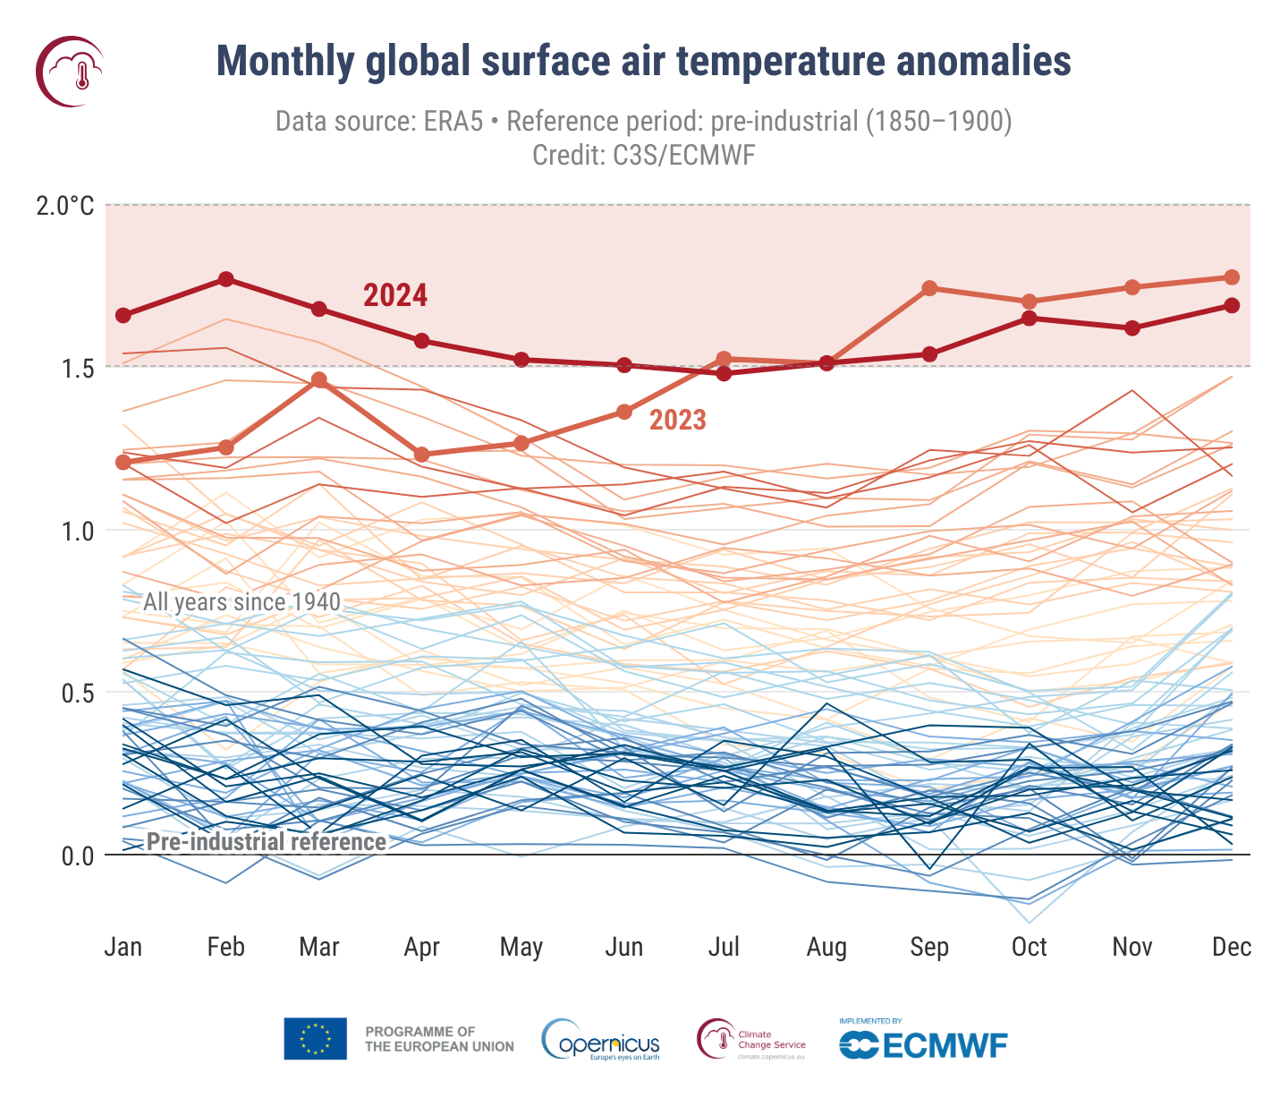
The era of 1.5 °C of global warming is dawning
The level of global warming in 2024 was 1.6 ºC, the first year during which the average global surface temperature exceeded the 1.5 ºC threshold of global warming.
2025 the 3rd warmest year on record (1.47 ºC) and 2023 the 2nd warmest (1.48 ºC).
2023-2025 the first 3-year period to exceed the 1.5 ºC threshold.
The world will burn through the remaining carbon budget to limit global warming to below 1.5 ºC over the next three years (Forster et al., 2025).
The Paris Agreement on Climate Change aims to keep global warming to ‘well below 2 ºC, preferably below 1.5 ºC’.
A 1.5 ºC warmer world is a more dangerous world with more extreme weather events. Aspects of climate change may become irreversible.
Global surface air temperature increase (°C) above the average for the pre-industrial reference period (1850–1900) for each month from January 1940 to December 2024, plotted as time series for each year. 2024 is shown as a thick red line and 2023 as a thick pink line, while other years are shown with thin lines and shaded according to the decade, from blue (1940s) to red (2020s). Data source: ERA5. Credit: C3S / ECMWF.

Slide 3
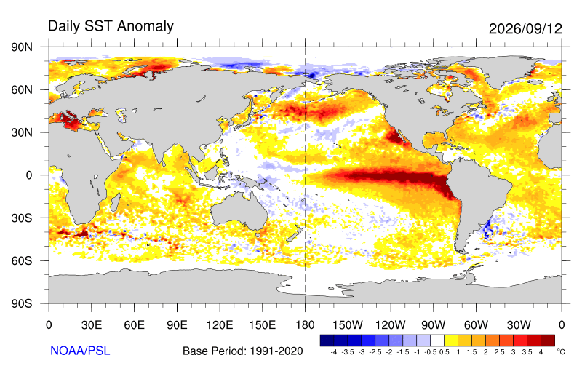
The super El Niño of 2026/27 has now formed

Slide 4
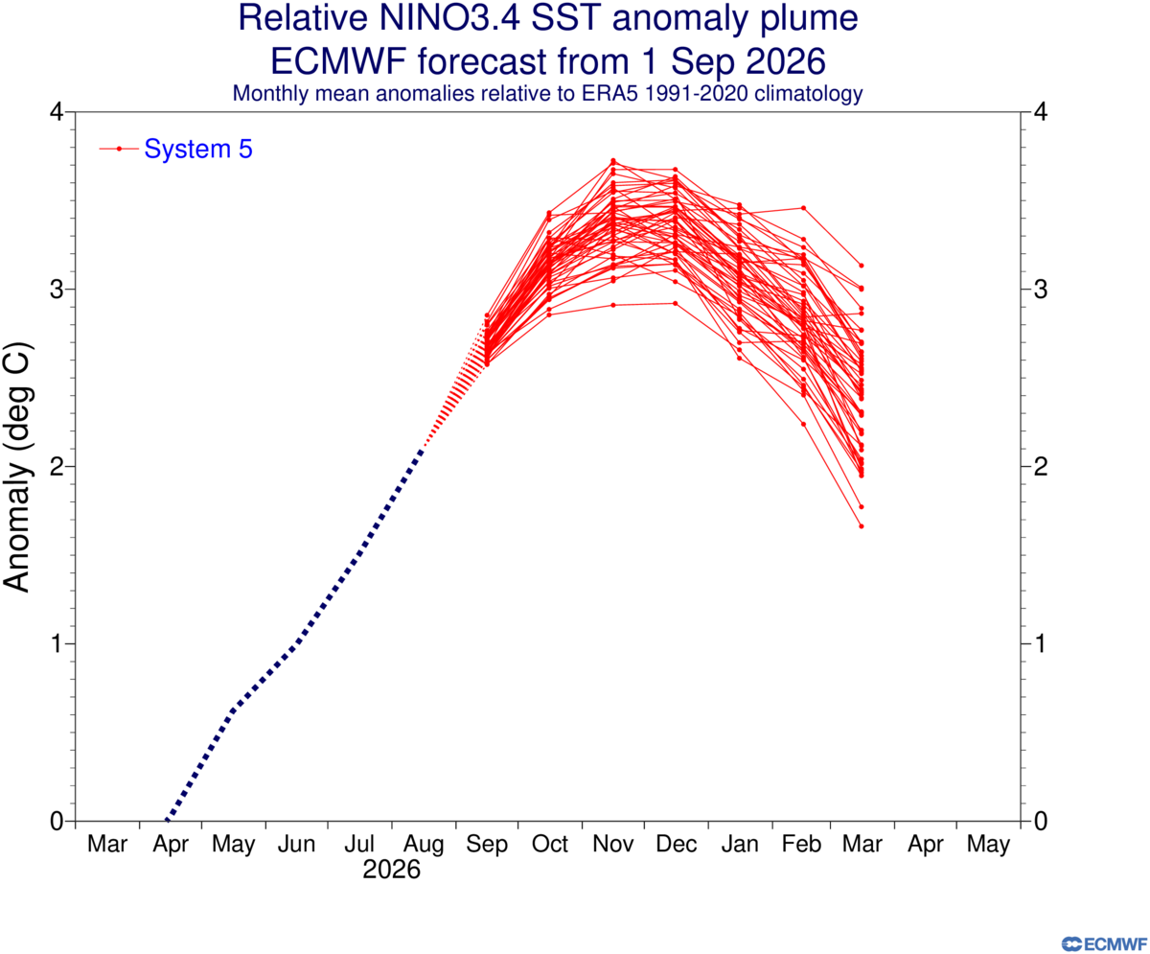
How will El Niño change in a warmer world?
The latest ECMWF ensemble indicates that the 2026/27 El Niño will likely be the strongest in living memory, with NINO 3.4 SST anomalies larger than 3 °C.
2027 is likely to be the warmest year on record, with a GWL of 1.7 °C.
Will El Niño events become stronger in a warmer world?
Will the ENSO teleconnection to southern Africa change?
How may we expect climate change and El Niño to combine to impact in southern Africa during 2026/27?

Slide 5
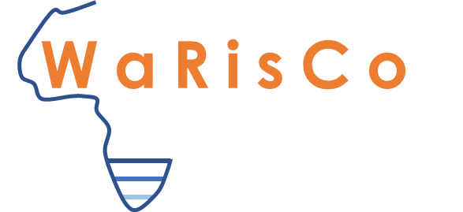
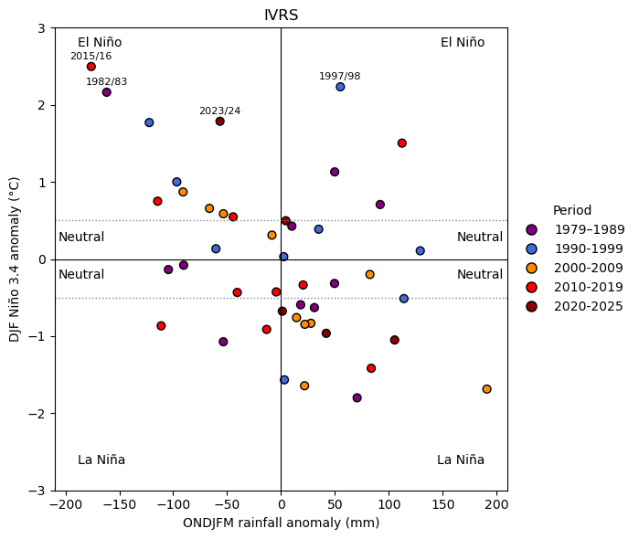
El Niño impacts on rainfall: IVRS
The relationship between summer SST anomalies (°C) in the eastern-tropical Pacific Ocean (y-axis) and summer half-year rainfall (mm) over the IVRS.

Slide 6
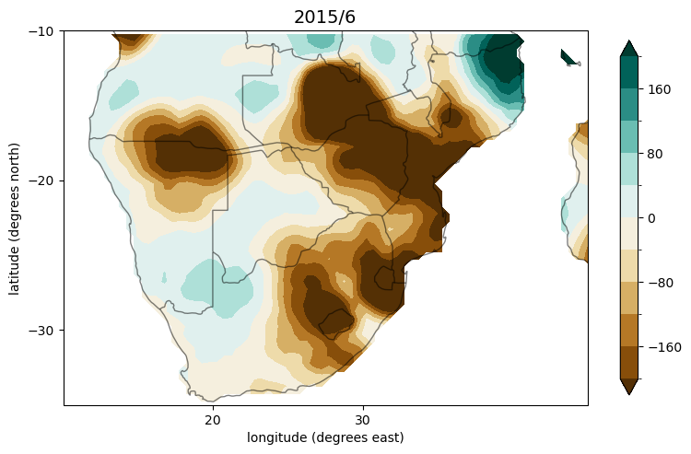
The 2026/2027 El Niño: worst-case scenario
A strong El Niño has formed in the Pacific Ocean, and is likely to develop into a super El Niño by the summer of 2026/27.
The El Niño is fuelled by climate change and is likely to be the strongest ever recorded.
2027 is likely to be the warmest year ever recorded, with the level of global warming reaching 1.7 °C.
Southern Africa is likely to experience below-normal rainfall and the drought may be severe.
The summer of 2026/7 is likely to be the warmest on record with unprecedented heat waves.
Widespread impacts can be expected on rainfed agriculture, water security and human health.
The 2015/16 super El Niño brought widespread drought and unprecedented heat waves to southern Africa. The figure shows rainfall anomalies (mm) for the period October to March 2015/16, relative to the long-term mean.

Slide 7
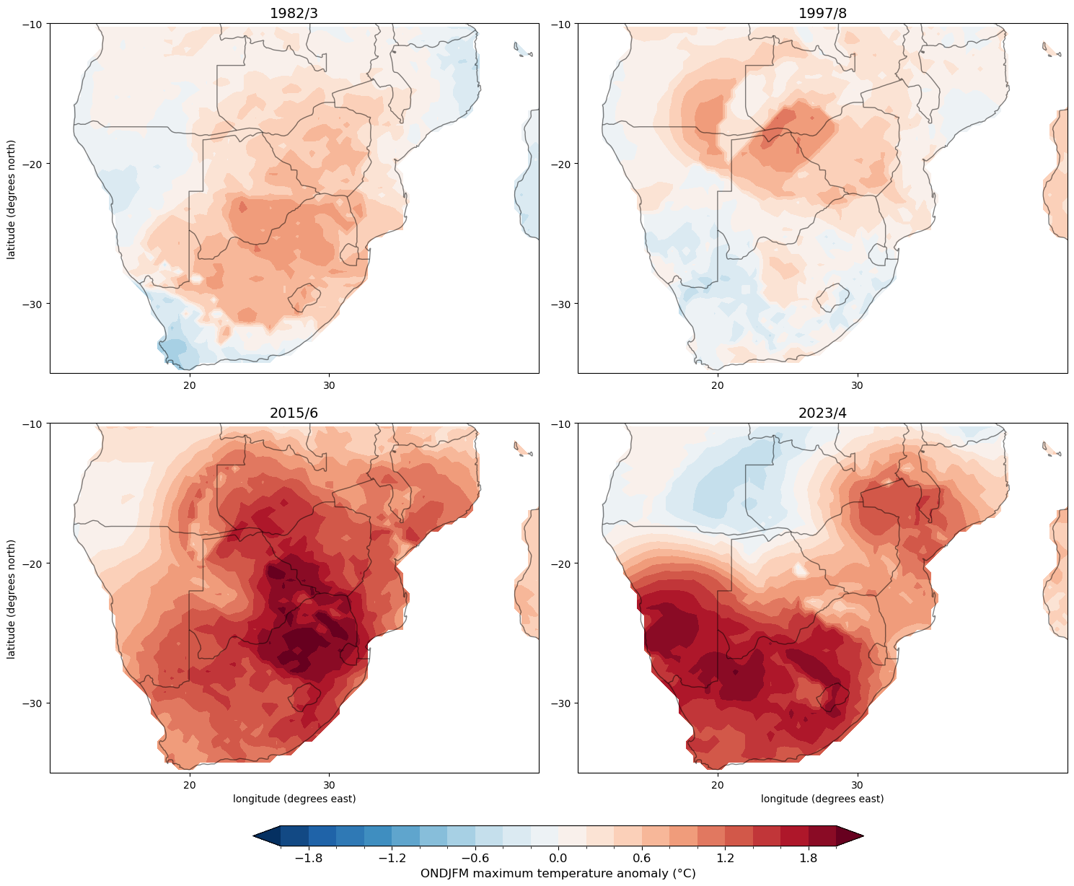
Differential impacts on southern African rainfall from different El Niño events
2027 is likely to be the warmest year ever recorded, with the level of global warming reaching 1.7 °C.
Southern Africa is likely to experience below-normal rainfall and the drought may be severe.
If the El Niño of 2026/27 is to bring below-normal rainfall to southern Africa, the summer is likely to be the warmest on record with unprecedented heat waves.
Climate change fuelled heat-stress is a major risk this summer: in terms of human health, crops and water losses via enhanced evaporation.
Figure: Observed maximum temperature anomalies (°C) during the summer half-year in southern Africa for different El Niño events.

Slide 8
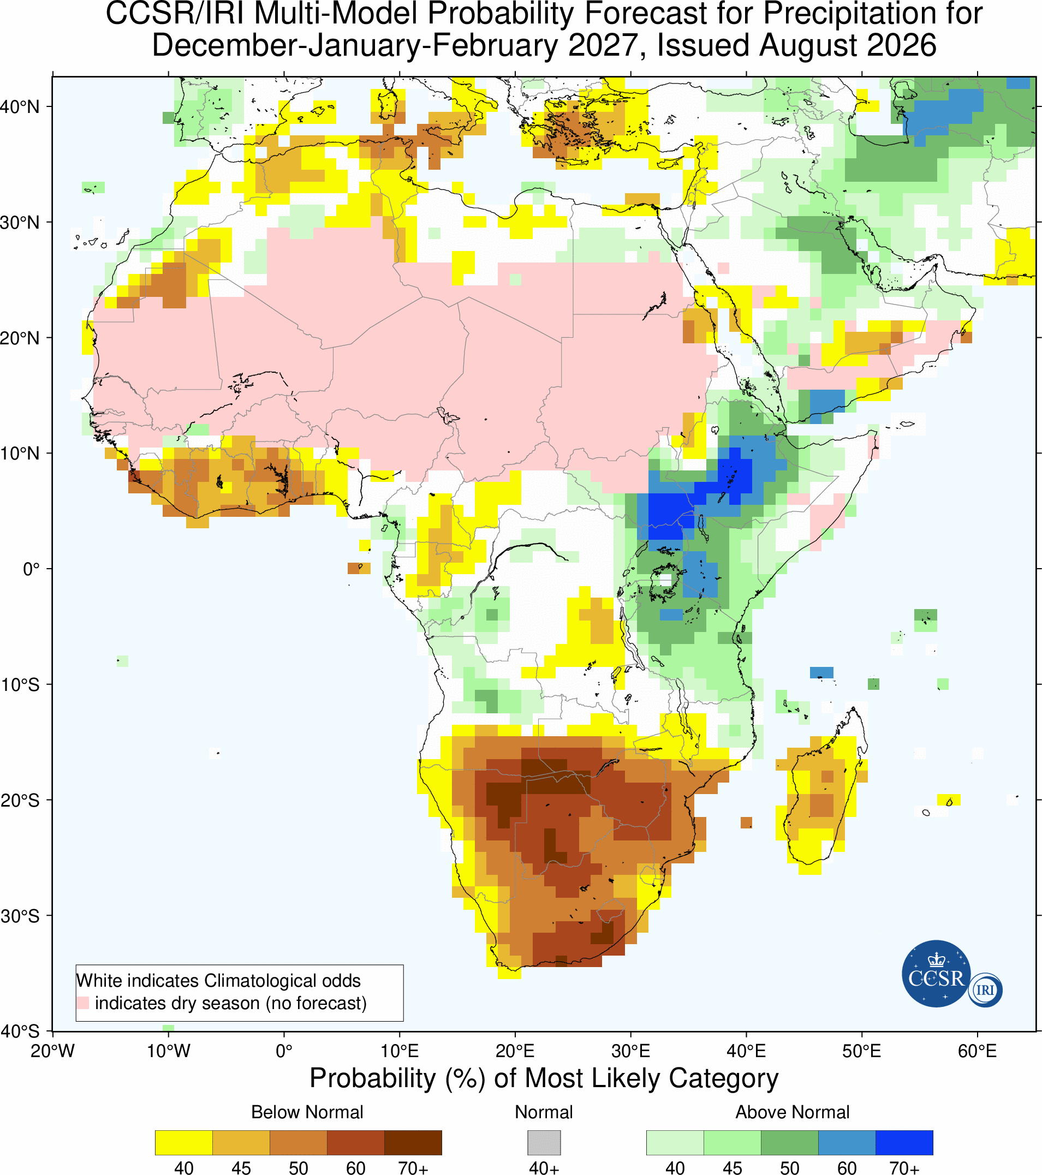
A super El Niño in 2026/27 – drought in southern Africa?
IRI ensemble shows high probabilities of below normal rainfall in southern Africa.
Drought in southern Africa may be severe, with unprecedented heatwaves and record-breaking temperatures.
2026/27 maize crop may be ~40% less compared to normal years.
Based on 2015/16 El Nino impact, the IVRS may lose 30-50% of its current water storage over the following year.
A key risk is high water demand in Gauteng, which in combination with water infrastructure and electricity provision issues may result in frequent water shortages/outages.
The elderly, people with co-morbidities and pregnant women, especially when living in informal housing, will be at risk.
The municipal water truck and water tanks may be a lifesaving intervention.
Heat waves can be skilfully predicted at a lead time of a weak, and this may help with water provision planning.

Slide 9
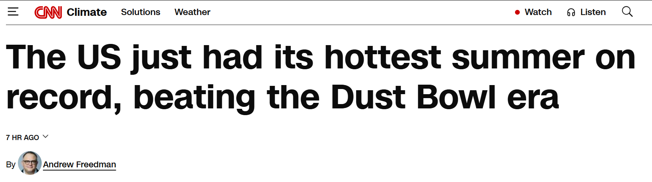
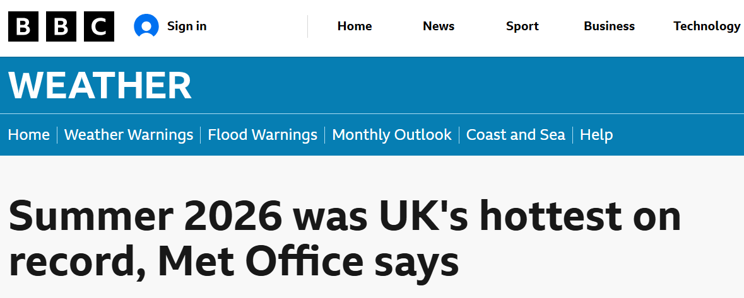
Will the summer of 2026/27 be the warmest on record in southern Africa?
The summer of 2026 brought record-breaking temperatures and unprecedented heat waves to Europe and the UK.
Excess deaths in Europe during the summer of 2026 is ~ 35 000, attributed to excessive heat stress during a summer of unprecedented heat waves.
If El Niño brings the likely signal of below normal rainfall to southern Africa, the summer will likely be the warmest on record, with unprecedented heat waves.
South Africa has an immense vulnerability to extreme heat, due to millions of people living in informal housing.

Slide 10
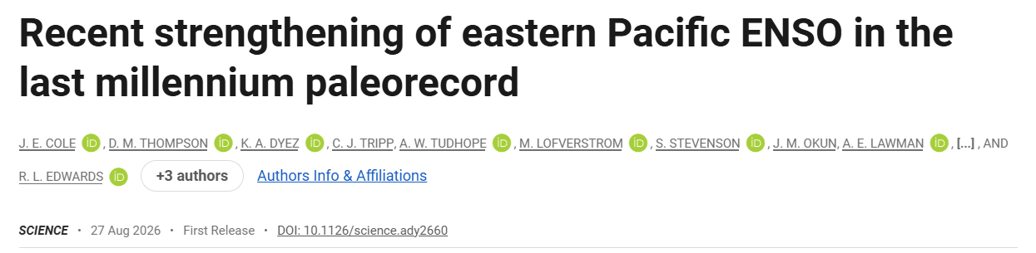
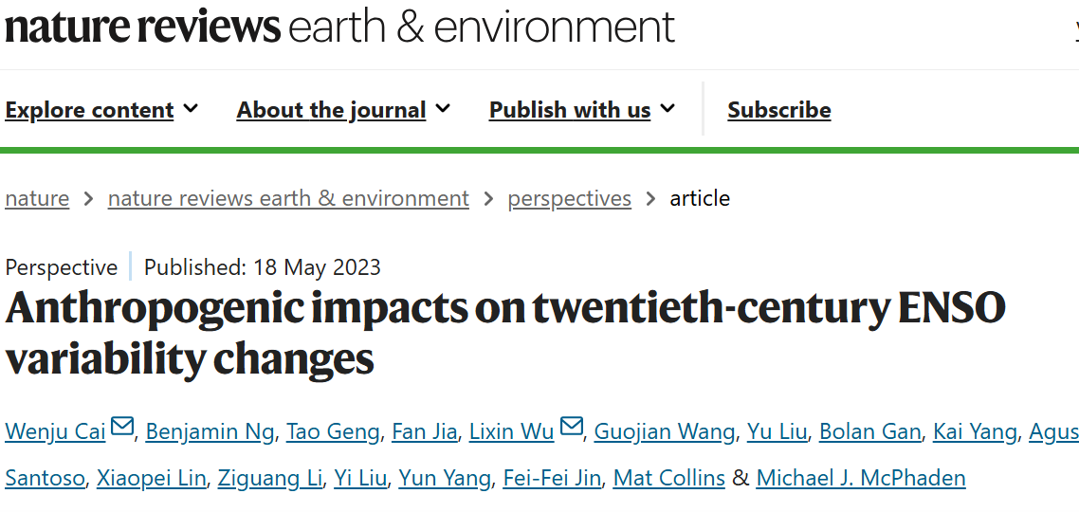
Growing evidence of stronger El Niño events in a warmer world
It is ‘virtually certain’ ENSO will remain dominant mode of interannual climate variability throughout the 21st century (IPCC AR6).
IPCC AR6: No consensus in CMIP6 models of a change in ENSO amplitude or frequency (that is, no confidence assessment was possible for the notions of strong El Niño events occurring more frequently, or of an increase in La Niña frequency).
Post AR6: Growing evidence that strong and very strong El Niño events are becoming more likely in a warmer world.

Slide 11
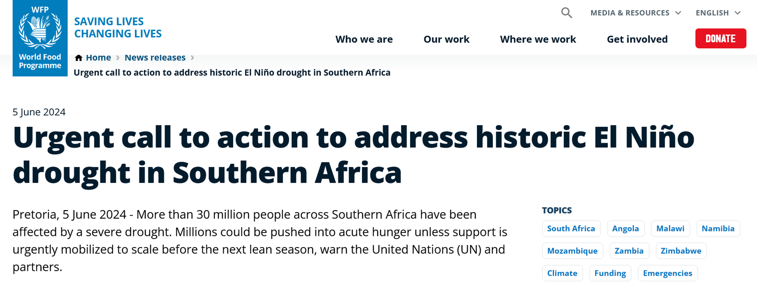

SADC countries appeal for help
Appeal for $5.5 billion of support to provide urgent lifesaving assistance, to help with recovery and long-term climate resilience
9th GEWEX-OSC
Sophie Biskop et al.

Slide 12
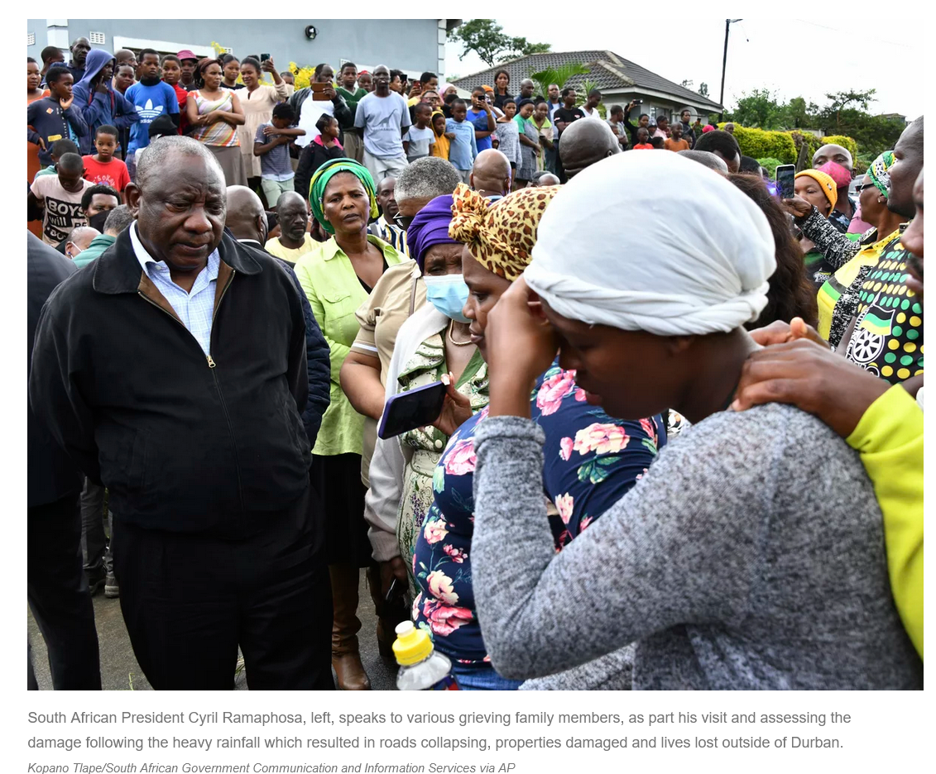
President Cyril Ramaphosa on 13 April 2022: "This disaster is part of climate change. It is telling us that climate change is serious, it is here”.
Loss of life: 544 people died
~ 7000 houses destroyed
~ 40 000 people displaced
Damages: $US 3.4 billion
Worst flood disaster in South Africa’s history
https://www.npr.org/2022/04/13/1092753563/flooding-climate-change-south-africa

Slide 13


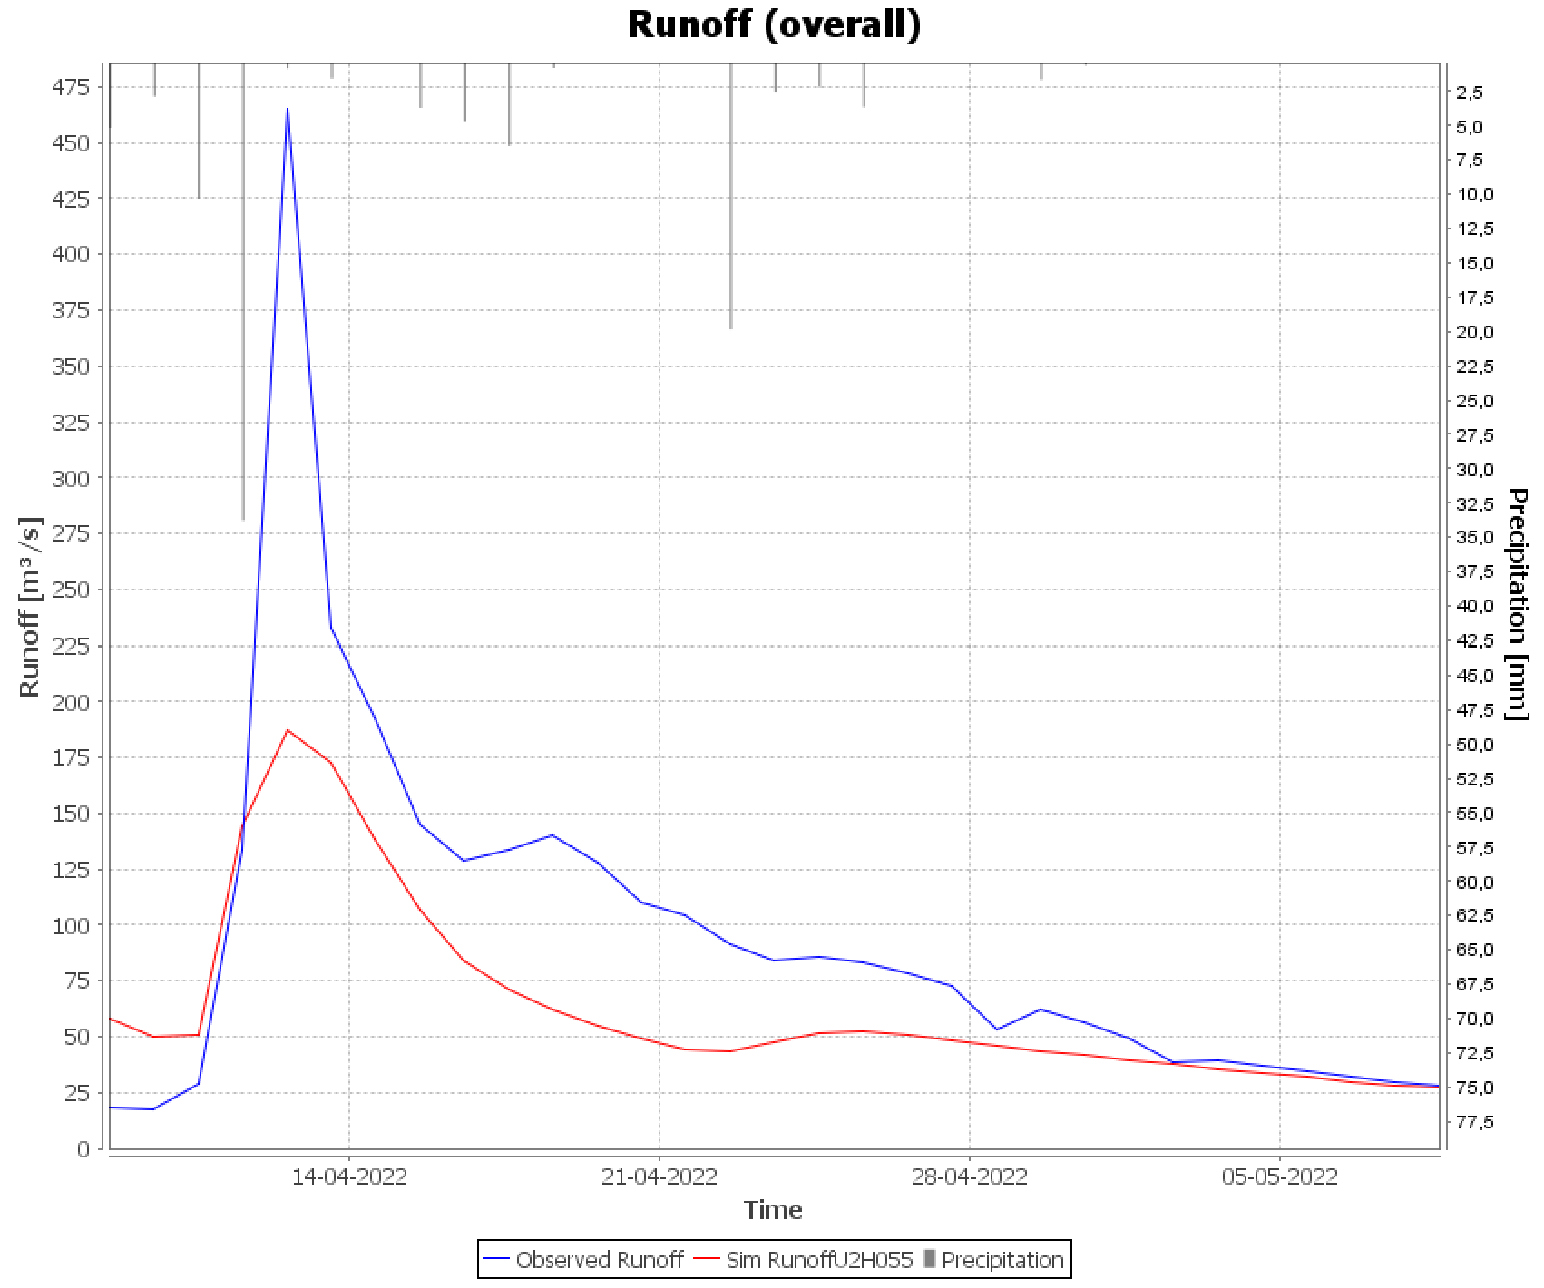
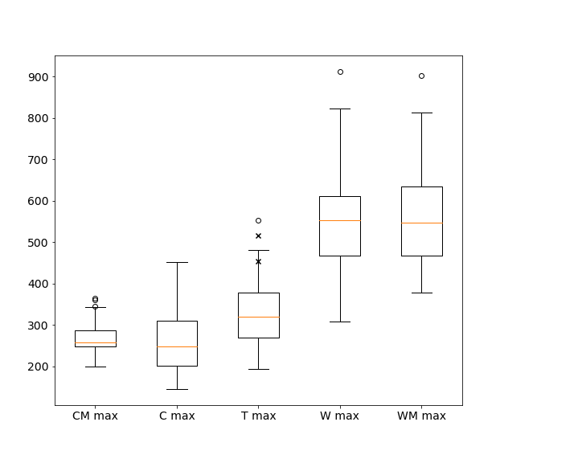
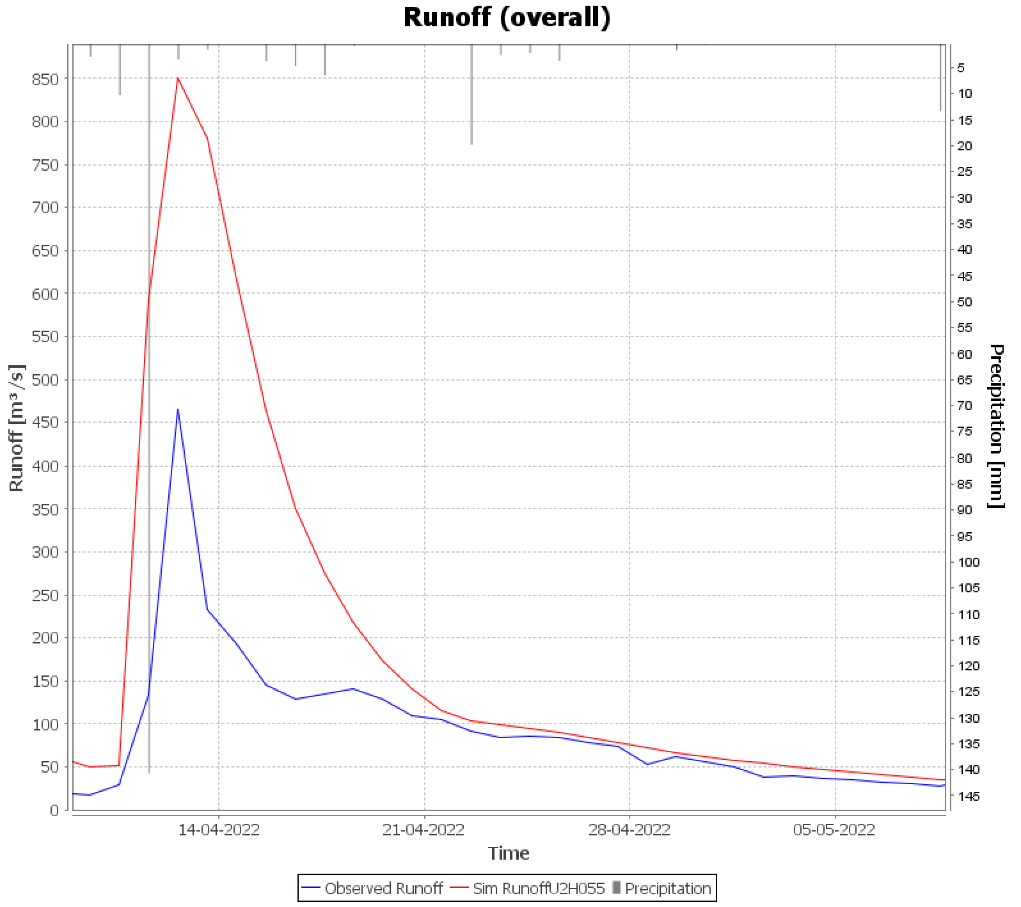
Climate change strongly amplifies flood risk
Water Risks and Resilience
Doubling of rainfall during 11-12 April 2022 and further doubling in a 2°C world
Doubling of peak flow during 11-12 April and a further doubling in a 2°C world
Simulated Runoff
(constructed cold world)
Observed Runoff (Umgeni)
Precipitation [mm]
Engelbrecht et al. (2025) Communications Earth and Environment.
Simulated Runofff
(2045 warm world)
Observed Runoff (Umgeni)
Observed peak flow for April 2022 flood vs. simulated counterfactual (upper) & 2045 warm (lower) world.
Simulated average rainfall for a cold world constructed from detrended SSTs, atmospheric temperature and moisture (CM ave), detrended SSTs and atmospheric temperatures only (C ave), the actual initial state on 11 April 2022 (T), a future warm world with trends added to SSTs and atmospheric temperatures (W ave) and a future warm world with trends added to SSTs and troposheric temperature and moisture (WM ave).

Slide 14
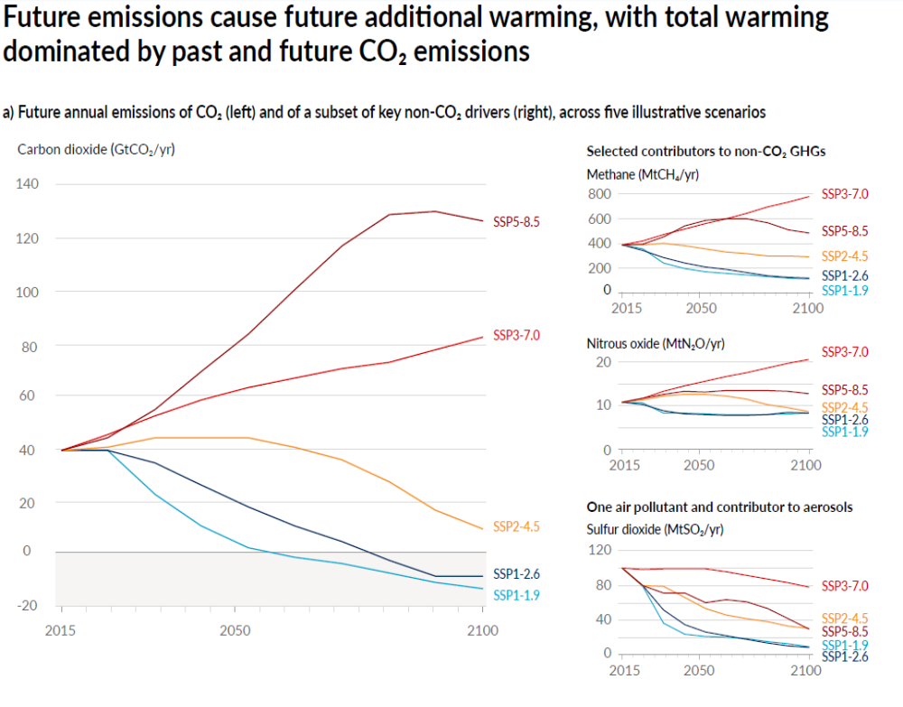
The WCRP no longer considers the worst fossil fuel scenario to be plausible:
Declining costs of renewable energy;
Climate policy
Recent observed emissions trends: global emissions have continued to increase, but much more slowly than SSP5-8.5 assumed.
Increasing evidence of emissions in China having peaked before the country’s official 2030 target
X
X

Slide 15
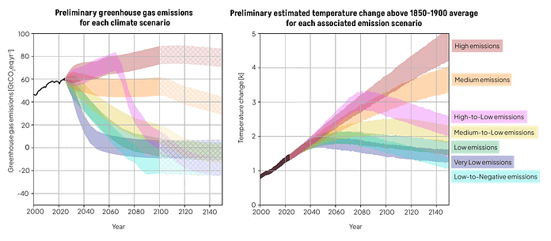
New WCRP mitigation scenarios for the Coupled Model Intercomparison Project Phase 7
X

Slide 16
Climate shocks and regional tipping points in a 1.5-2 ºC warmer world
More frequent and damaging large-scale floods along the South African east coast, Mpumalanga and Limpopo Lowveld, Limpopo River Basin and into Mozambique are likely. This implies the urgent need for climate smart DRR and longer term adaptation interventions.
Unprecedented heat waves is a major risk to human health and mortality in a 1-5-2 ºC warmer word. The lives of the vulnerable (e.g. the elderly, people with co-morbidities) living in informal housing are at risk during long-duration heat waves and in the absence of easy access to cool water.
More frequent El Niño driven droughts, including multi-year droughts, impacting on the maize crop and cattle industry (e.g. via unprecedented heat waves combined with severe drought). The tipping points, where the maize crop and cattle industry collapse in southern Africa, are estimated to be between 2 and 3 ºC of global warming.
Future day zero droughts become more frequent in the southwestern Cape in a 2 ºC world, and increase in likelihood in Gauteng (via the Integrated Vaal River System).
Wild life is fenced in across southern Africa, and vulnerable to multi-year droughts that substantially deplete grazing.

Slide 17
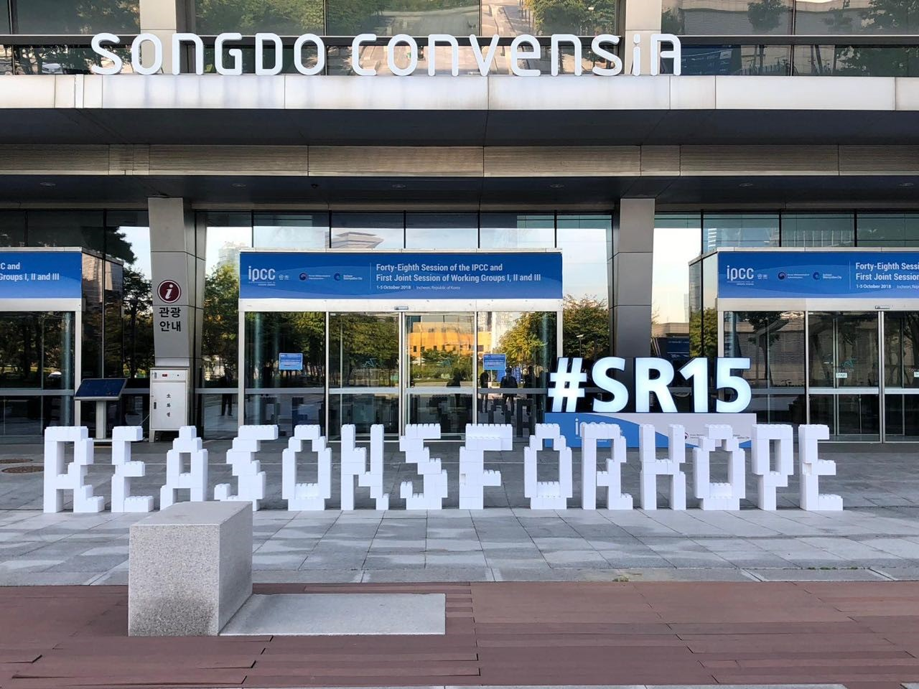
Reasons for hope
With strong climate change mitigation, we can still avoid the 2 °C threshold of global warming and related impacts.
Climate change science helps us to foresee, adapt and prepare for key risks (noting that there are also limits to adaptation).
South African government, local government and financial/private sector are increasingly engaging with climate science.

