Slide 1


Slide 2
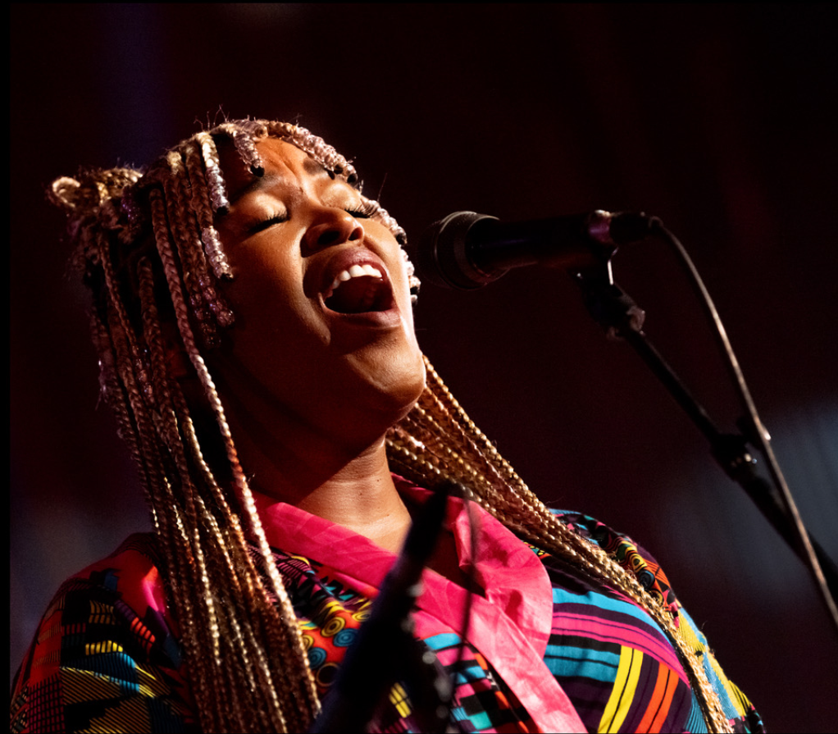
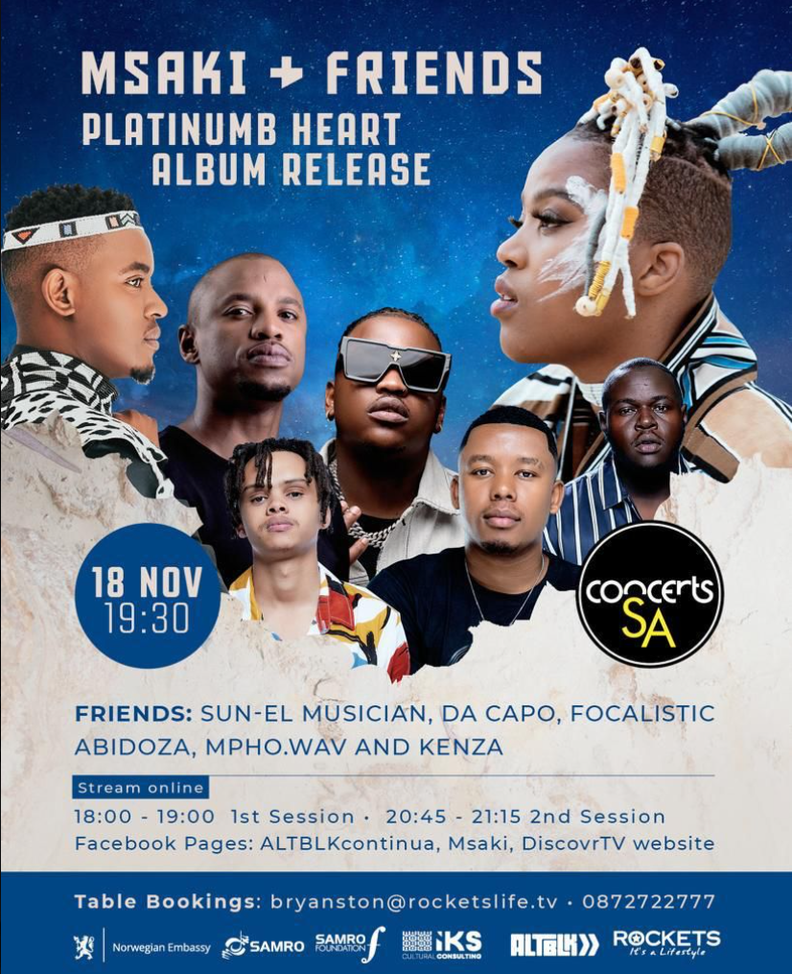

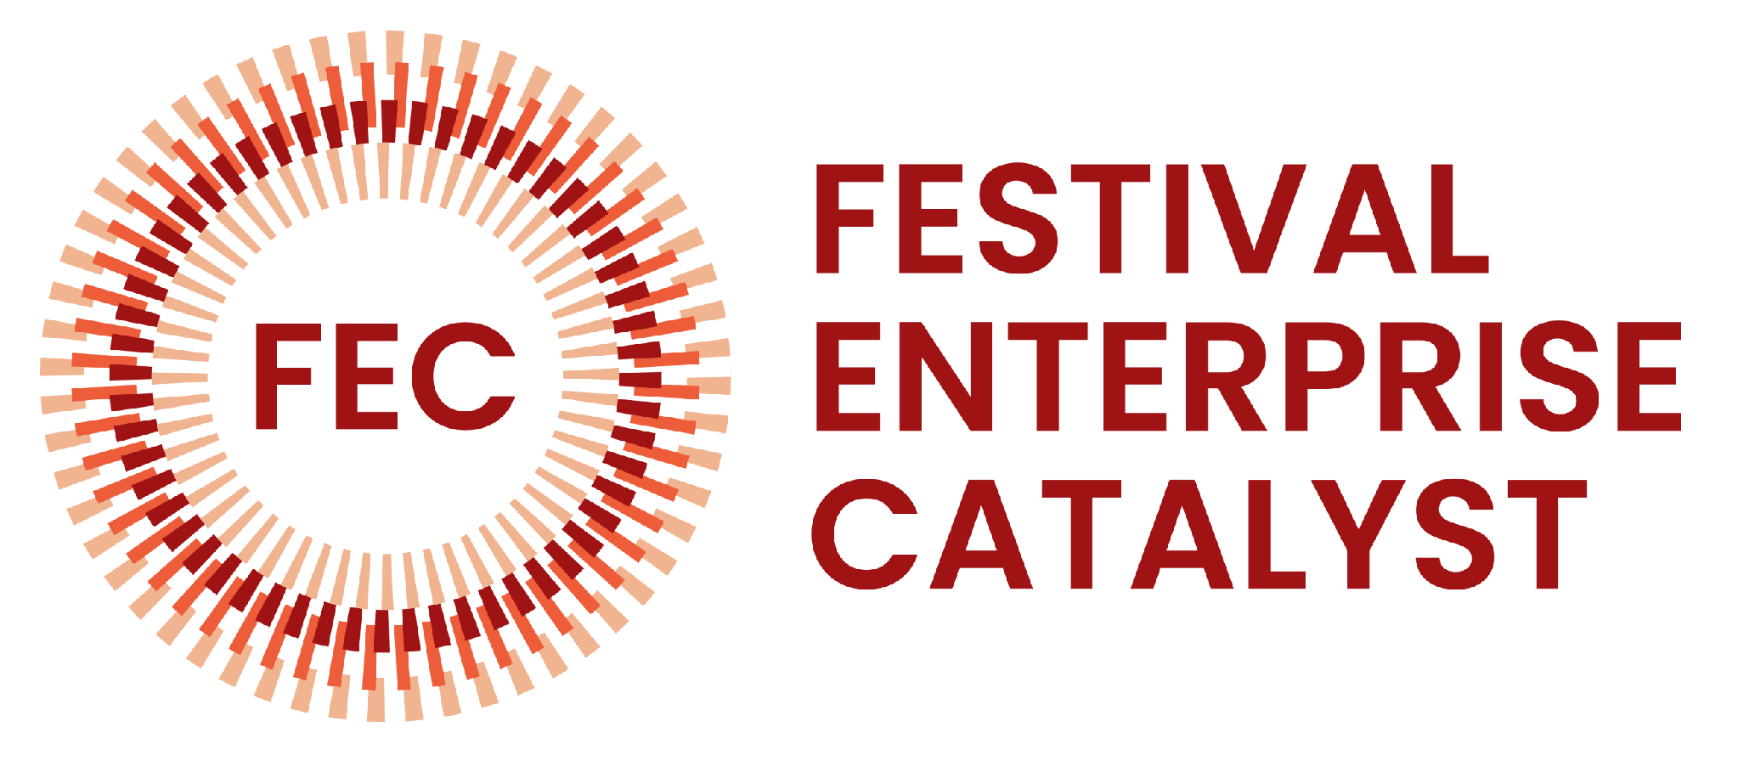


Slide 3
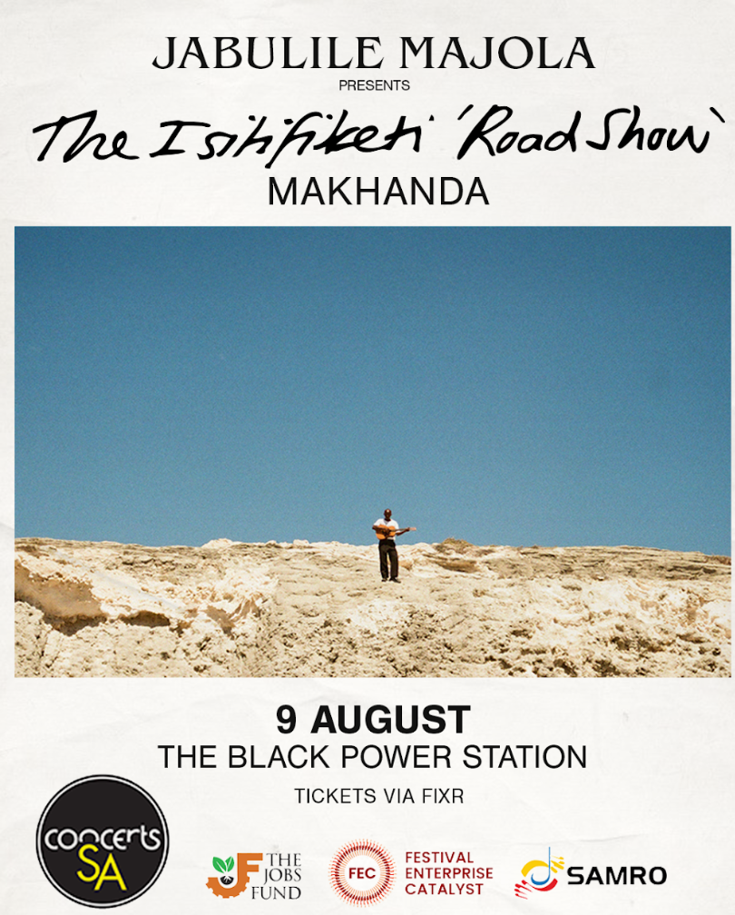
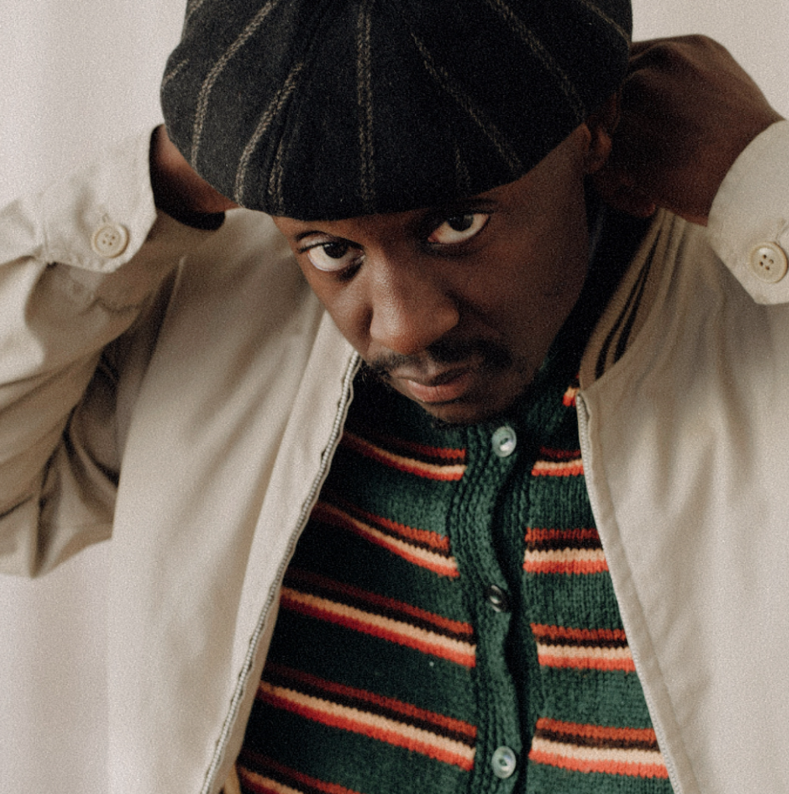

Slide 4
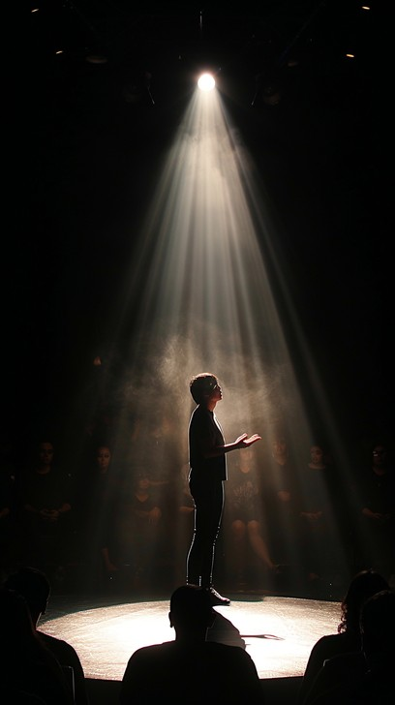
There is a tendency to think about culture through what is most visible: the festival, the concert, the new building, the celebrated artist, the major sponsorship

Slide 5
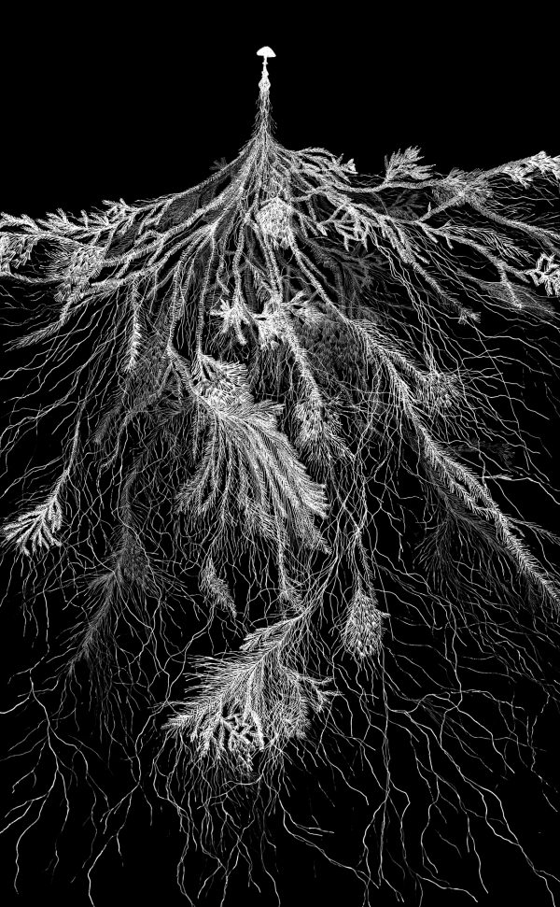
But much of culture's value happens somewhere else.
It happens between people: in relationships, networks, places, conversations, repeated encounters and the accumulation of trust.

Slide 6












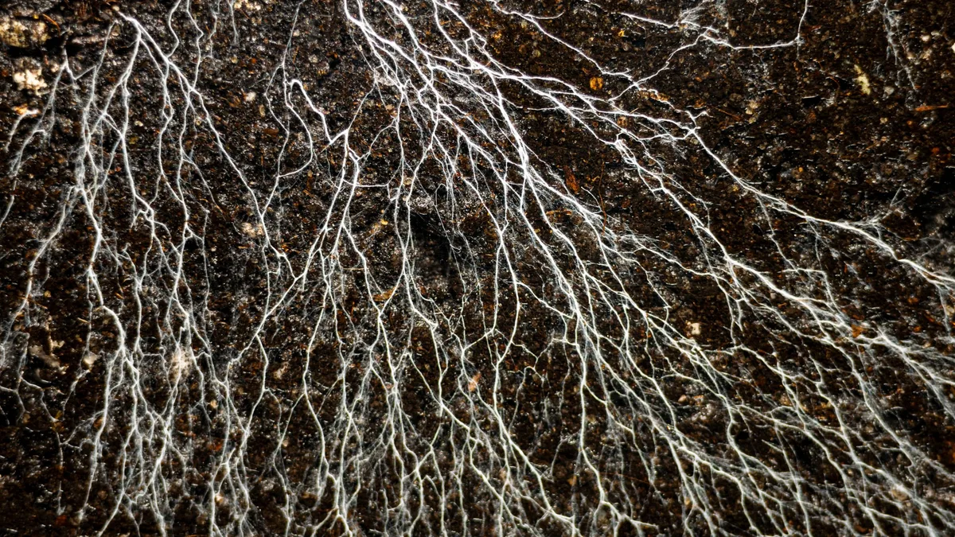
Summary | Concerts South Africa (CSA) from 2013 to 2026
More than
1.02 Million
28 330
273
355
3 980
Work Opportunities
School
concerts
Digital Mobility Fund
Grants Awarded
Concerts
Audiences in small venues / online
More than 203
13 African Countries & 9 SA Provinces
36
R74M
2 195
8
Partnerships
Workshops
Geographic Reach
Investments
Venues & Spaces
Research Projects

Slide 7
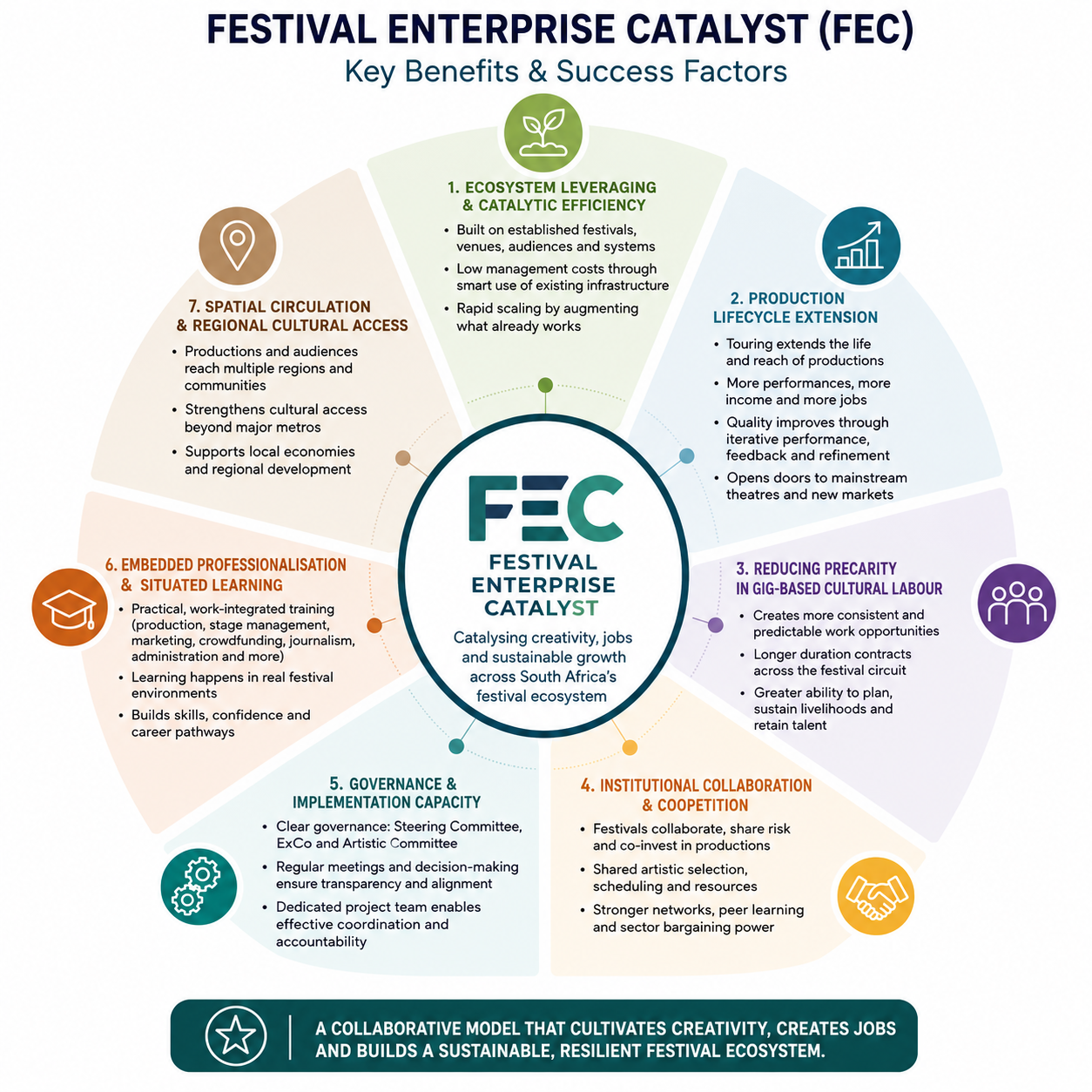

Slide 8
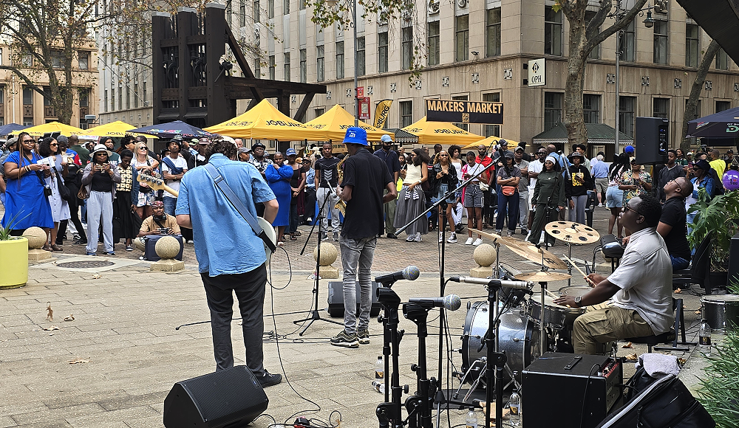
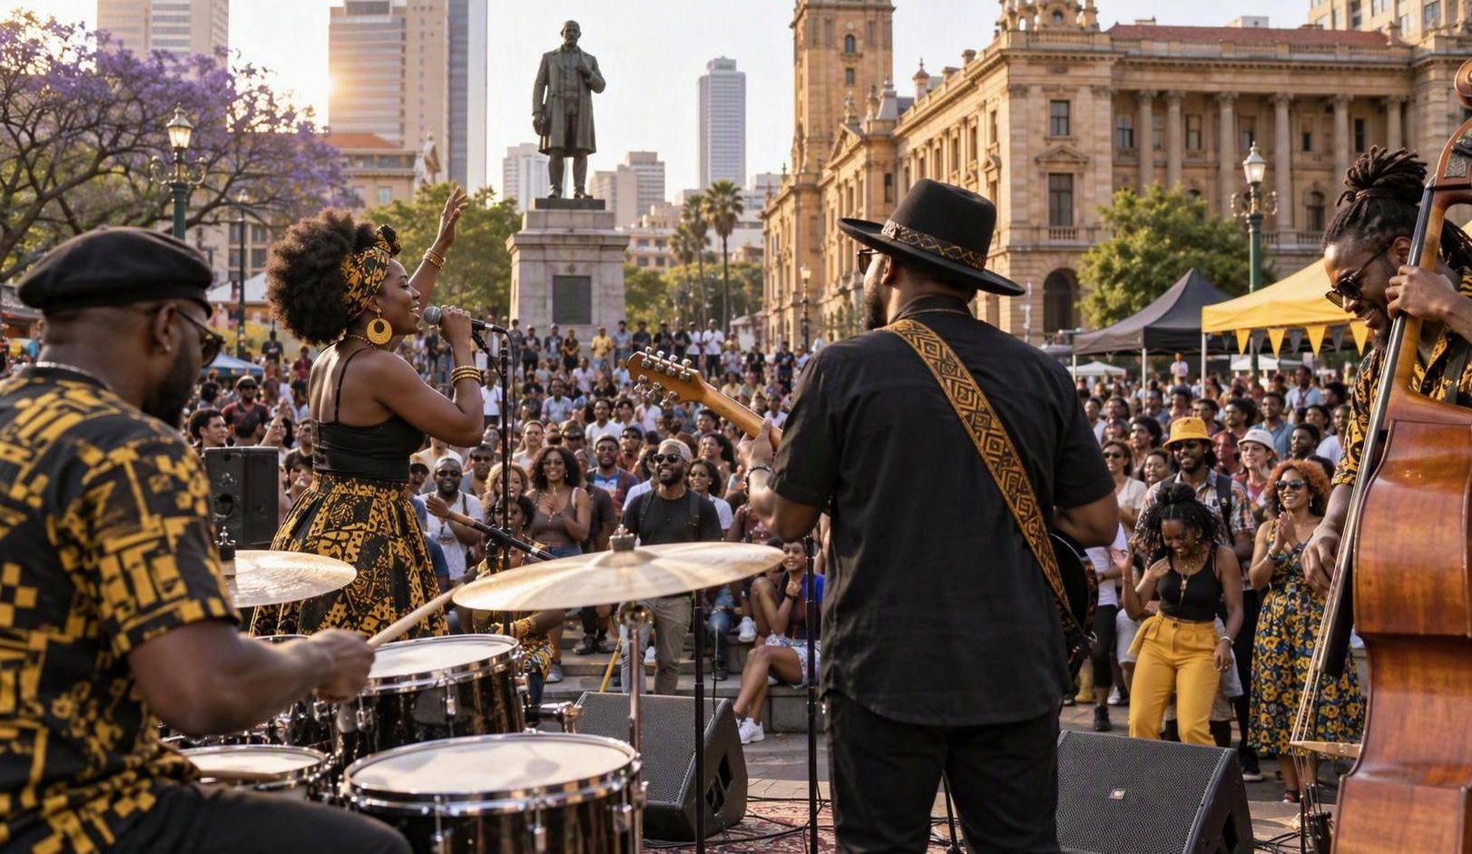
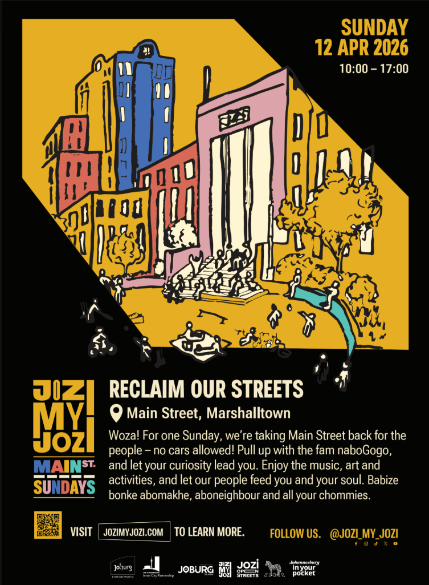

Slide 9
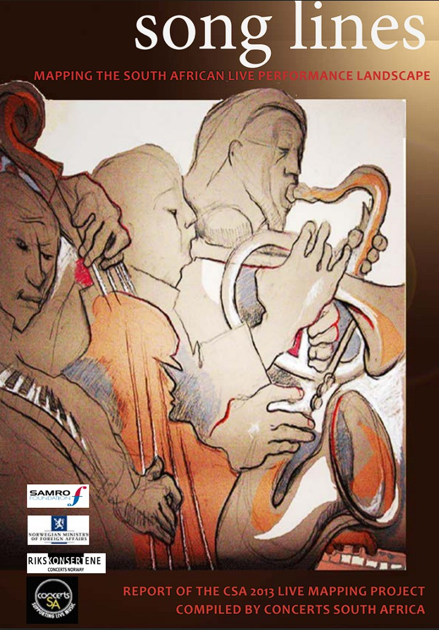
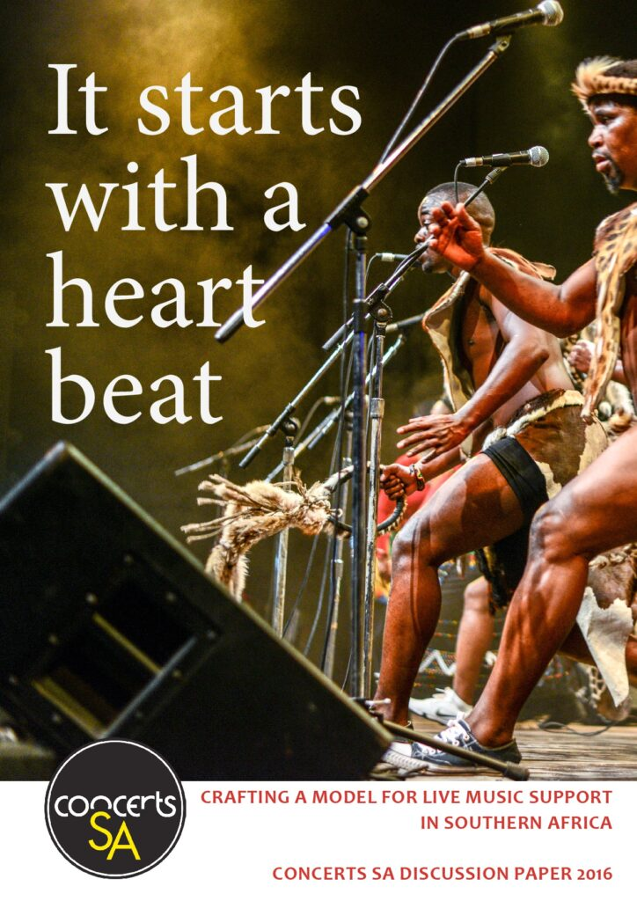
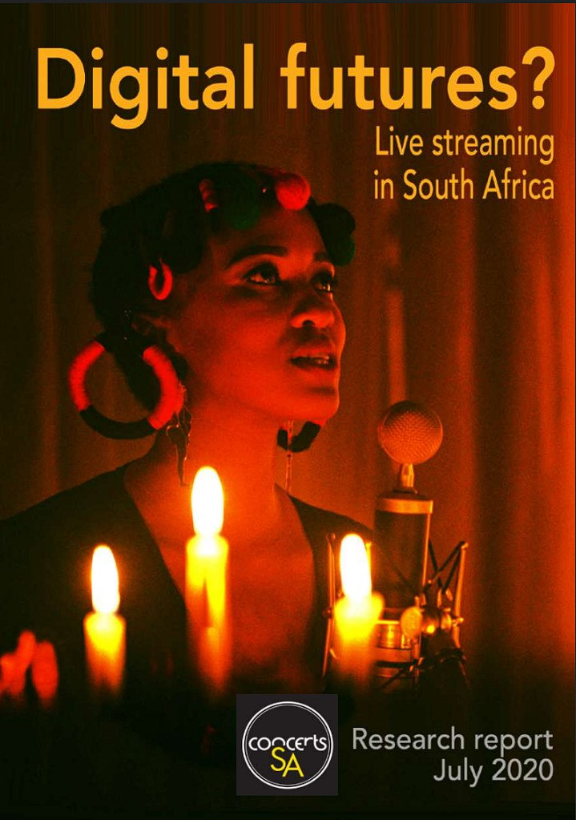
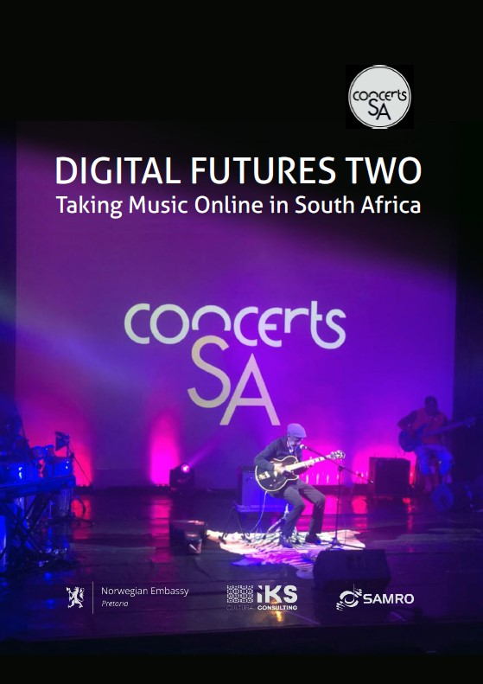
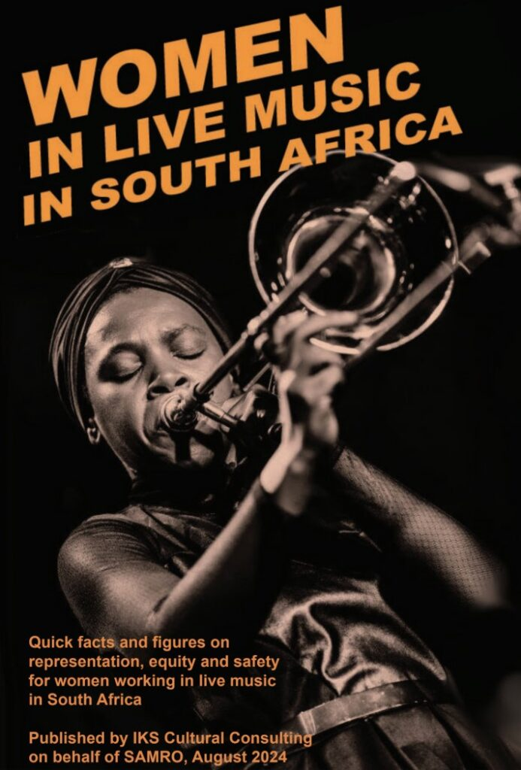
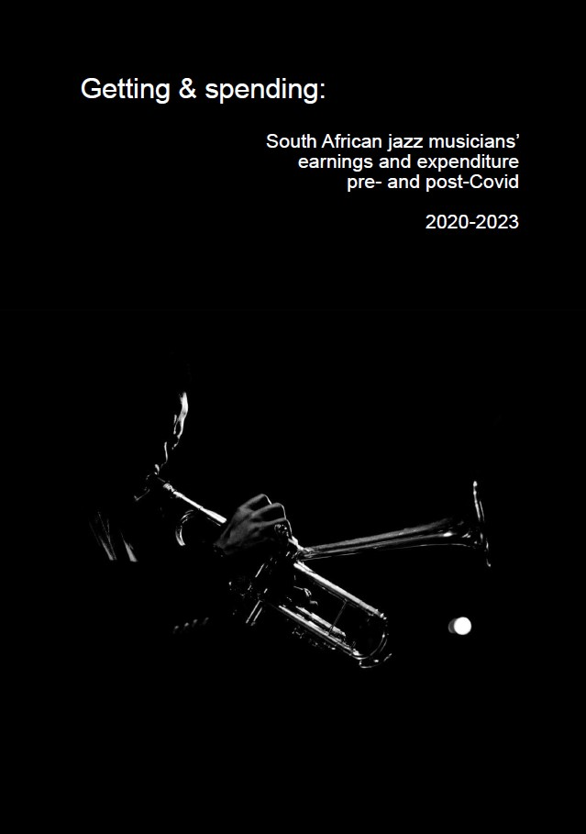
RESEARCH IS INFRASTRUCTURE

Slide 10
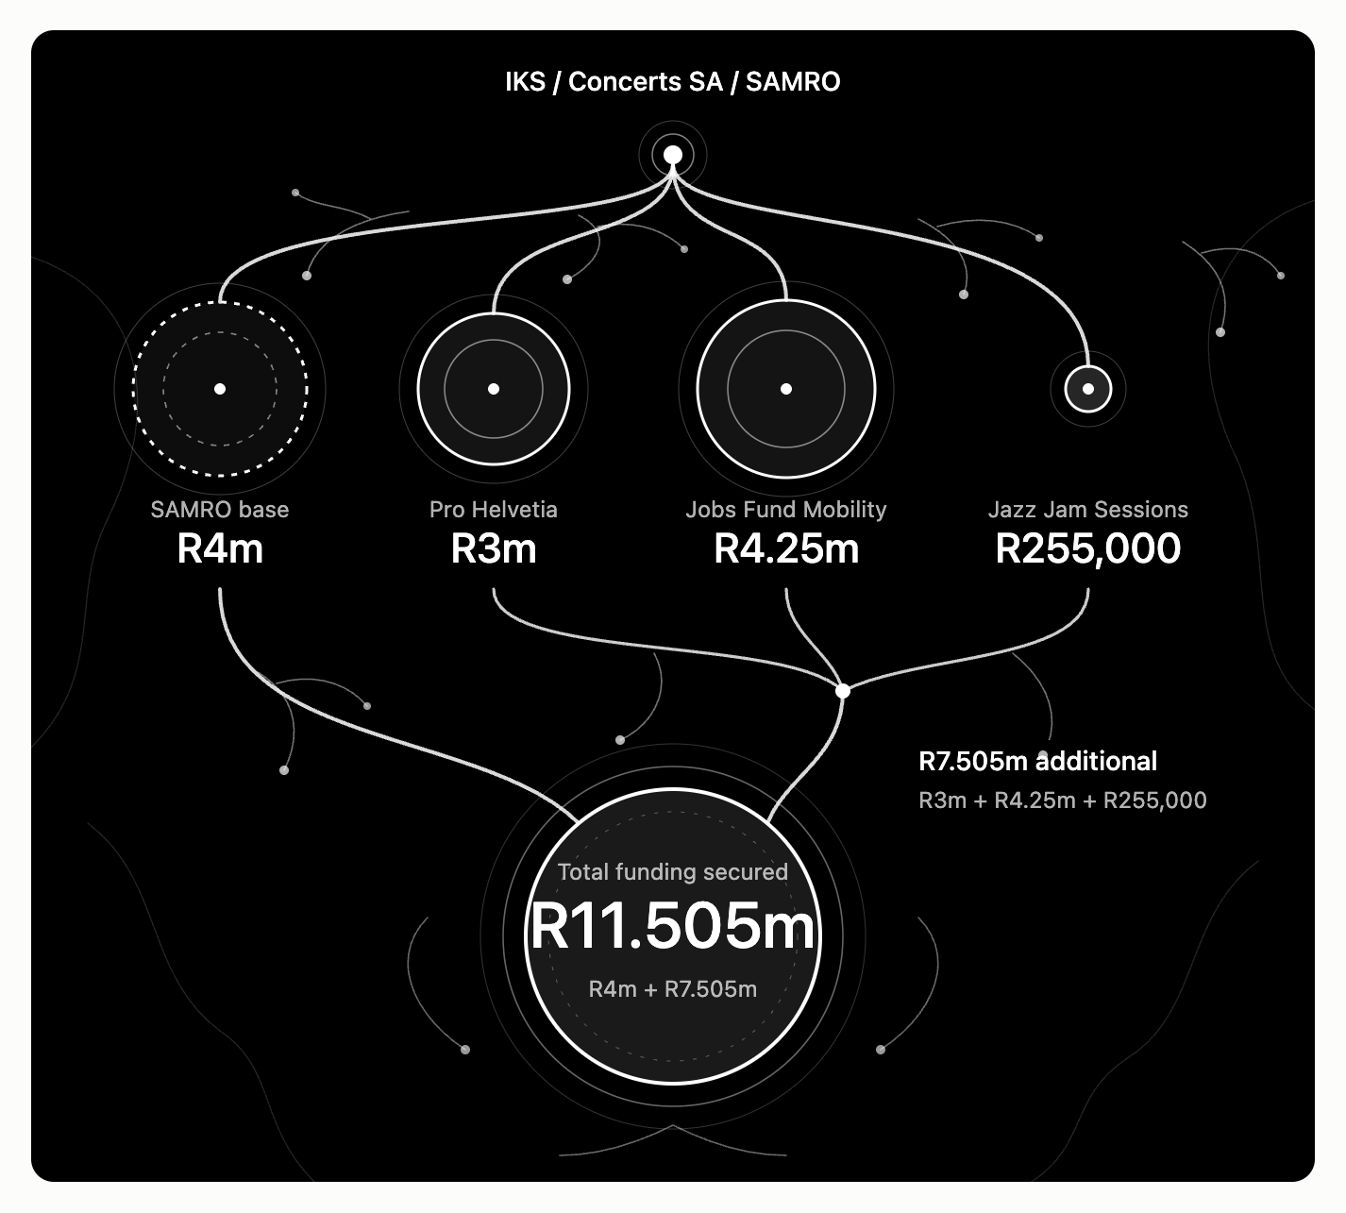
The intermediary is not overhead
The intermediary is not overhead

Slide 11
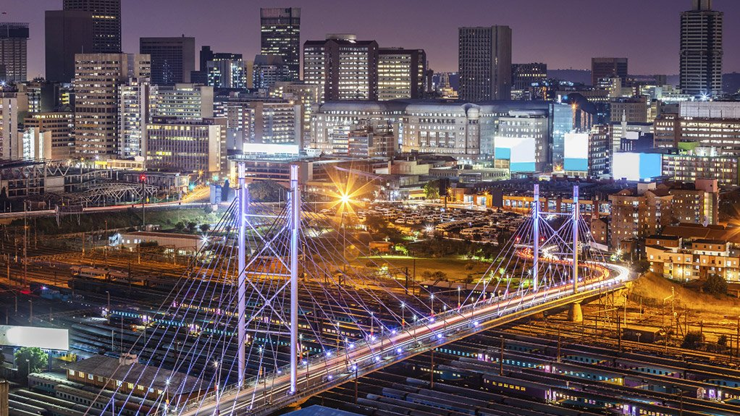
Night Economy

Slide 12
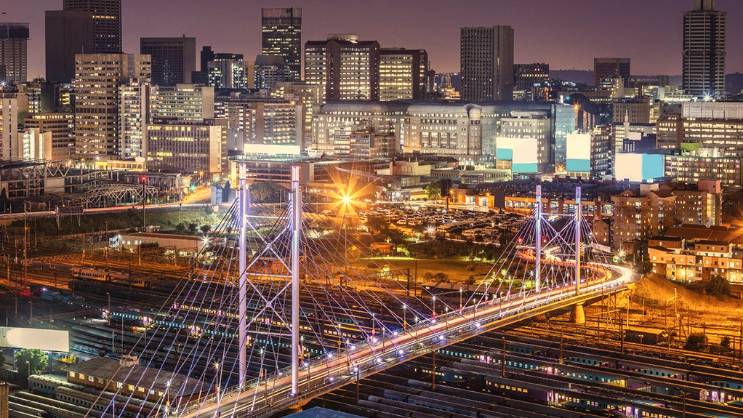
From funding cultural projects to developing cultural environments
Knowledge
Leadership
People
Networks
Mobility
Places
Markets
Intermediaries

Slide 13
