Slide 1
The fork in the road: AI, inclusion and our sector
Serious Social Investment Conference · GIBS · 7 October 2026
Leanne Emery-Hunter, CEO, Tshikululu Social Investments
Notes:
Thank you to our sponsors, Tiger Brands, Discovery, Spar and, of course, our headline partner, the FirstRand Foundation, for bringing us together on this beautiful GIBS campus for this important discussion.

Slide 2


2040: two women, the same symptoms
A big city
Medical aid, a smartphone, reliable connectivity.
Her wearable and health dashboard flag what might be wrong before she sees a doctor.
A rural community
Hours from the nearest hospital.
Unreliable connectivity, an overstretched clinic, specialist care far away.
Illustrative scenario
Notes:
I'd like to start by asking you to imagine that it is 2040, in South Africa.
Imagine two women. Roughly the same age. The same symptoms. But they live in two very different South Africas.
The first lives in Johannesburg. She has medical aid, a smartphone and reliable connectivity. Before she has even seen a doctor, her wearable device and personal health dashboard have flagged what might be wrong, drawn on her health history and helped her doctor make a better decision, earlier.
The second woman lives in a rural community, several hours from the nearest hospital. Same symptoms. But connectivity is unreliable, her local clinic is overstretched, and specialist care is a long way away.
In one version of 2040, fifteen years of extraordinary technological progress have transformed healthcare, but largely for the first woman. The second has been left behind. The gap between them is wider than it is today.
But there is another version of 2040. In that future, AI helps the nurse in her local clinic make an earlier diagnosis. It puts specialist knowledge that used to sit hundreds of kilometres away into that nurse's hands. It helps overcome language barriers. It connects her patient to the right care, in time.
[Photos: 'Healthcare_consultation' and 'Community Development_woman smiling' from the Stock Images bank. Team may prefer a rural clinic image for the right, e.g. 'Healthcare_maternal health' or 'Healthcare_clinic plaster'.]

Slide 3
Both futures are possible
The technology could be the same.
What needs to change is who we design it for, who we invest in, and who has access to it.
Notes:
The technology could be exactly the same.
What changes is who we designed it for. Who we invested in. And who we made sure could participate.
Both futures are entirely possible. Which one becomes reality is not a technology question. It is an investment question. It is a leadership question. And for those of us in this room, it is a serious social investment question.
[pause]

Slide 4

Where the money is going
<1%
Starting from inequality
South Africa is widely regarded as the most unequal society in the world.
Barriers where AI could help most
Social innovators in lower-income countries work on the problems AI could help solve. Yet, they face the greatest barriers: hardware, connectivity, skills and investment.
of AI investment is directed towards social impact, and most of the benefits stay in high-income economies
Source: World Economic Forum, 2026
Sources: World Bank, Inequality in Southern Africa (2022); World Economic Forum, AI for Impact (2024); World Economic Forum (2026).
Notes:
Let me be clear: I am genuinely excited about AI. It is already changing how we analyse data, conduct research, deliver services and make decisions. The potential for social innovation - in healthcare, education, agriculture, climate resilience and economic empowerment - is enormous.
But South Africa is widely regarded as the most unequal society in the world, with untenable levels of poverty, crime, youth unemployment, and gender-based violence and femicide. If access to AI, meaning the technology, the infrastructure, the skills and the investment behind it, follows the same patterns as everything else, we are in danger of reproducing that inequality in a new form.
And we can already see it happening. Social innovators in lower-income countries are often working on precisely the problems where AI could make the biggest difference. Yet they face the greatest barriers to the hardware, connectivity, skills and investment needed to build and scale their solutions.
According to the World Economic Forum, less than 1% of AI investment is directed towards social impact, with most of the benefits confined to high-income economies.
Less than one percent. [pause] This is not a future problem. We can already see where the money is going.

Slide 5

The starvation cycle
We fund the
programme officer
but not the data system.
We fund the laptop
but not the connectivity, the maintenance or the training.
AI makes this problem much more urgent.
We fund delivery
but we are far less
comfortable funding capability.

Slide 6
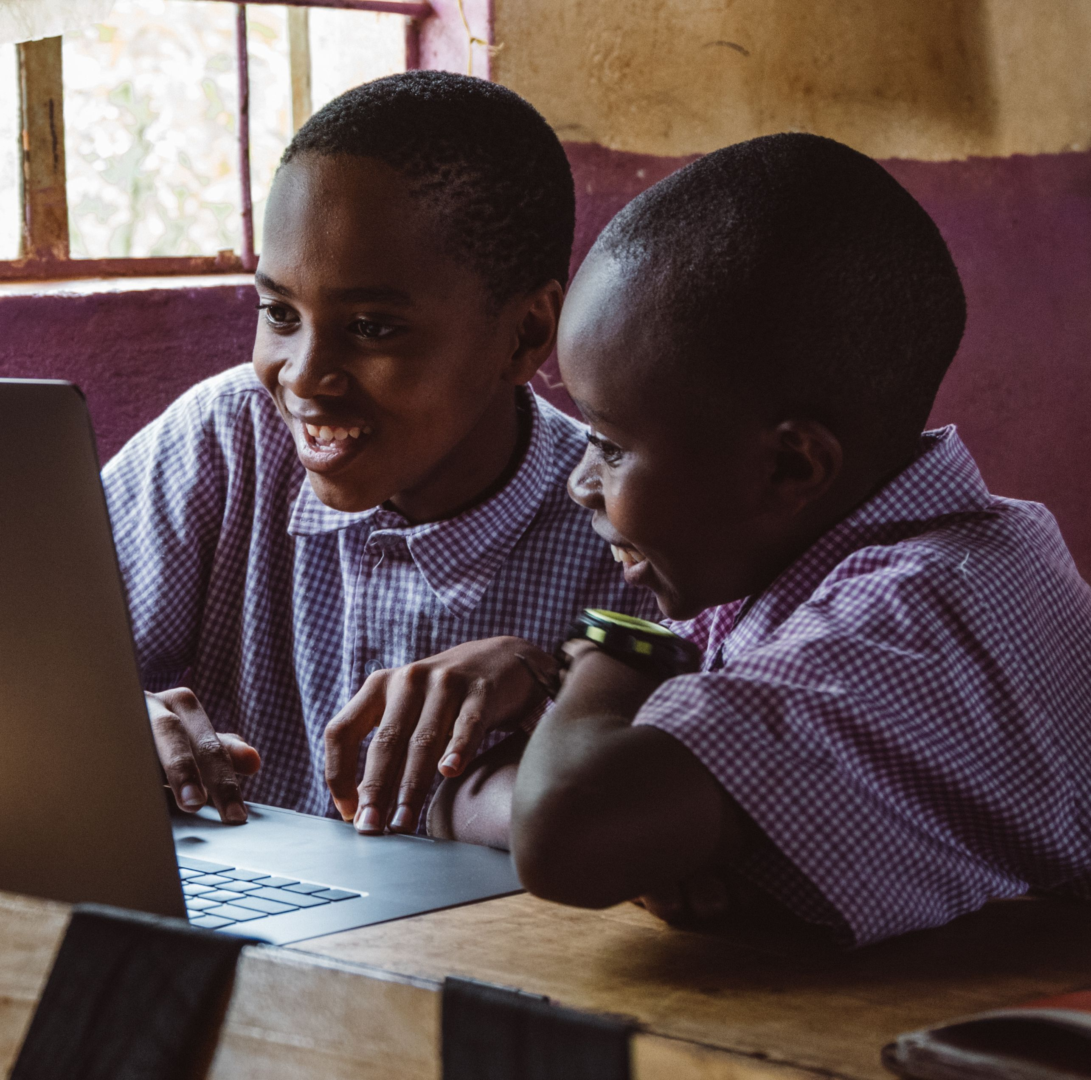
We see it in our own work
Wi-Fi in schools
Devices distributed
Teachers trained
The hard questions should be asked in the design
Who maintains the devices?
Who provides the technical support?
Who keeps training the teachers?
Who pays for the data?
Answer them at the design stage, not after the launch photographs.

Slide 7

What’s possible when we get
it right?

Slide 8
What's possible when we get it right
The Kokstad Advertiser, KwaZulu-Natal
A 144-year-old community newspaper with no digital presence in January.
When a young girl went missing, its coverage helped mobilise a community search and a police search-and-rescue operation.
The hard part is still ahead
Staff capacity, connectivity, financial systems and governance. That is the plumbing.
354,000
people a month at its peak, reached online by March through the Digital News Transformation Fund
Source: Digital News Transformation Fund half-year progress, 2026
Digital News Transformation Fund: a partnership between Google and the Association of Independent Publishers, administered by Tshikululu.
Notes:
Let me show you what's possible when we get it right. In January this year, the Kokstad Advertiser, a 144-year-old community newspaper in KwaZulu-Natal, had no digital presence at all. By March, through the Digital News Transformation Fund, which Tshikululu administers, it was reaching up to 354,000 people a month. When a seven-year-old girl went missing, its coverage helped mobilise a community search and a police search-and-rescue operation. But the newsrooms themselves will tell you the hard part is still ahead: staff capacity, connectivity, financial systems and governance. That is the plumbing.
[pause]
[Optional: photo of the Kokstad Advertiser, with the newsroom's permission.]

Slide 9

Three key questions in the age of AI
01
02
03
Who benefits?
Who bears the costs?
Who gets to shape it?
Technology companies, investors, and the organisations and people with the skills and resources to use AI.
One in four workers globally is in a job with some exposure to generative AI. Clerical and customer-service roles, often a first job, are most exposed.
118 countries, mostly in the Global South, are not part of any of the major AI governance initiatives. Only seven are part of all of them.
Sources: (02) International Labour Organization, Generative AI and jobs: 2025 update; (03) United Nations, Governing AI for Humanity (2024).
Notes:
So when we talk about inclusion, we usually ask one question: who has access? AI demands that we ask three. Who benefits? Who bears the costs? And who gets to shape it?
Who bears the costs? Start with jobs. According to the International Labour Organization, one in four workers worldwide is in a job with some exposure to generative AI. Most of those jobs will be transformed rather than lost. But the most exposed are clerical and customer-service roles, and women are more exposed than men. In South Africa, those are often the jobs that give a young person their first step into work. If AI removes that first rung and we don't build another, we deepen exclusion in a country where so many young people are already locked out.
The costs may also fall on communities without the infrastructure to participate, and even on countries like ours, carrying some of the energy and environmental costs of the infrastructure that powers AI.
And then there is the question of who shapes the rules. My own research has made me think hard about the difference between being invited into a conversation and having the power to shape it.
A United Nations advisory body found that 118 countries, most of them in the Global South, are not part of any of the major international initiatives on how AI should be governed. Only seven countries are part of all of them. The Global South can have a seat at the table without having an equal voice. And the same is true of the communities we serve.
Inclusion isn't being given access to a technology somebody else designed. It is having agency in the future that technology is creating.

Slide 10
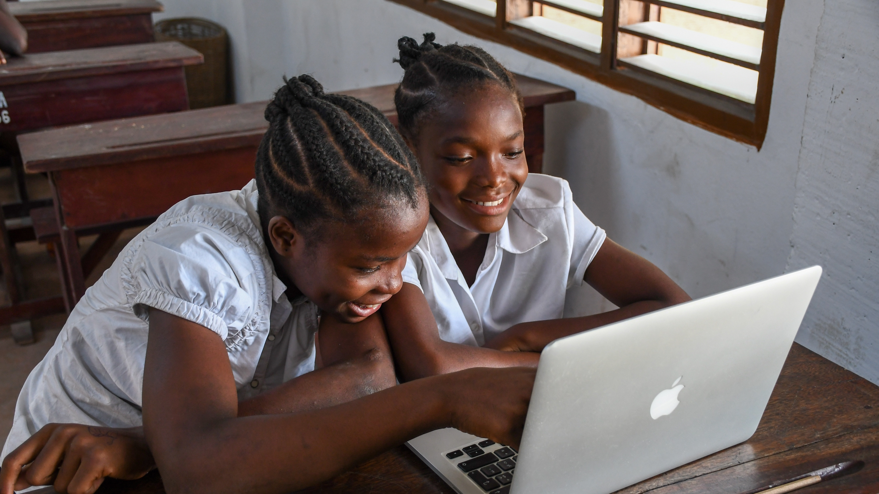
Access without capability, agency, trust and sustainability
is not meaningful inclusion.

Slide 11
Where our value lies
AI can read a thousand grant applications. It does not notice who
isn't speaking.
Judgement. Relationships. Context. Governance. Making sure resources actually reach the people they are meant for.
Notes:
So what does this mean for organisations like ours? AI will make much of our work faster and cheaper, and we should embrace that. But AI can read a thousand grant applications. It cannot sit in a community meeting and notice who isn't speaking. It cannot build the trust that brings a corporate funder, a government department and a community organisation around the same table.
That is where our value lies: judgement, relationships, context, governance, and making sure resources actually reach the people they are meant for.

Slide 12
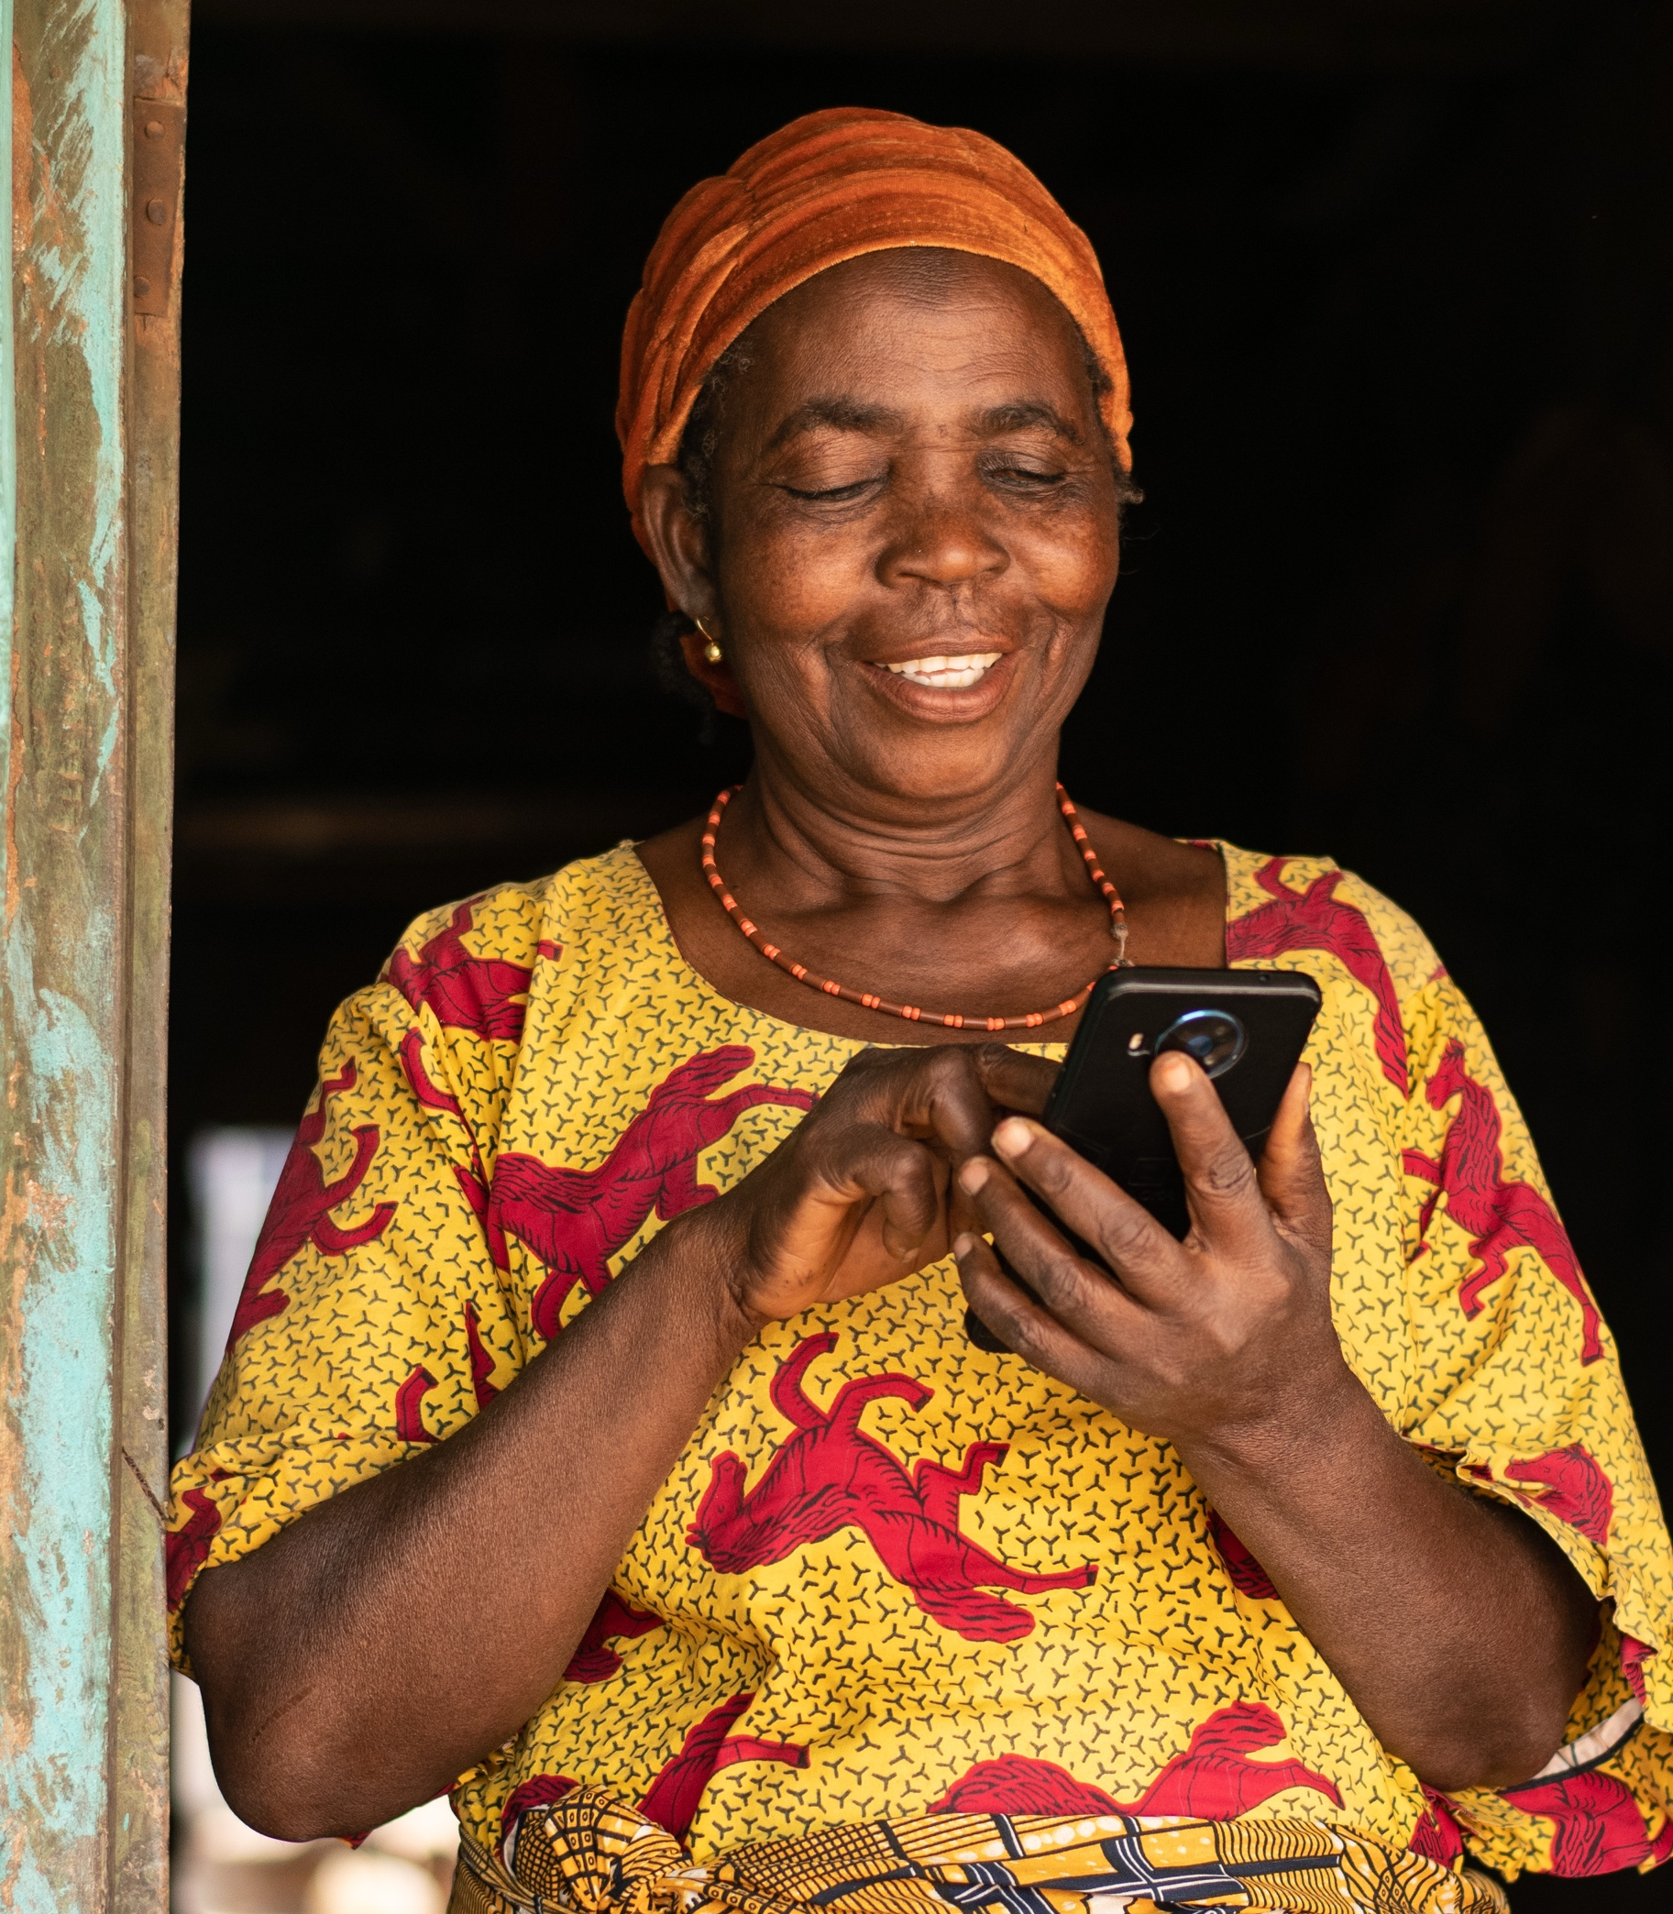
What does this mean for us?
Use AI to make ourselves better
Stronger systems, better data, less repetitive work and more time for the work that matters.
Make sure the benefits reach further
Make sure AI's benefits reach the people and organisations the market won't prioritise.

Slide 13
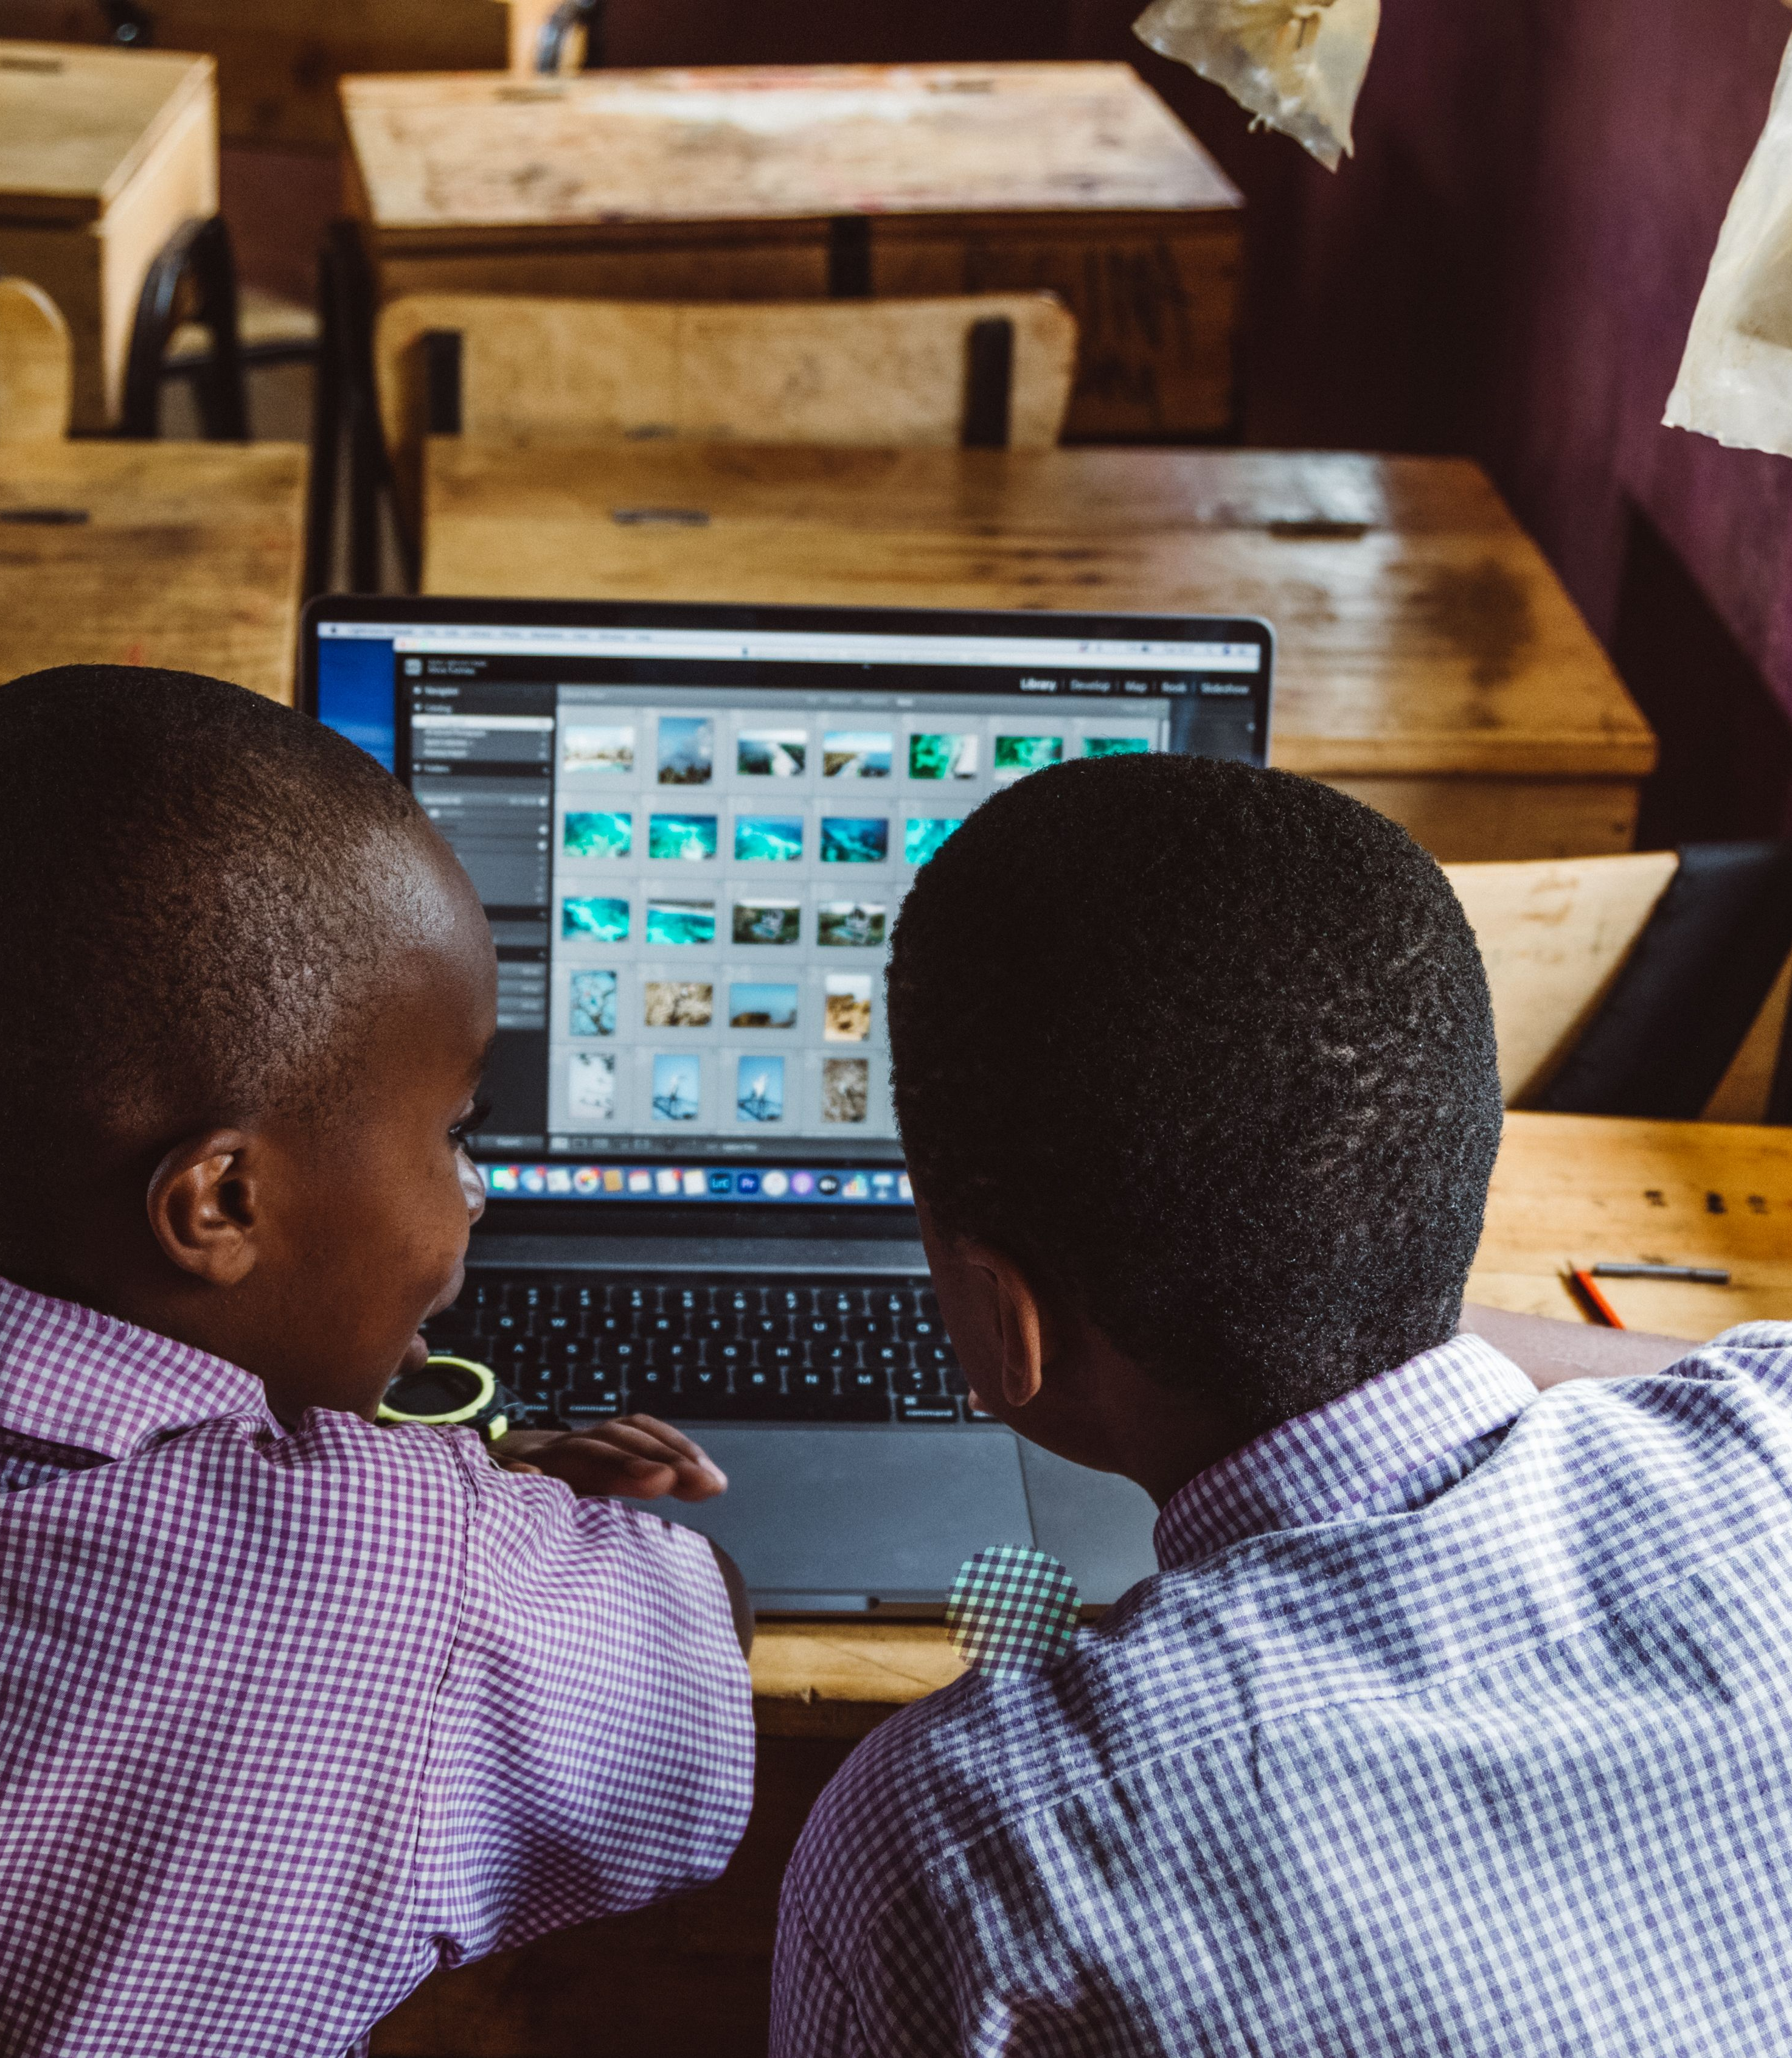

Socio-economic development implementation partner
SSI Conference 2026 | The fork in the road
Notes:
So we have to do two things at once. Use AI to make ourselves better, with stronger systems, better data, less repetitive work and more time for the work that matters. And make sure the benefits of AI reach the people and organisations the market won't prioritise.
That is why I am so proud that Tshikululu has been appointed as the socio-economic development implementation partner for the B20 Digital Inclusion Fund. What excites me isn't the technology. It is the chance to be deliberate about who participates in digital transformation.
[pause]

Slide 14
Three things I'd leave us with
Fund the
plumbing
Fund inclusion deliberately
Govern this process properly
Data, systems, connectivity, cybersecurity, skills. Part of programme delivery, not overhead.
NPOs: tell us what it really costs.
Markets take technology to people who can pay. We can take risk, test models, fund localisation and build capability.
It starts with us: boards that understand AI, clear policies, protected data. Give communities a voice. Measure lives improved.
SSI Conference 2026 | The fork in the road
Notes:
So I would leave us with three things.
First: fund the plumbing. Data, systems, connectivity, cybersecurity, skills, organisational capability. These aren't overheads to squeeze out of every grant. They are part of programme delivery. And to the NPOs in the room: tell us what it really costs. Don't hide it to look lean.
Second: fund inclusion deliberately. Markets are very good at taking technology to people who can pay for it. Social investment has a different job. We can take risk where markets won't. We can test models, fund localisation, build capability, and back innovations designed around the realities of the people we serve.
Third: govern it properly. AI raises real questions about bias, privacy, accountability, misinformation and trust. Communities cannot simply be recipients of technology. They need a voice in how it is designed, delivered and evaluated. And we must hold ourselves accountable not for whether we deployed the technology, but for whether it actually improved people's lives.
And governance starts with us. It is not enough to fund impact programmes alongside government. We need the leadership and governance, in our own organisations and in those we fund, to sustain them: boards that understand AI, clear policies on how we use it, and real protection for the data we hold about the people we serve. Some of that data belongs to the most vulnerable people in this country. We owe them that care.
[pause]

Slide 15
Back to 2040
Technology alone will not decide which version of 2040 we inherit.
We will.
Through what we choose to fund, what we are brave enough to experiment with, the organisations we strengthen and the voices we include.
Notes:
Which brings me back to those two women in 2040.
The technology will exist. The question is who it will serve.
Technology alone will not decide which version of 2040 we inherit.
We will.
Through what we choose to fund. Through what we are brave enough to experiment with. Through the organisations we strengthen. Through the voices we include.
The second woman in my story isn't real. But somewhere in rural South Africa today there is a young woman who will be her in 2040. Which version of 2040 she lives in is being decided now, in rooms like this one.
AI is going to change our sector. Let's make sure it closes the gaps we already have, rather than deepening them.

Slide 16
Thank you
Leanne Emery-Hunter
Tshikululu Social Investments
www.tshikululu.org.za
Notes:
Thank you.

