Slide 1
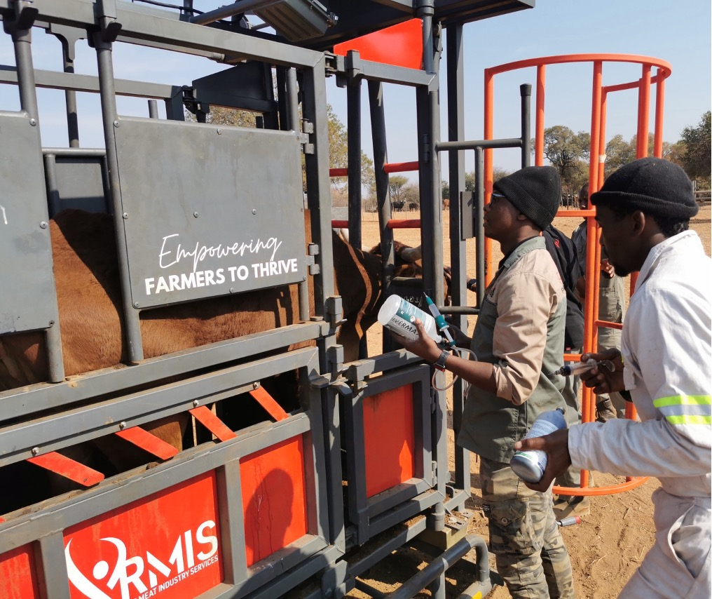

INCLUSIVE GROWTH
BUILDING RESILIENT LIVESTOCK SYSTEMS
www.rmis.co.za
PRESENTED BY DR PHILLIP OOSTHUIZEN
CHIEF OPERATIONS OFFICER

Slide 2

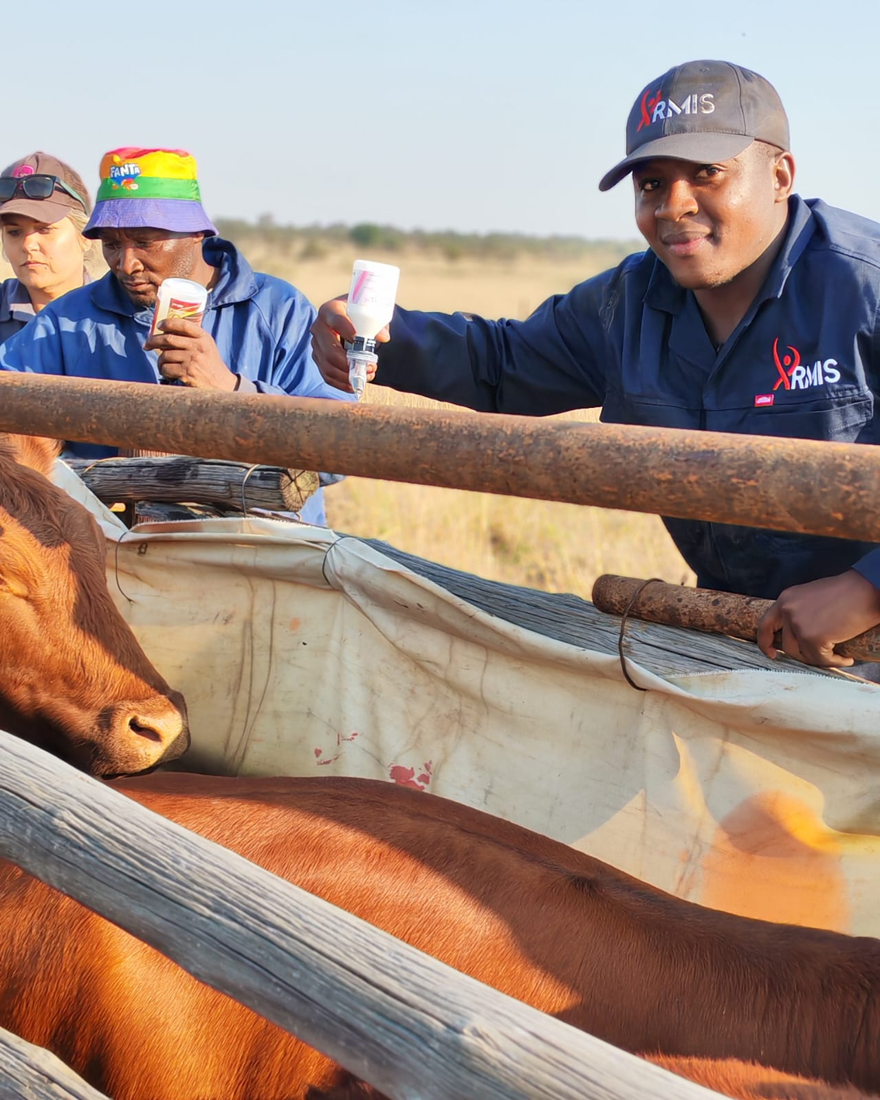
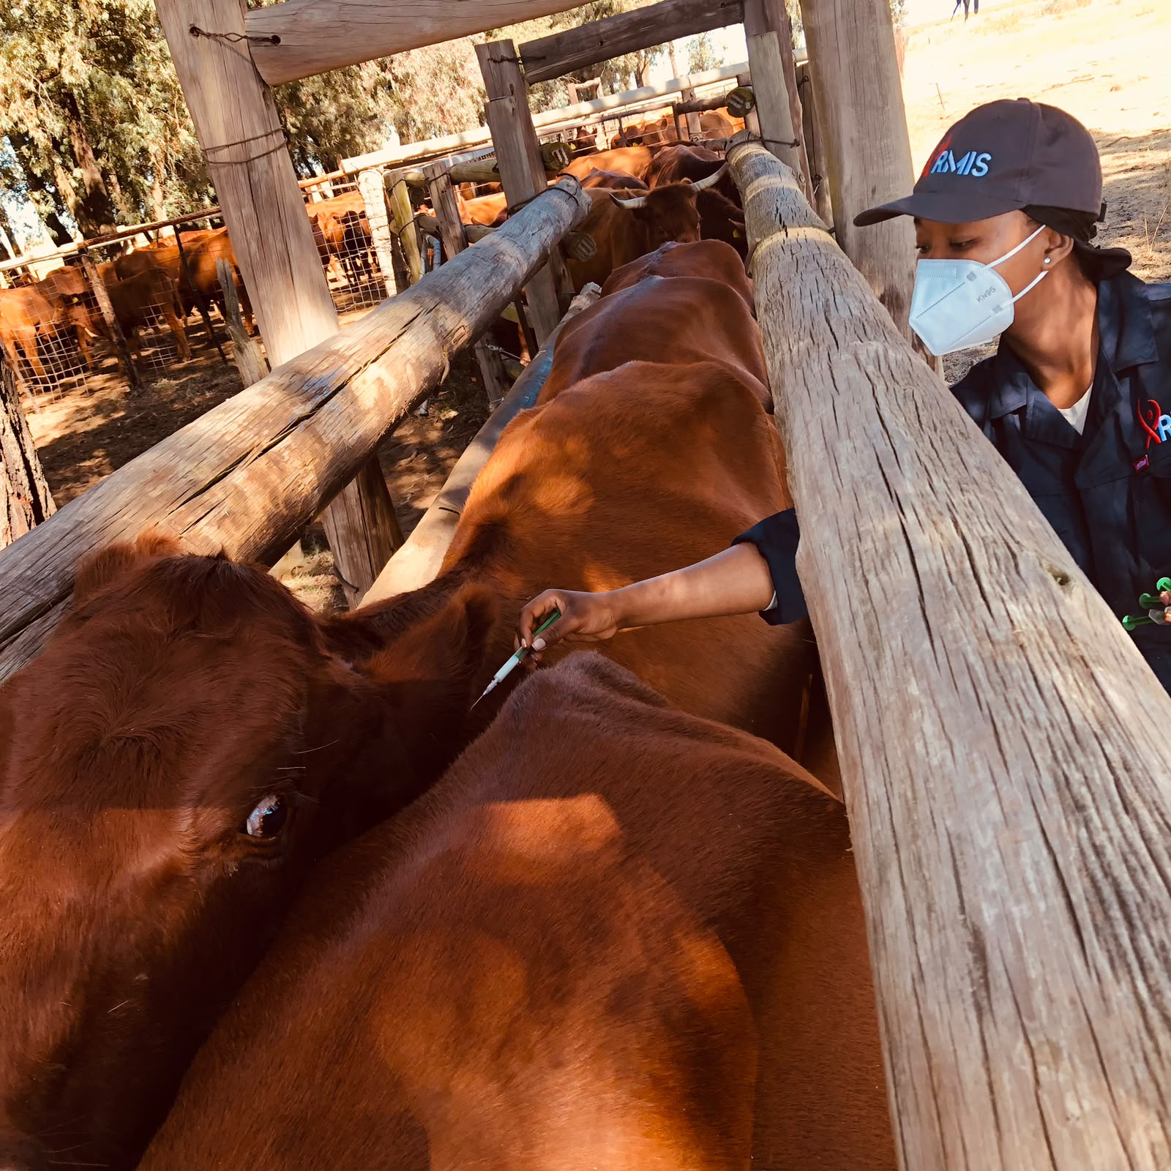
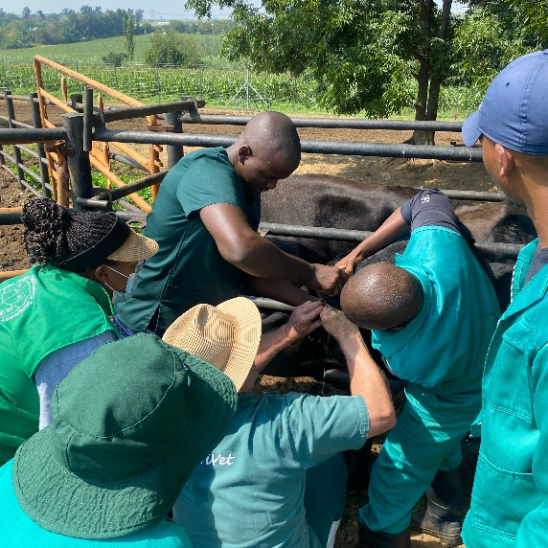
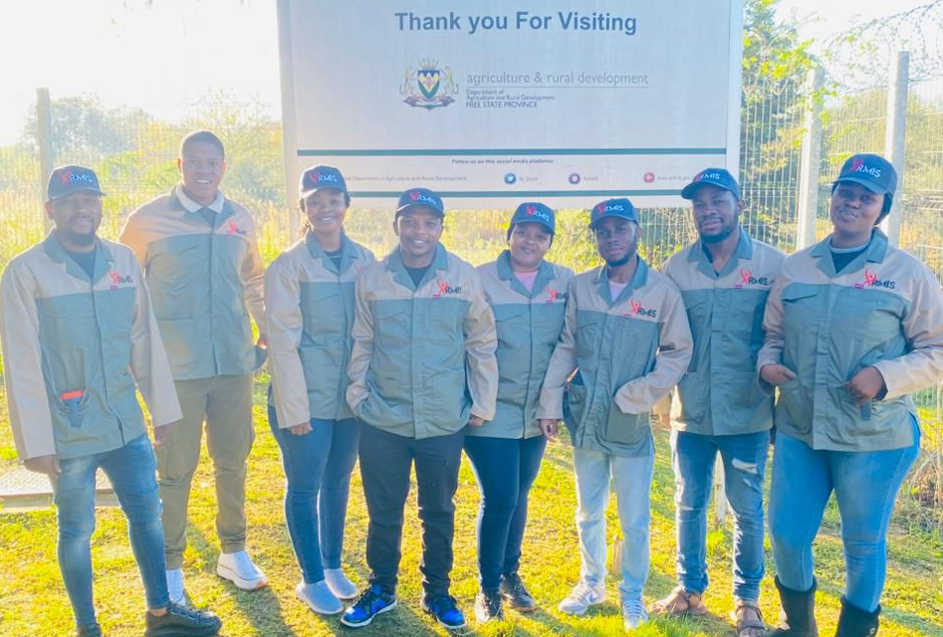
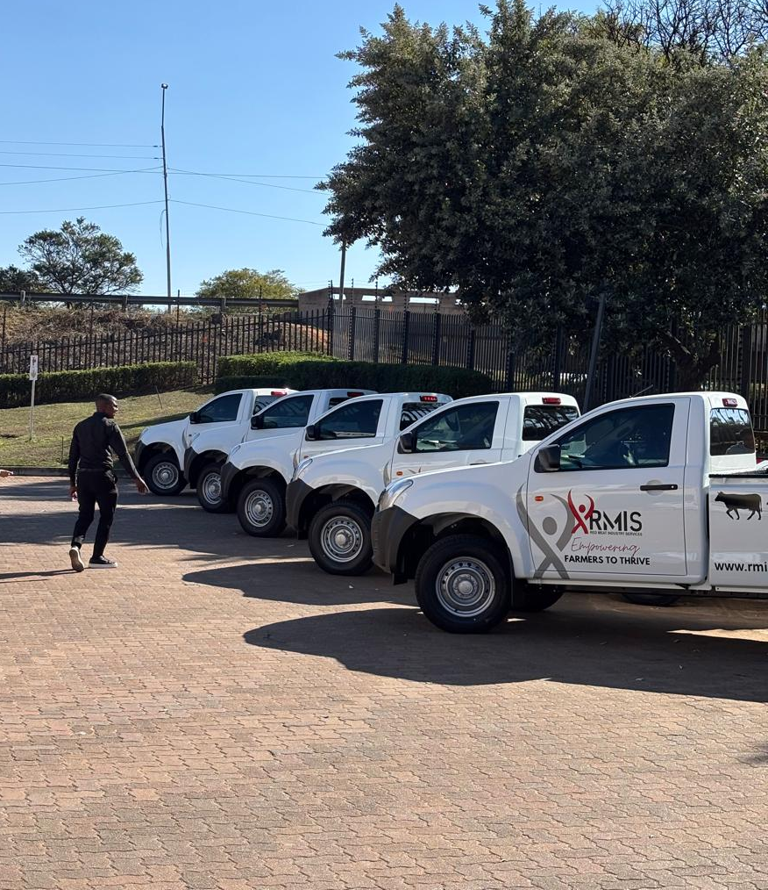
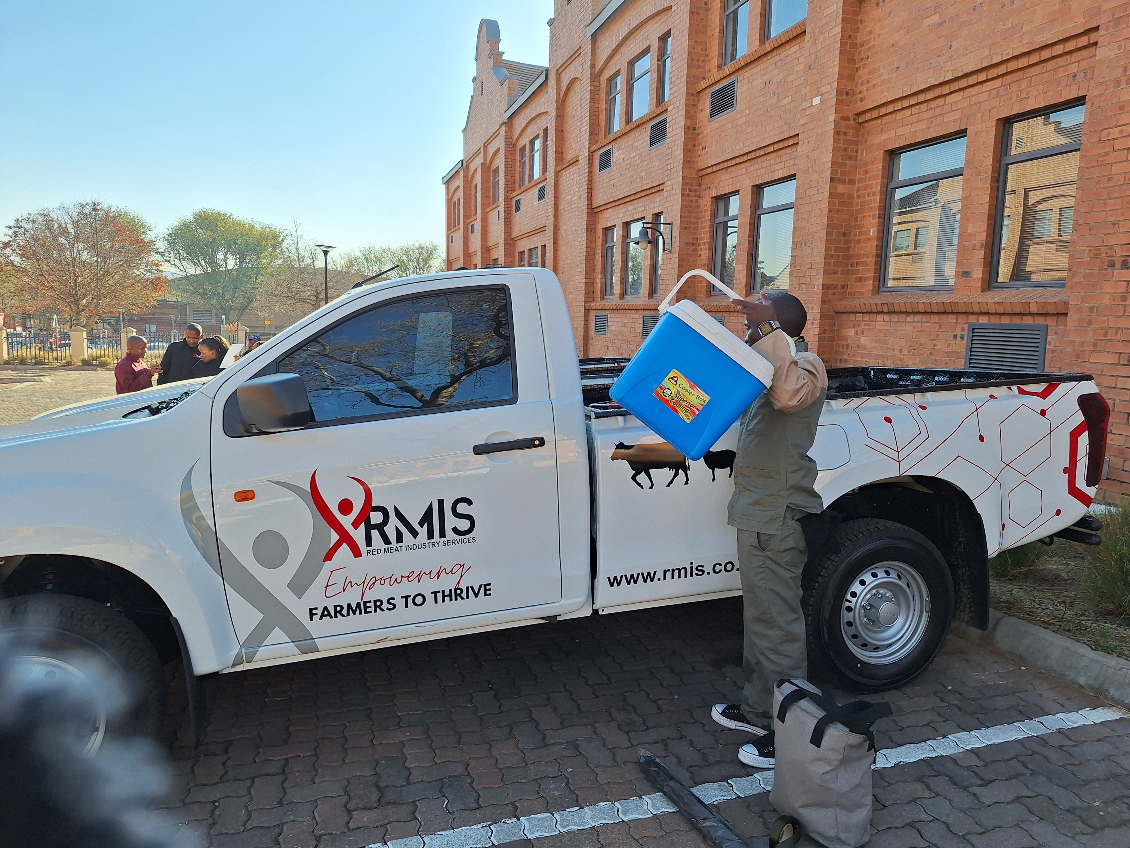
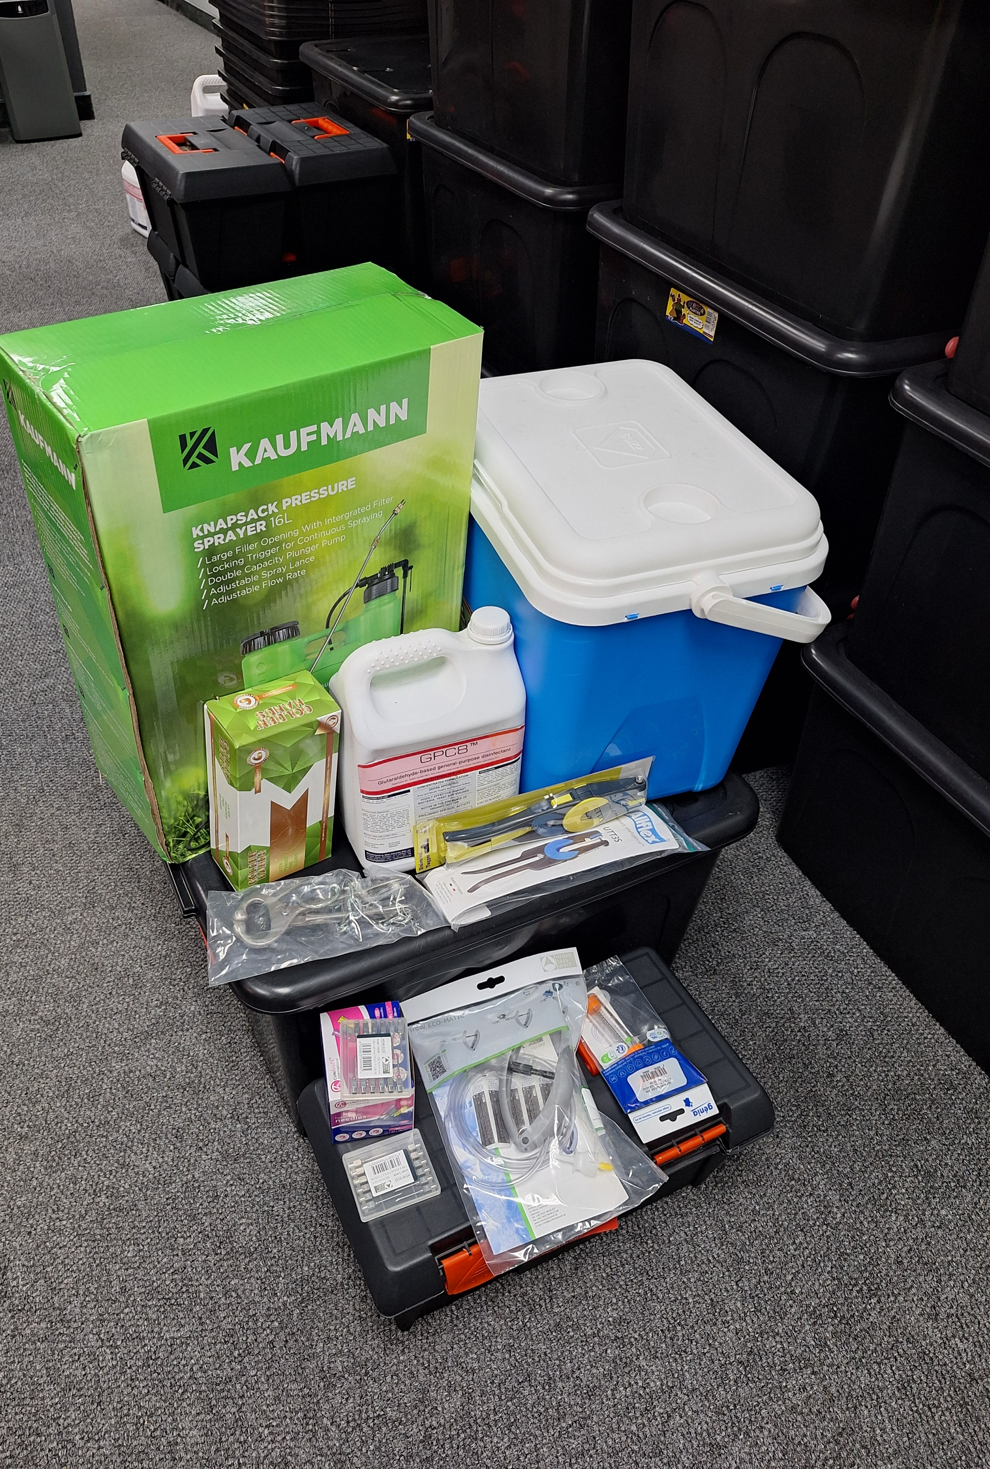
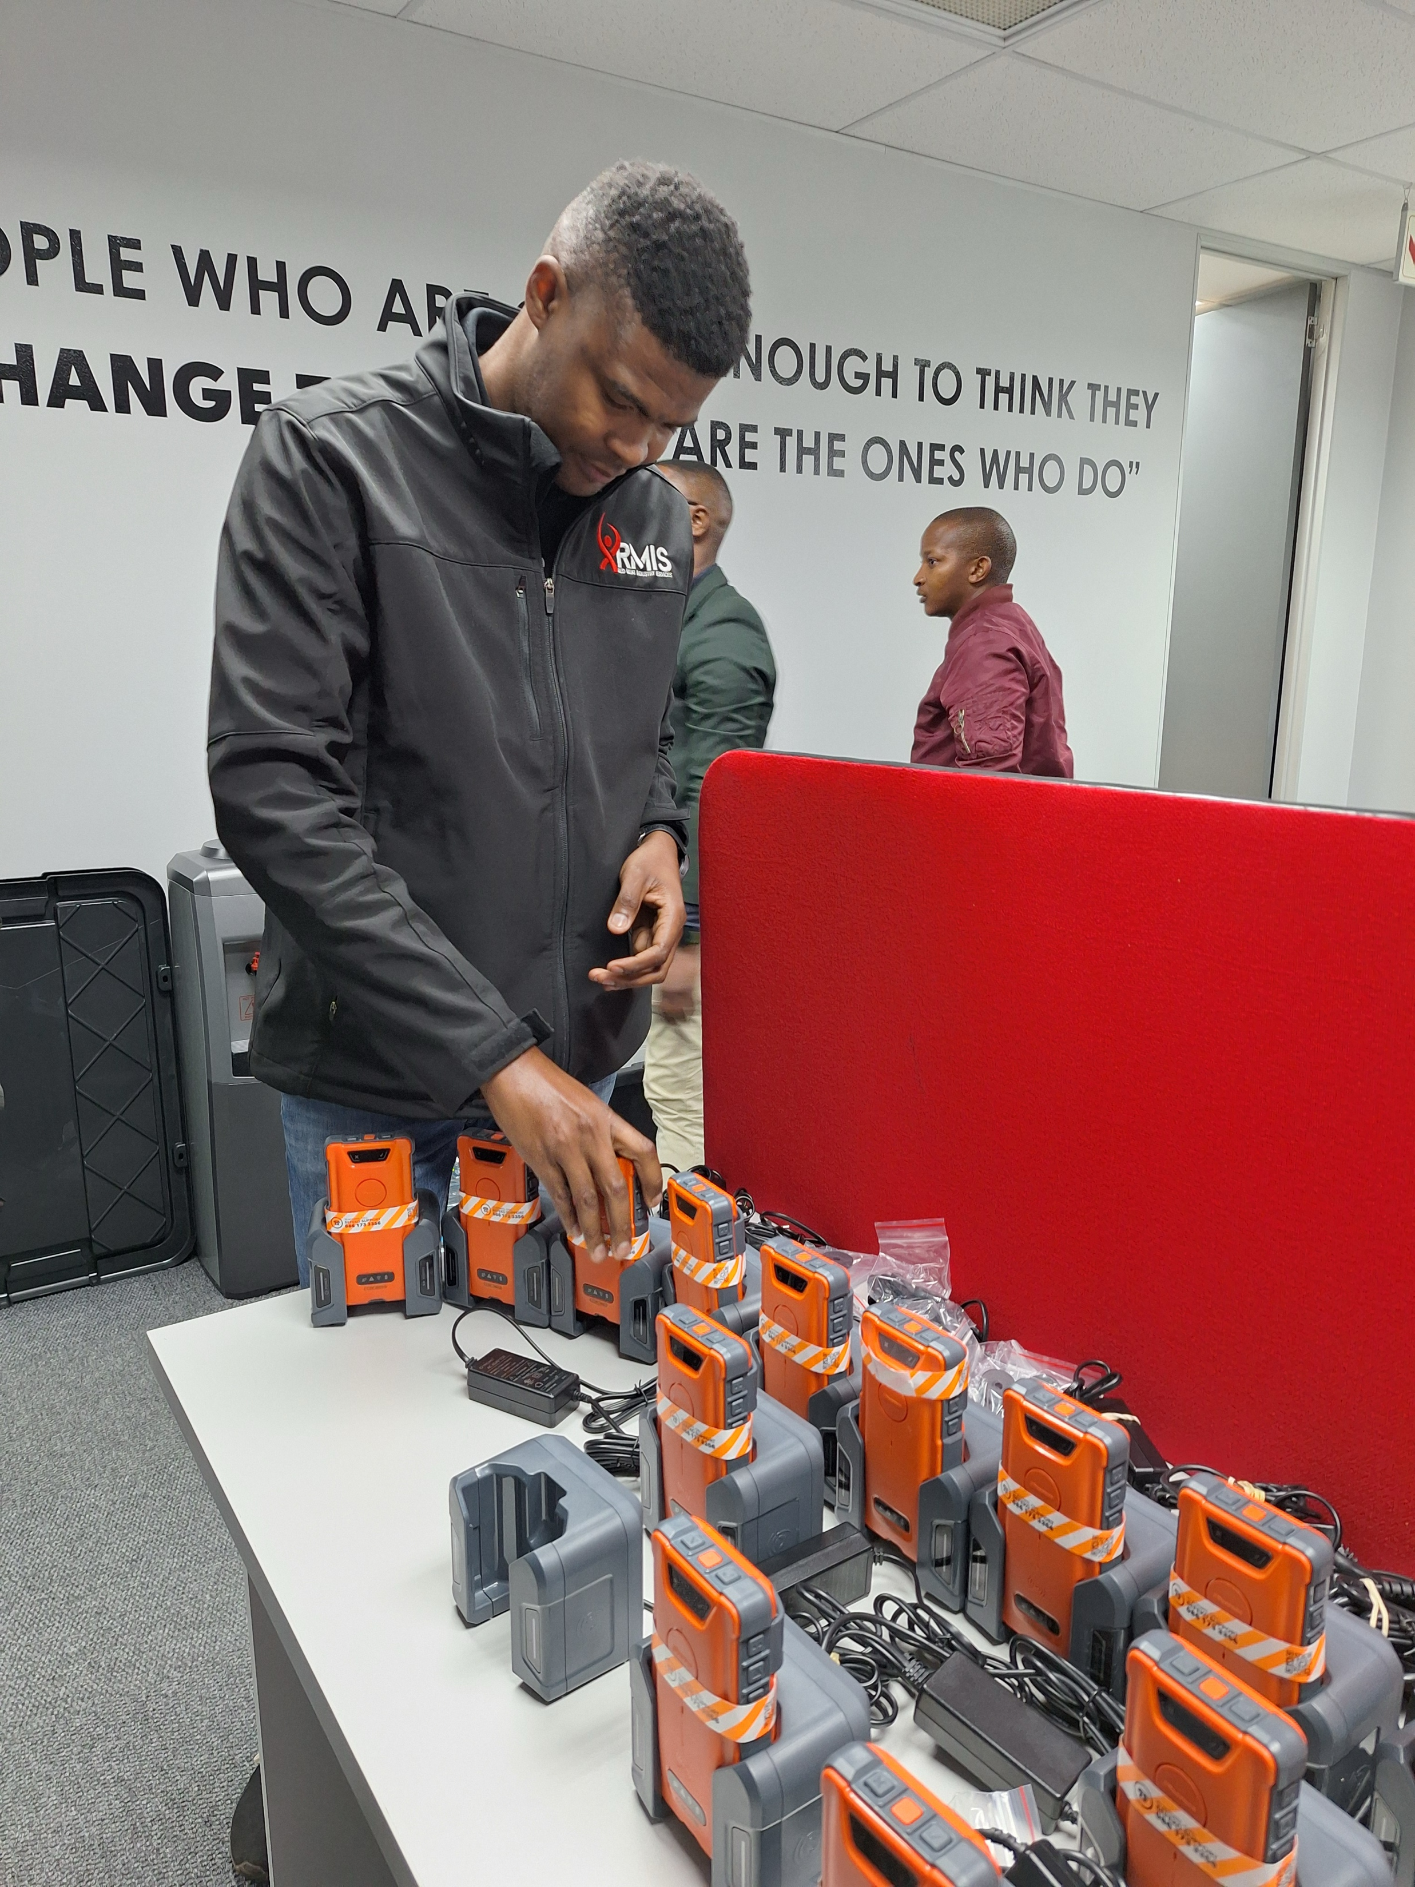
YOUTH EMPLOYMENT
Creating opportunities for animal health technicians
20 AHT
TRAINED
FULLY EQUIPPED

Slide 3
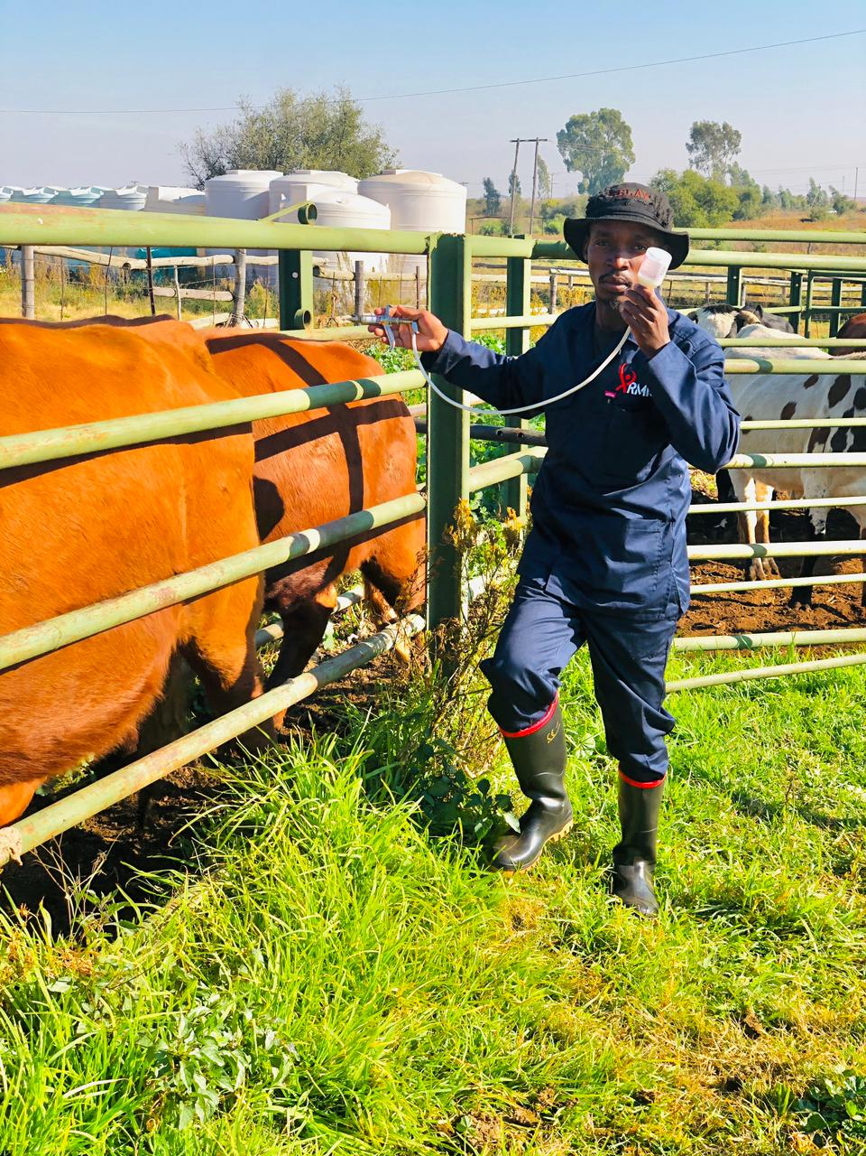
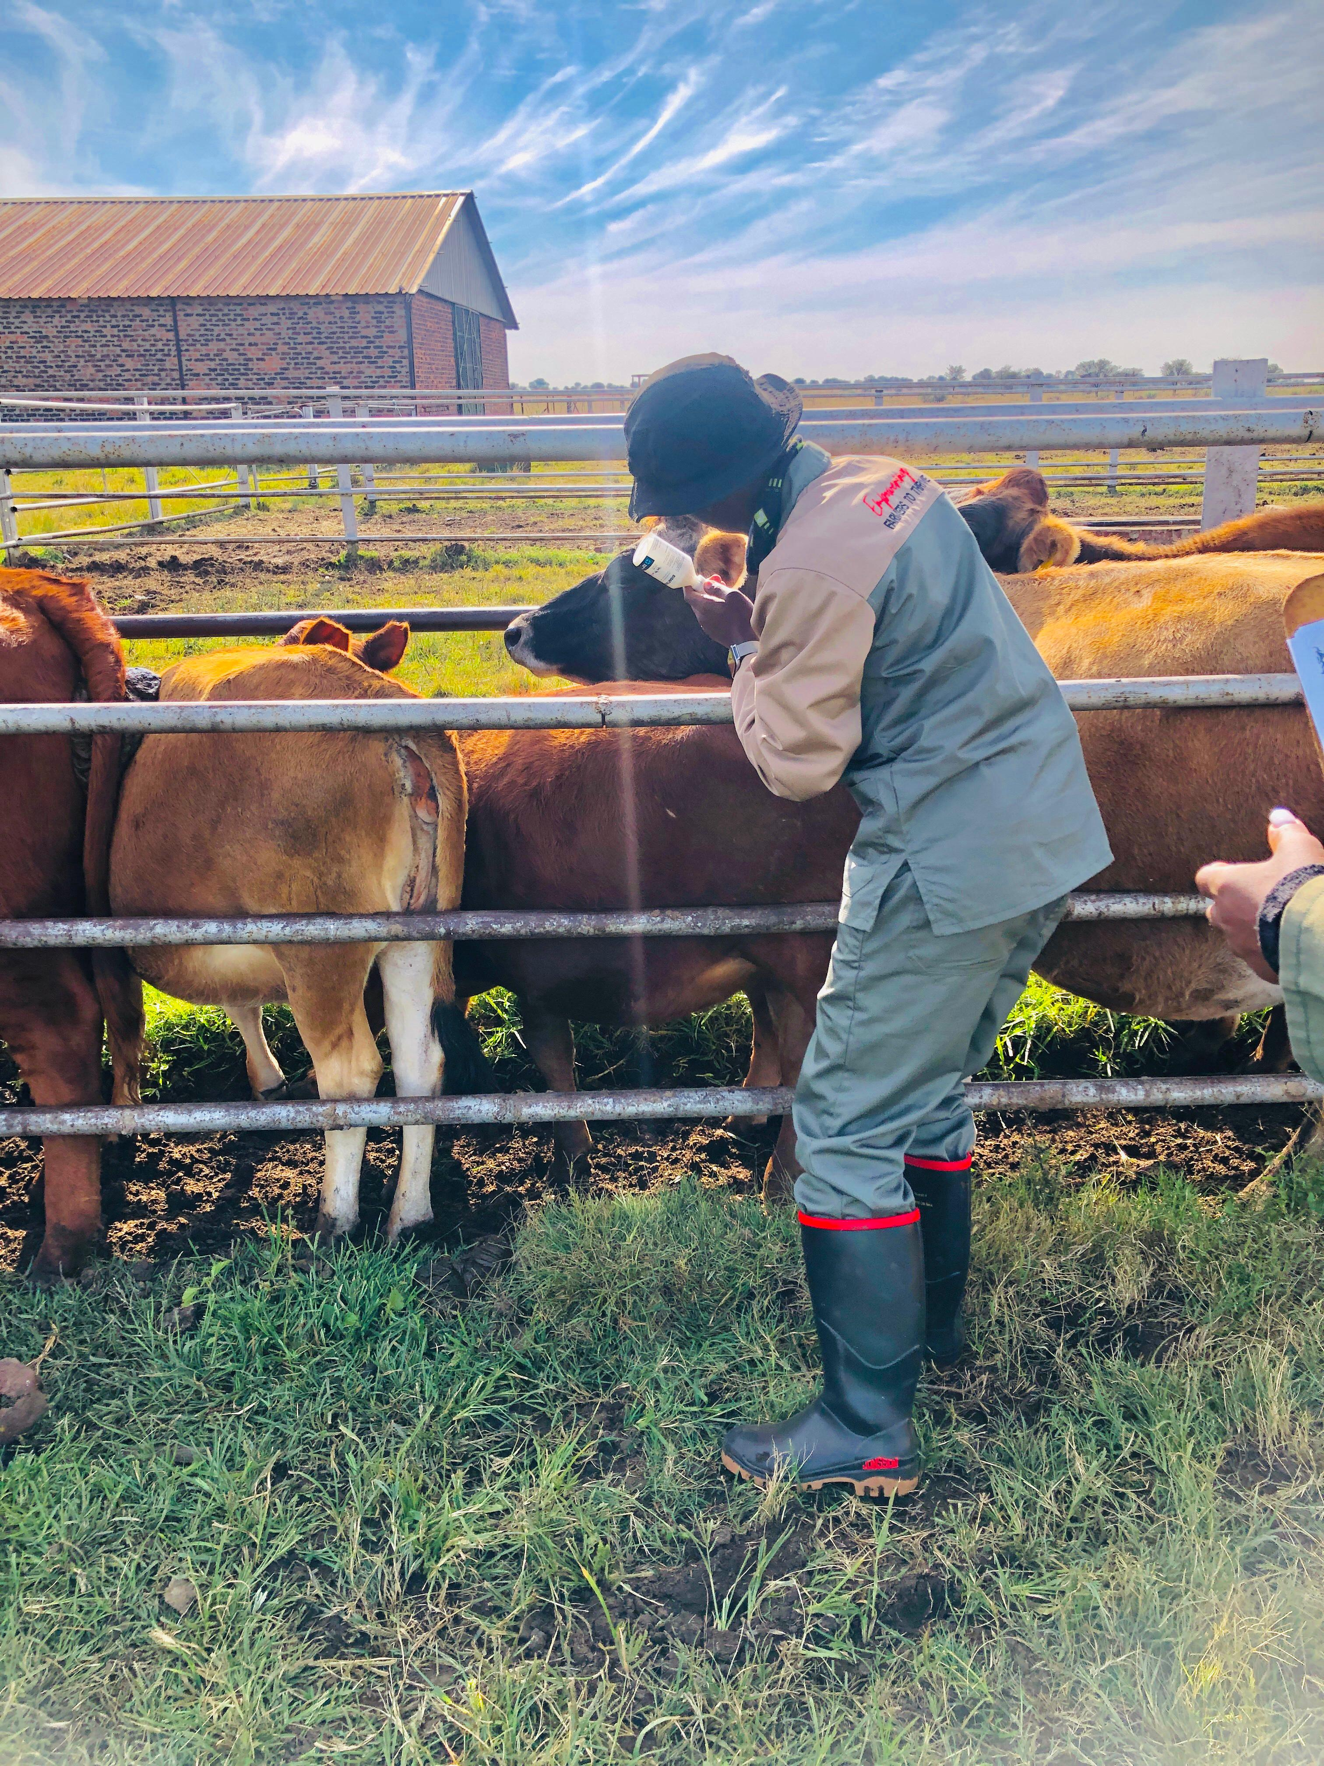
FMD SUPPORT
  20 Animal Health Technicians employed
  Deployed with state vet services
  Assisting with FMD vaccinations in rural communities
  Distributing tags to communal farmers to aid FMD vaccination roll out
FMD Vaccinations
184 997
  Free Mobile application to record FMD Vaccinations

Slide 4
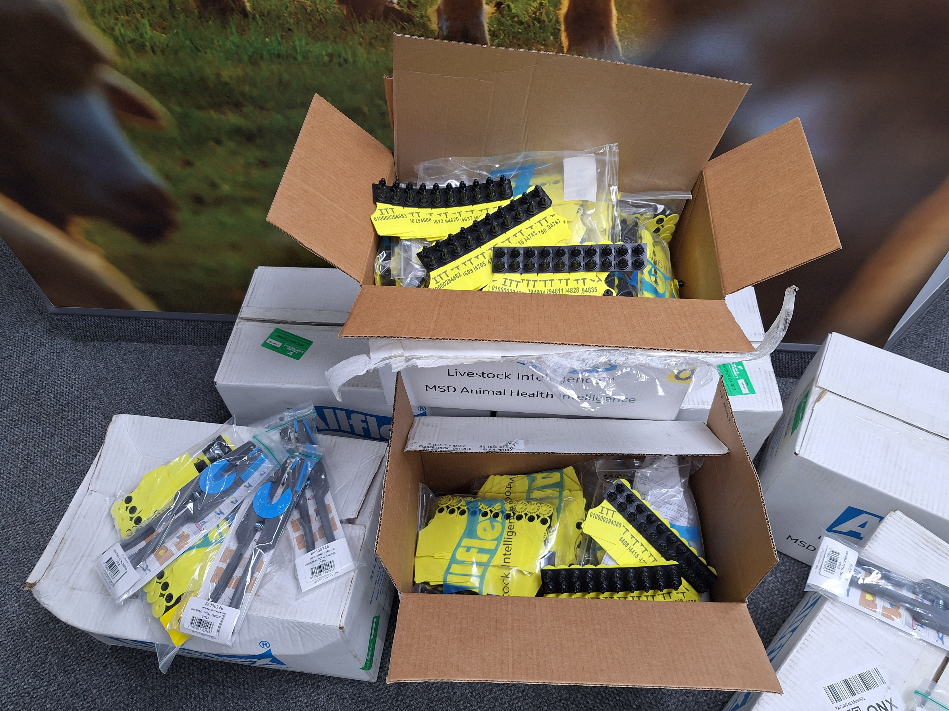
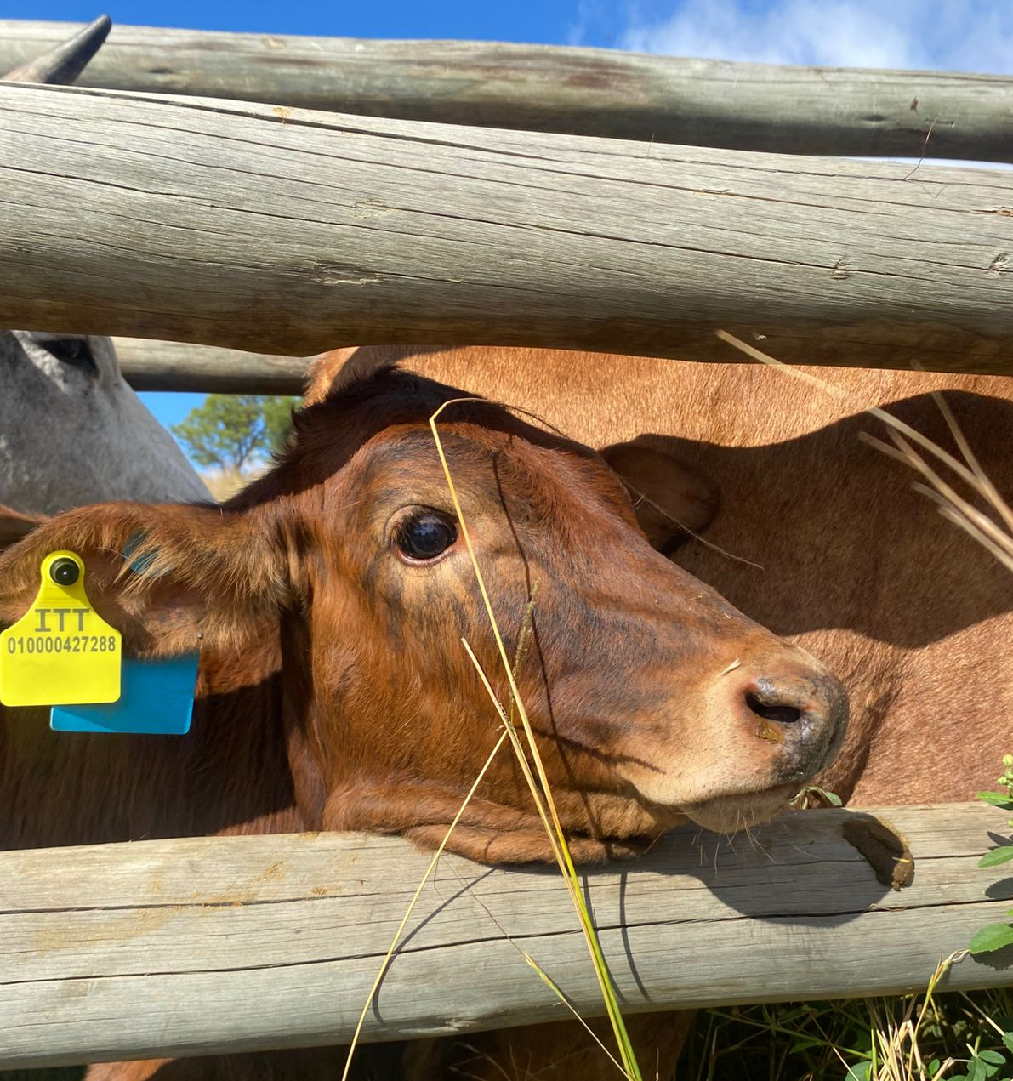
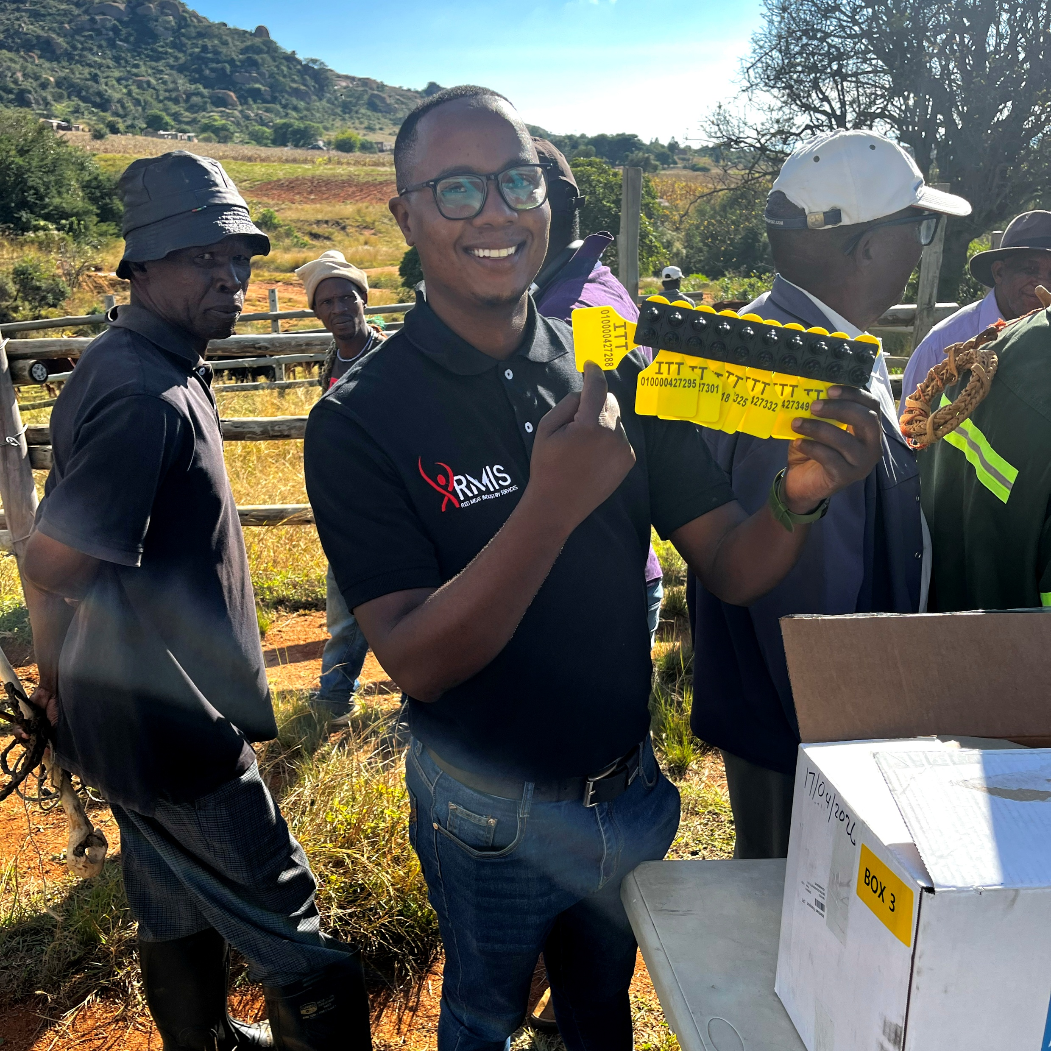
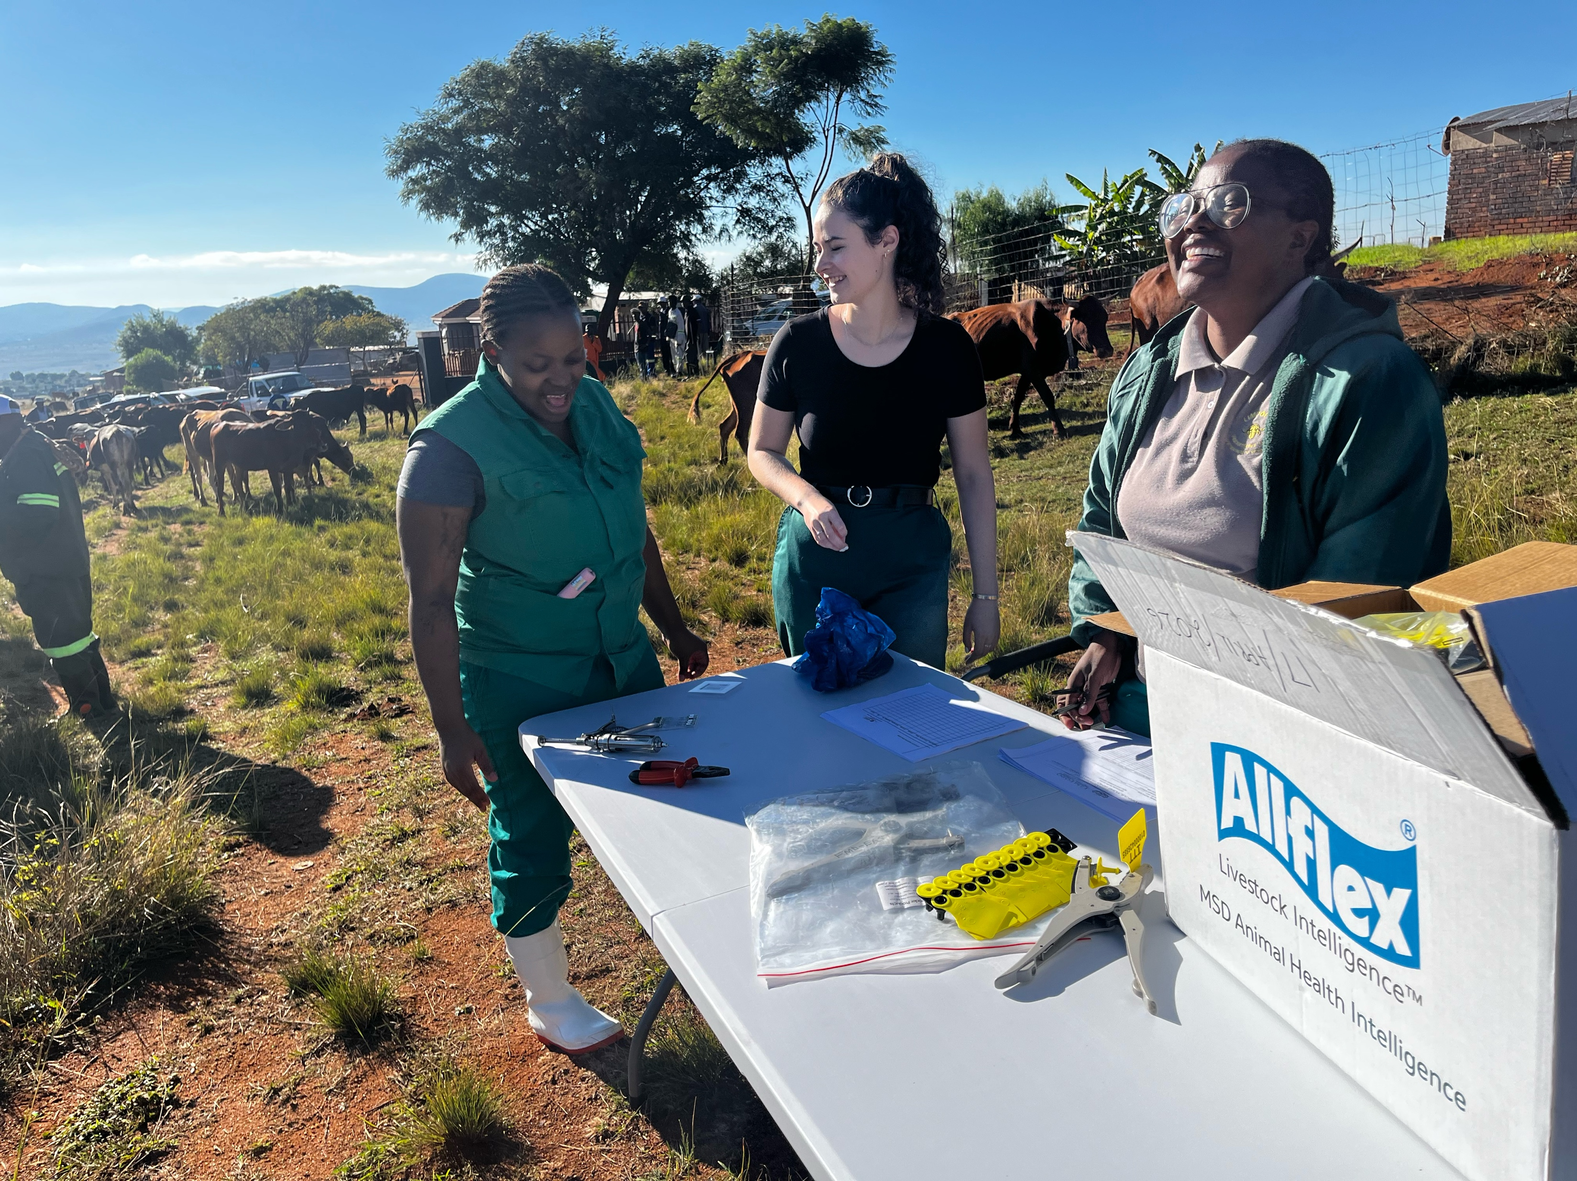
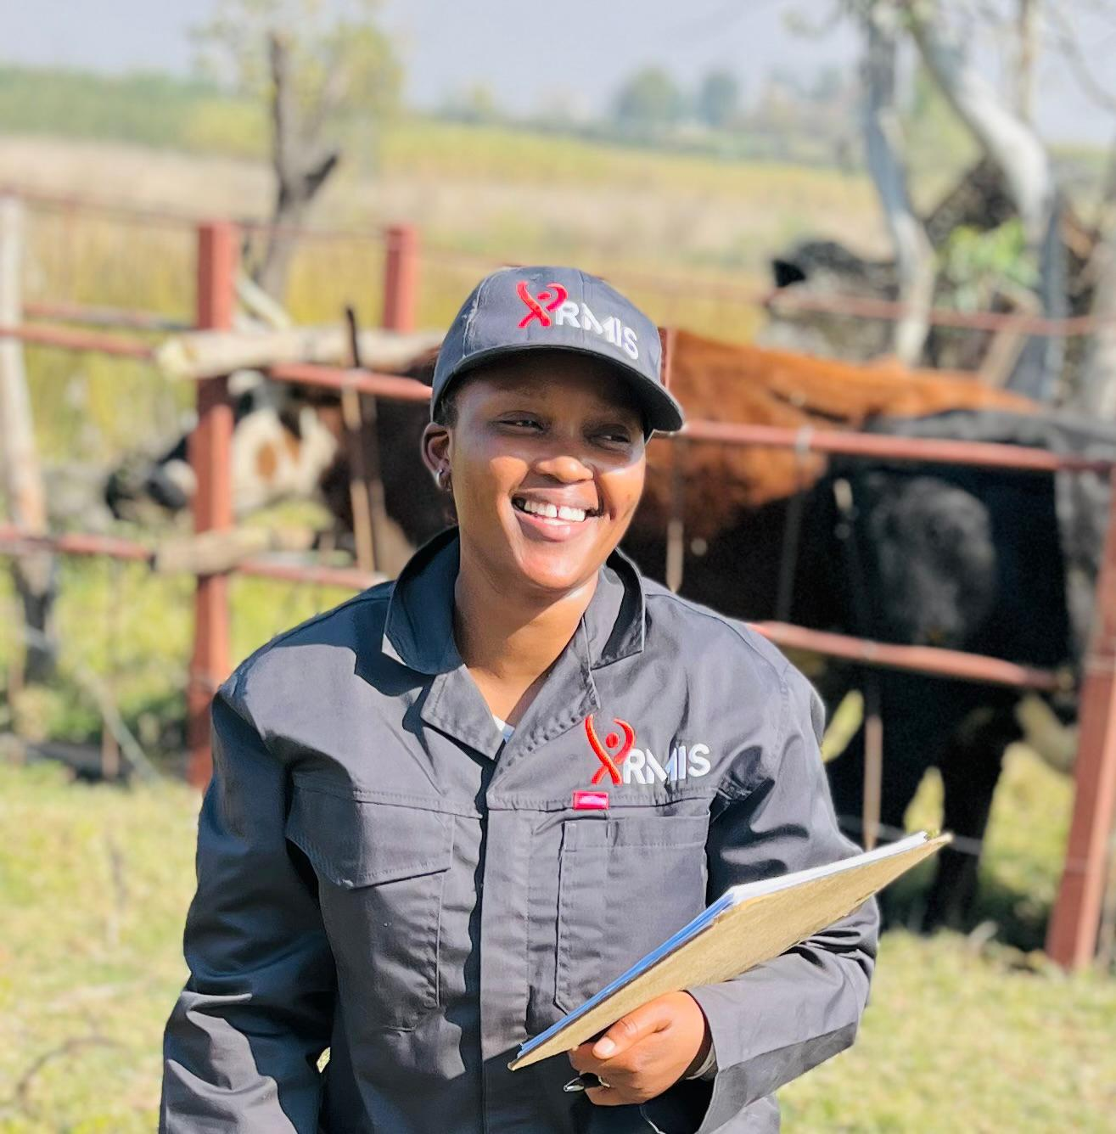
TAG DISTRIBUTION
making traceability accessible to emerging farmers
Industry Traceability Tags (ITT)
Supporting Record Keeping of FMD Vaccination in Rural Communities
Tags Distributed to date
205 000

Slide 5
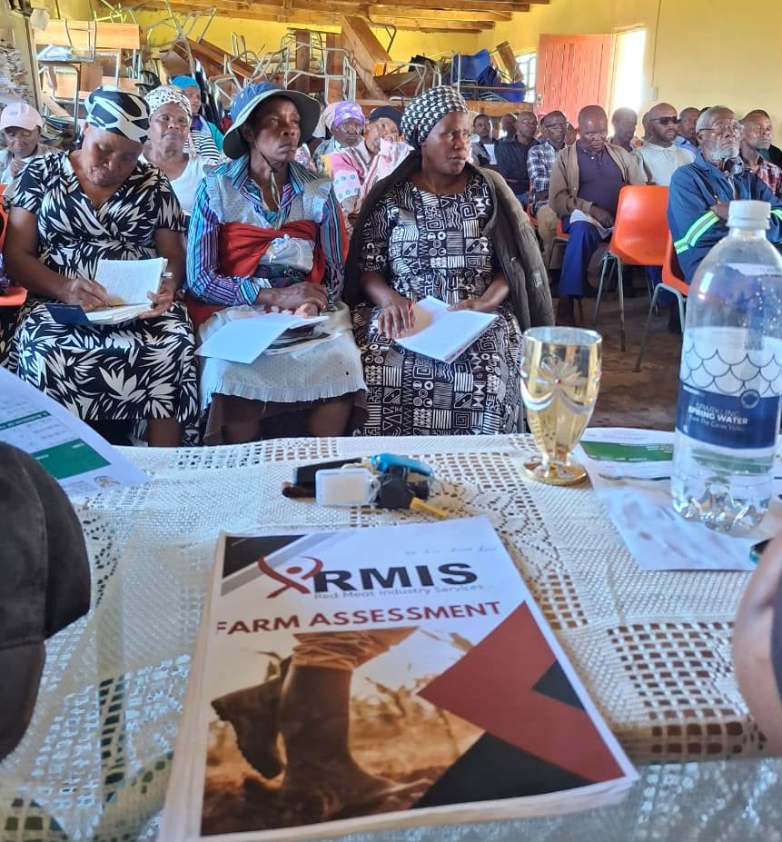
COMMUNITY DEVELOPMENT
building farmer capability
Uplifting communities through:
Training Courses
Mentorship visits
Mobile Cattle Handling Interventions
Monthly Free Webinars
Genetic Improvement – Bulls
Herd Restructuring - Cows
Delivering first 30 bulls in Eastern Cape on 13 October

Slide 6
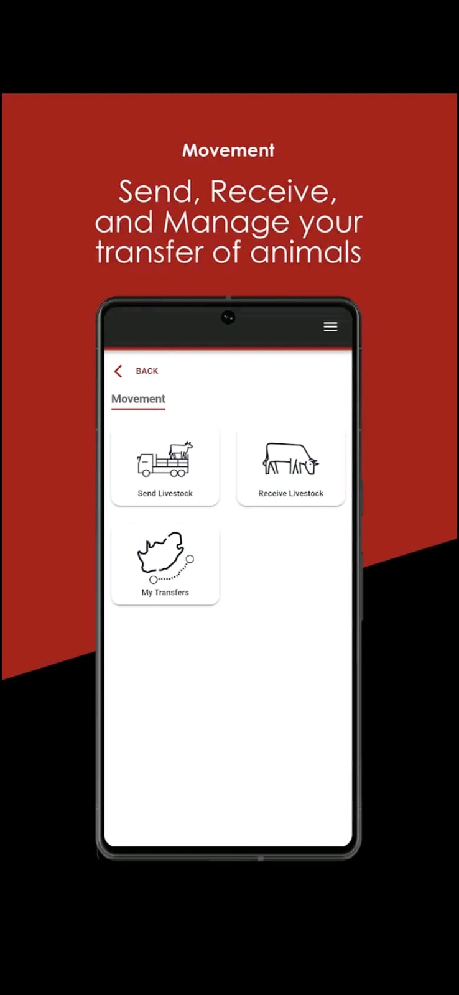
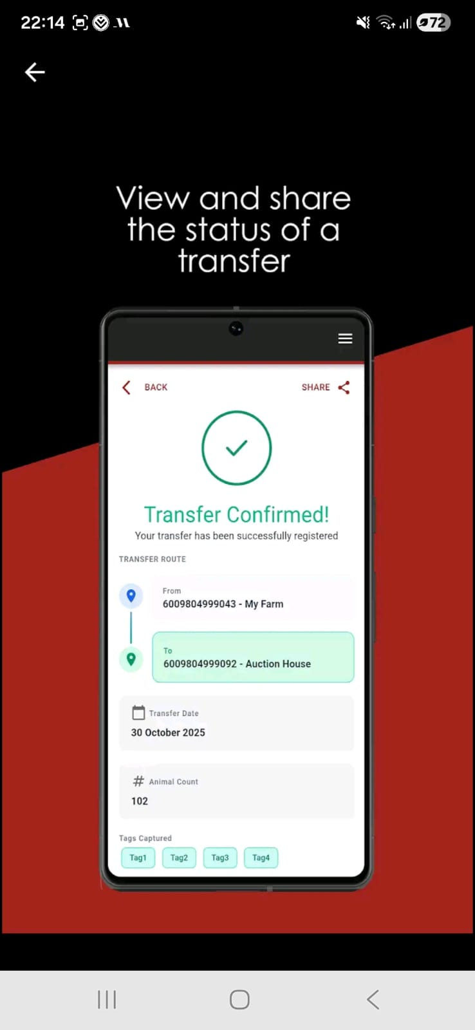

DIGITAL INCLUSION
making traceability accessible to emerging farmers
  Identification of Production Units - GLN: Global Location Number
  No cost to register GLN
  Geo-fencing | biosecurity zone
FREE RMIS APPLICATION
  Send, Receive & manage animal movements
  Capture FMD Vaccination
  Access industry statistics and dashboards

Slide 7
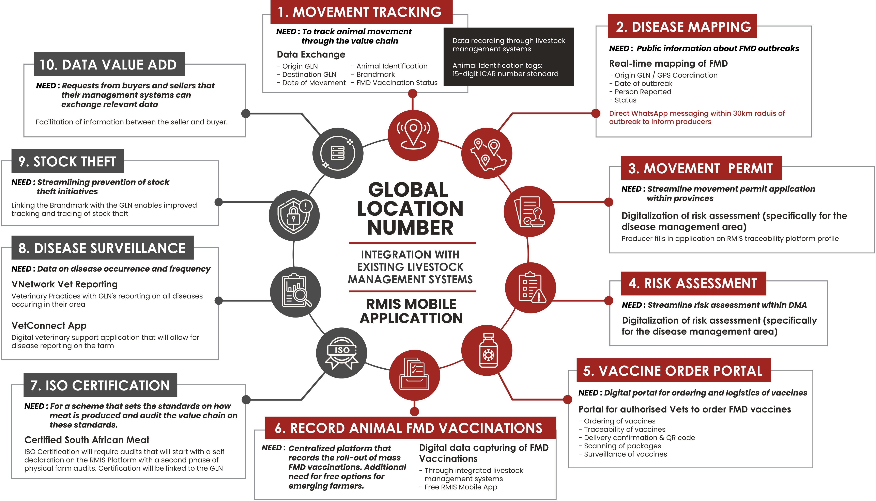

Slide 8

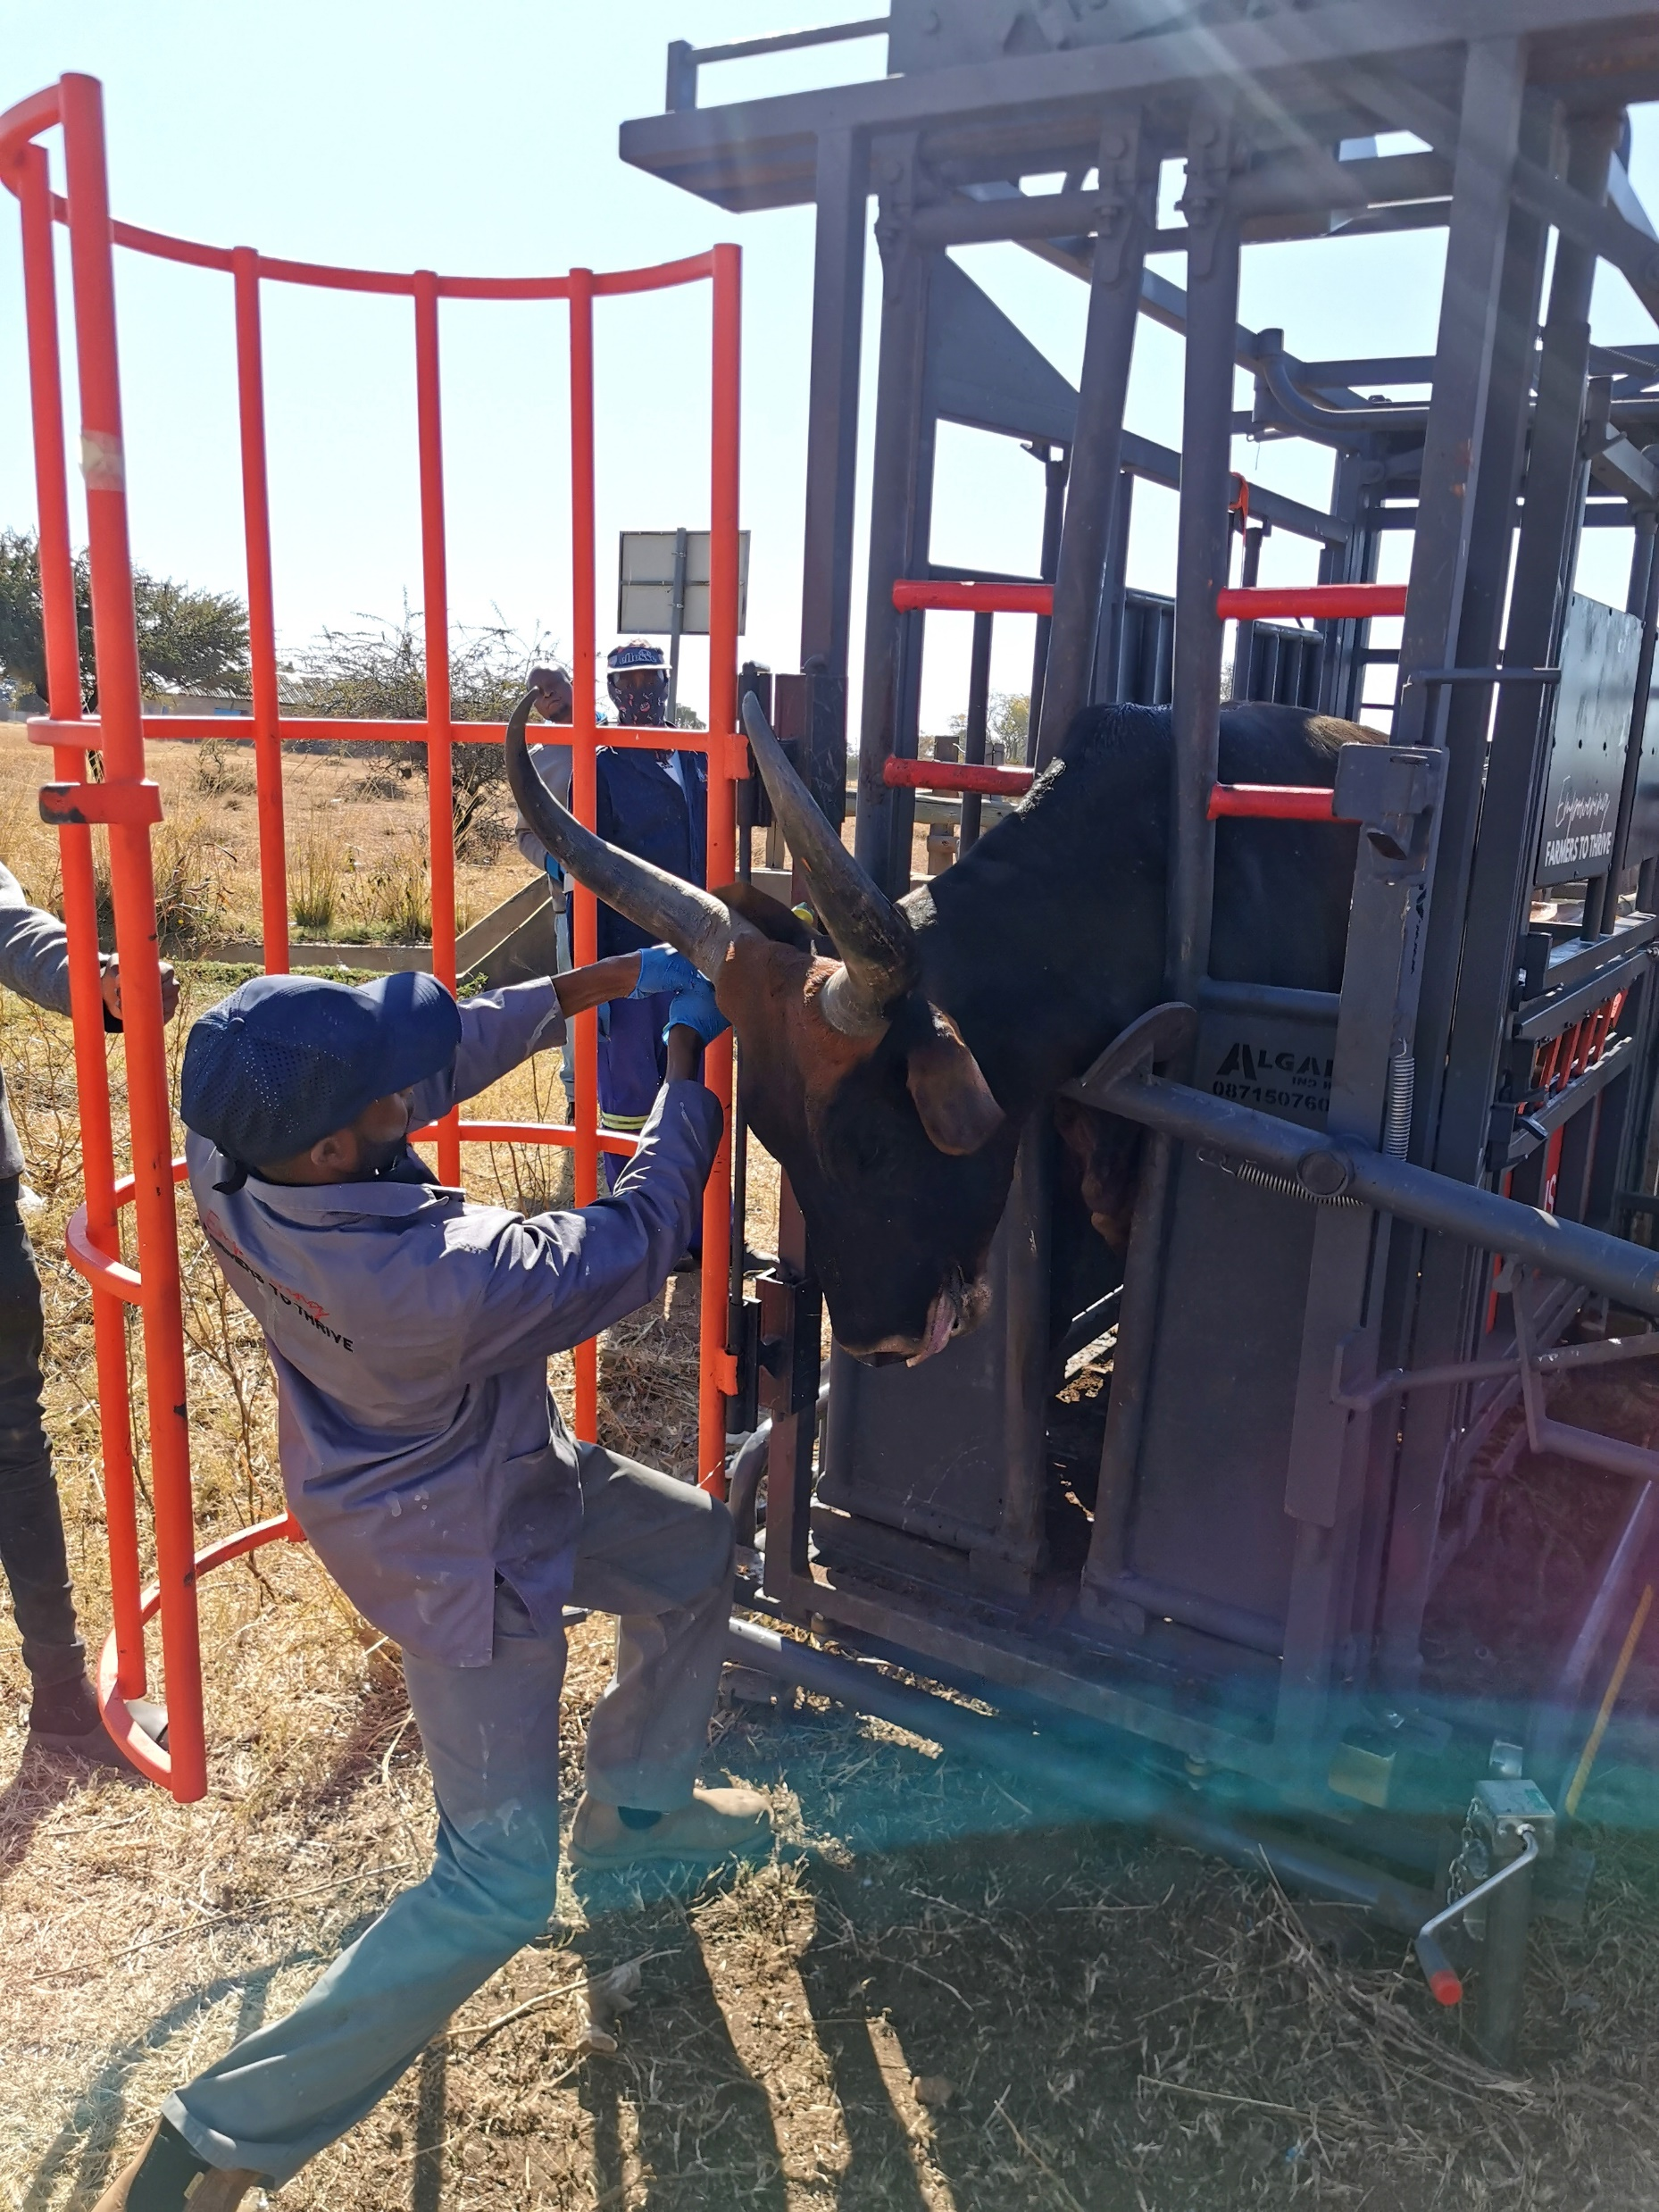
THANK YOU
www.rmis.co.za

