Slide 1
GIBS EXECUTIVE KEYNOTE • JOHANNESBURG
The Geography of Capital: Place-Based Urban Regeneration
Breaking the spend trap through concentrated capital, municipal co-governance, and precinct stewardship.
From Marshalltown to Gandhi Square and Rosebank

Slide 2
MACRO SOCIAL SPEND
The Capital Spend Paradox
R120B+
Corporate Social & SED Spend Over the Past Decade
R11B–R13B deployed annually into upliftment, yet spatial fragmentation endures across metropolitan commercial corridors.

Slide 3
URBAN REALITY
The Cost of Spatial Division
35%–40%
1,000s
4m Walls
Spatial Poverty Tax
Vulnerable Traders
Defensive Enclaves
Commuter income consumed by fragmented transit networks.
Operating on unmanaged curbs without basic services.
Corporate retreats behind barriers as streets deteriorate.

Slide 4
ROOT CAUSE ANALYSIS
Breaking the Spend Trap
Spatial Dilution
Place-Based Impact
"Misting capital into the wind"
Concentrated Geographic Stewardship
Isolated: Fifty disconnected bursaries scattered nationally.
Geographic Footprint: Capital focused on defined precincts.
Episodic: Ad-hoc handovers tied to single-day events.
Co-Governance: Direct alignment with local government.
Zero Anchor: No collective resilience when funding stops.
Sustained Assets: Daily physical maintenance and safety.

Slide 5
RISK MITIGATION
The Street Is an Extension of Your Asset
"The tenant, the shopper, the office worker, and the client do not experience a building in isolation. They experience the precinct."
300m Commuter Walk
Broken Curbs & Darkness
Commercial Vacancies
Fear of muggings compromises pristine corporate lobbies.
Dark streets accelerate property valuation declines.
Decaying public infrastructure erodes enterprise value.

Slide 6
STRATEGIC ALIGNMENT
Corporate Silos vs. Place-Based ROI
Operational Dimension | Traditional CSI / ESG Model | Place-Based Precinct Model
Primary Metric | Isolated spend inputs | Measurable footfall and safety uptime
Capital Horizon | 12-month compliance cycle | Multi-year pooled co-investment
Spatial Strategy | Fortified corporate enclaves | Stewarded public commons

Slide 7
IMPACT FRAMEWORK
Measuring Precinct Vitality
Safe Corridor Footfall
Micro-Retail Turnover
Public Infrastructure Uptime
Commercial Retention
Rising commuter pedestrian traffic daily.
Stabilizing revenue for informal vendors.
Low vacancy and renewed multi-year leases.
Working streetlights and prompt waste sorting.

Slide 8

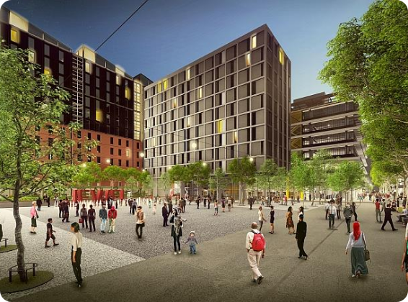
EMPIRICAL EVIDENCE
Inner City Ground Truth
Place Concentrates Social Capital
Spatial Continuity: Value created past building perimeters.
Proximity Compounds: Interventions multiply when clustered.
Civic Confidence: Functional streetscapes build cross-sector trust.

Slide 9
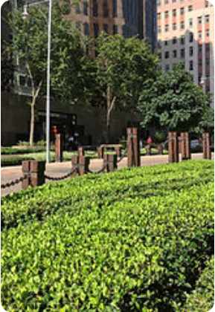
CASE STUDY 01
Marshalltown & Main Street Mall
The Civic-Corporate Spine
Mining houses and institutional banks pooled resources via SWID rather than retreating behind fortress walls.
Pedestrian Spine: Tree-lined promenade with heritage artifacts.
Active Maintenance: Dedicated street teams and patrol crews.
Shared Economy: Structured kiosks integrated into pedestrian flow.

Slide 10
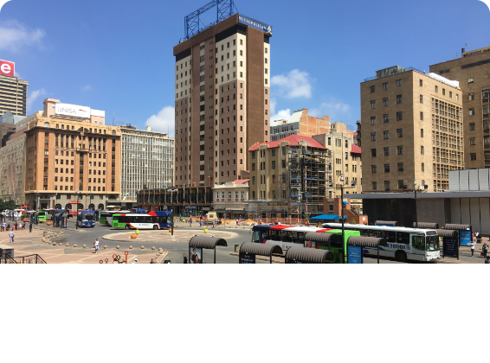
CASE STUDY 02
Gandhi Square
The Transit Lifeline
A dangerous bus depot transformed into Africa's premier commuter interchange through public-private stewardship.
Dignified Transit: Clean waiting colonnades and 24h security.
Flanking Retail: Pharmacies, diners, and everyday banking.
Economic Nodes: Protecting the lifeblood of working commuters.

Slide 11

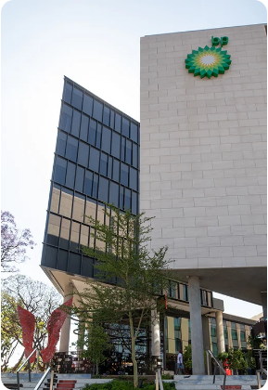

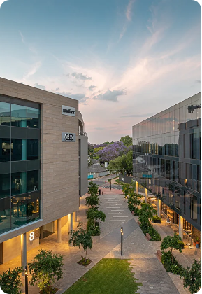
CASE STUDY 03
Rosebank & Oxford Parks
Walkability & Transit Density
Designed from inception to connect Gautrain transit into high-street retail, pedestrian boulevards, and corporate headquarters.
Pedestrian-First: Universal ramps, cycle lanes, and public art.
Seamless Services: Private security integrated with municipal teams.
Mixed Ecosystem: High-density living alongside global institutions.

Slide 12
BARRIERS TO SCALE
Four Cross-Sector Frictions
CORPORATE SECTOR
LOCAL GOVERNMENT
CIVIL SOCIETY
COMMUNITIES
Mandate Creep
Private Overreach
Gentrification
Token Consultation
Fear of replacing municipal duties.
Anxiety over private control of streets.
Risk of displacement of informal workers.
Consulted without real executive power.

Slide 13
PRECINCT BLUEPRINT • PART 1
Rules 01 & 02: Capital & Operations
02
01
Prioritize Daily Opex
Pool Spatial Capital
Beyond Ribbons: Shift focus from ceremonies to maintenance.
Unified Budgets: Blend CSI, ESD, capex, and rates.
Dedicated SPV: House funds in precinct entities.
Daily Presence: Fund cleaning crews in high-vis vests.
Infrastructure Scale: Repair substations and paving collectively.
Early Beats: Deploy community foot patrols at 6:00 AM.

Slide 14
PRECINCT BLUEPRINT • PART 2
Rules 03 & 04: Inclusion & Governance
03
04
Integrate Informal Economy
Anchor in Formal Vehicles
No Displacement: Avoid sweeping poverty into next blocks.
Legal Form: Institutionalize through CID or SRA non-profits.
Dignified Trading: Build sheltered stalls with water points.
Transparent SLAs: Bind municipal service level agreements.
Supply Chain Partners: Integrate waste reclaimers and taxi ranks.
Leadership Continuity: Protect compacts against CEO turnover.

Slide 15
EXECUTIVE ACTION
The Monday Morning Litmus Test
QUESTION 01
QUESTION 02
QUESTION 03
The Doorstep Audit
The Coalition Table
The Contracting Shift
Look 2km outside your ground lobby.
Meet the building owner next door.
Reallocate 30% of social spend.
Is the street safe for your workforce?
Have you convened a joint compact?
Can you fund a 3-year precinct entity?

Slide 16
THE PATH FORWARD
"We cannot privatize our way out of public decay."
Rebuilding Johannesburg street by street, pavement by pavement, and precinct by precinct.
Siyabonga • Baie Dankie • Thank You

