Slide 1
The Compounding Power of Purposeful Social Investment
SERIOUS SOCIAL INVESTING CONFERENCE 2026
7 October 2026

Slide 2
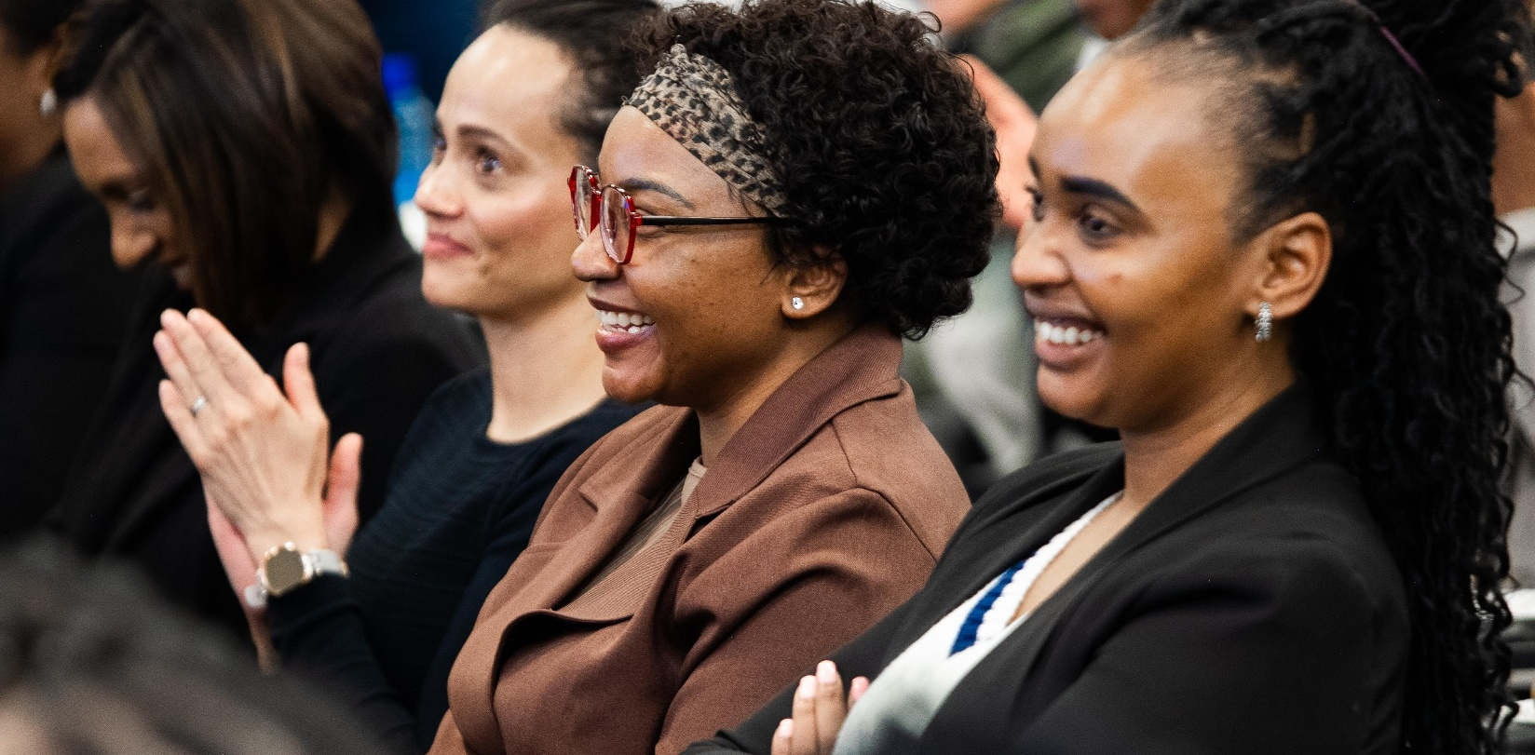
To cultivate and nourish lives, every day and every tomorrow.
Purpose. Focus. Sustained commitment.

Slide 3
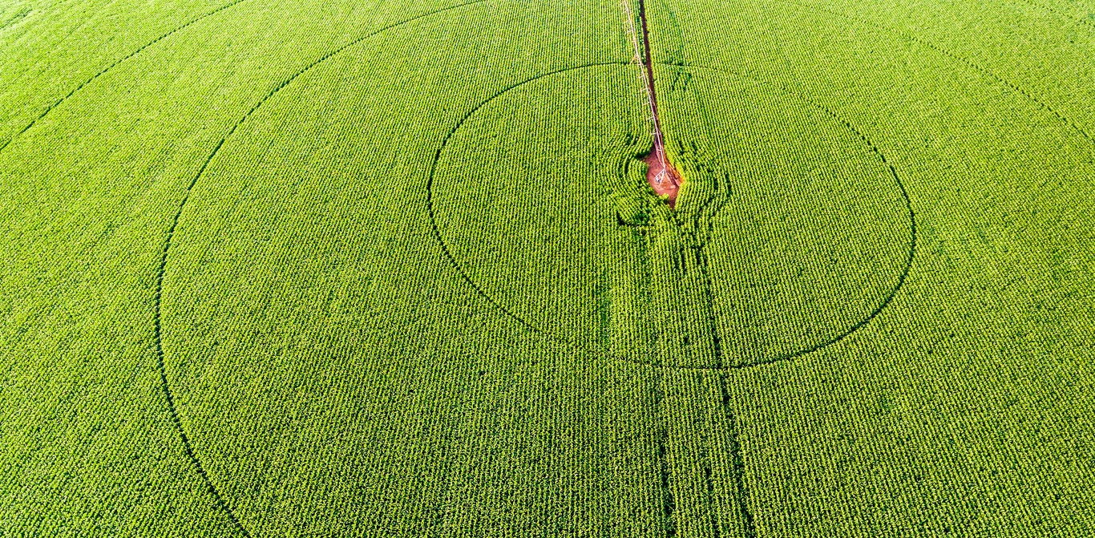
Impact compounds over time
Becoming more effective with every year of commitment.

Slide 4
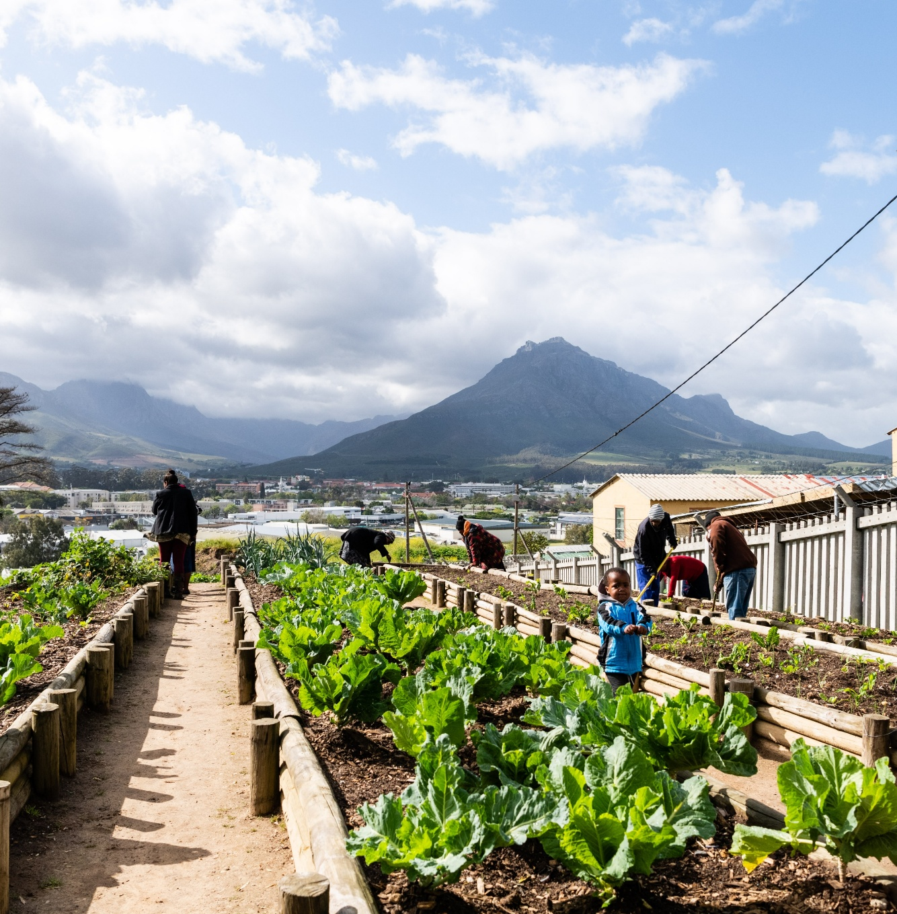
FOOD INSECURITY IS NOT A PERIPHERAL ISSUE
63.5%
of South African households experienced moderate to severe food insecurity
2023 National Food and Nutrition Security Survey

Slide 5
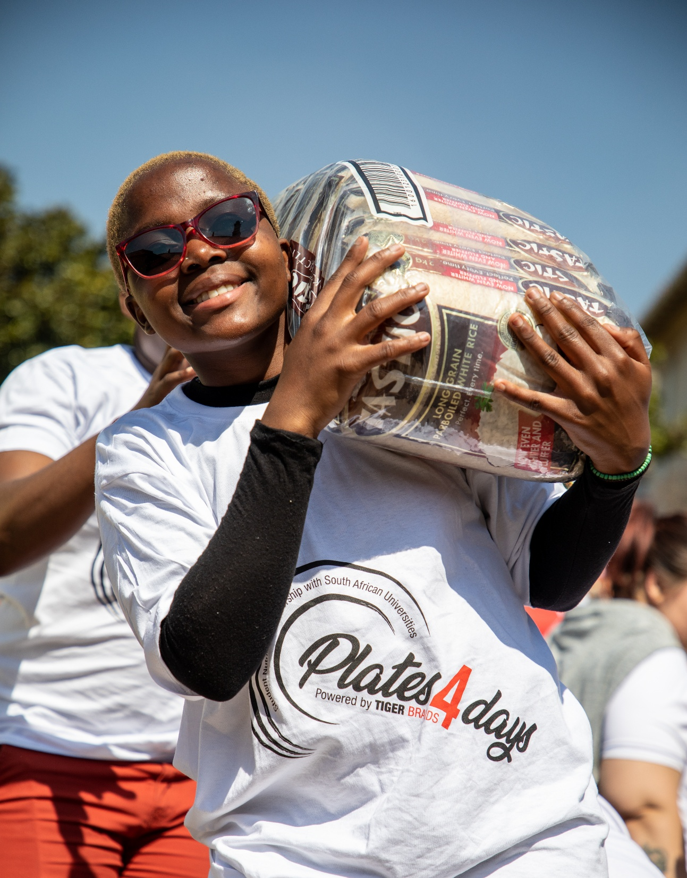
Access to university is not enough if hunger stands in the way of progress.

Slide 6

Consistency creates scale.
Evidence to improve design
15 years
More than 150 million breakfasts
Partnership as an operating model

Slide 7
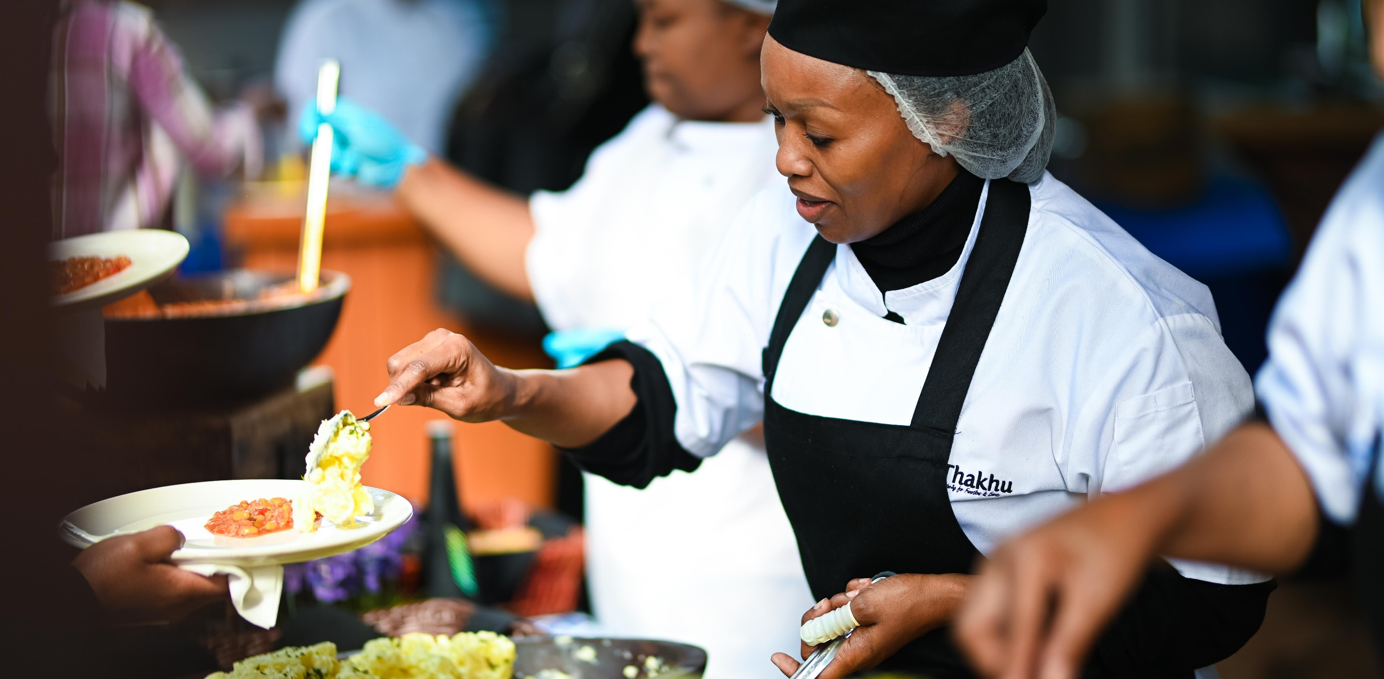
Connected challenges require connected capabilities.
Different strengths. One shared outcome.

Slide 8
DIFFERENT ORGANISATIONS DOING WHAT EACH DOES BEST, TOGETHER.
Every day. Every tomorrow.

Slide 9
WERNA OBERHOLZER
CHIEF CORPORATE AFFAIRS & SUSTAINABILITY OFFICER
TIGER BRANDS
Werna.Oberholzer@tigerbrands.com
+27 72 547 4915

